Slide 1
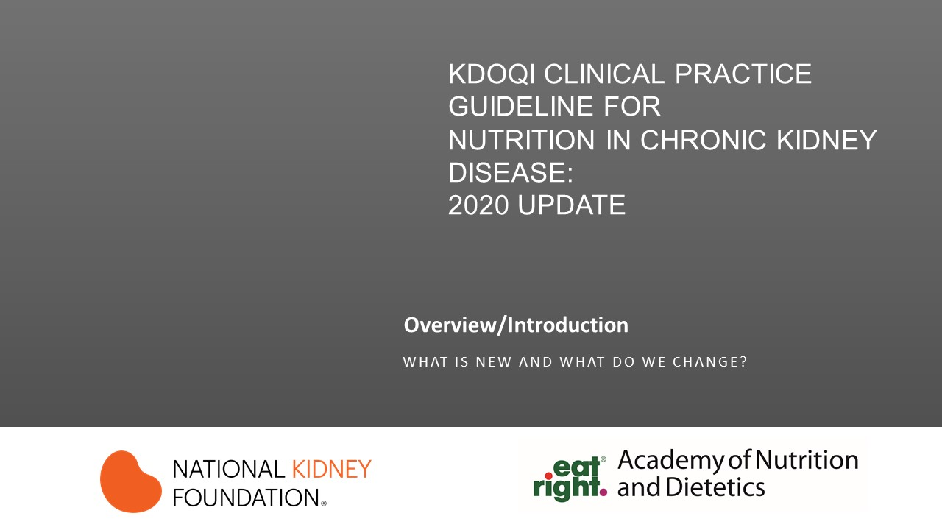

Slide 2
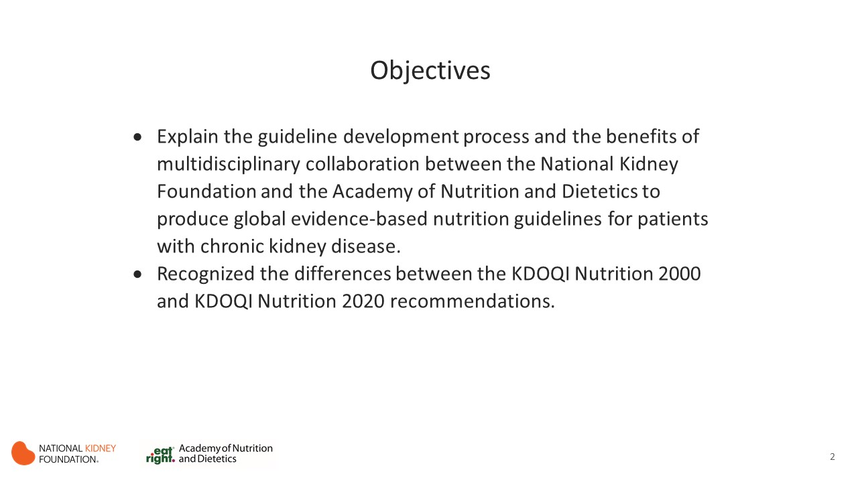

Slide 3
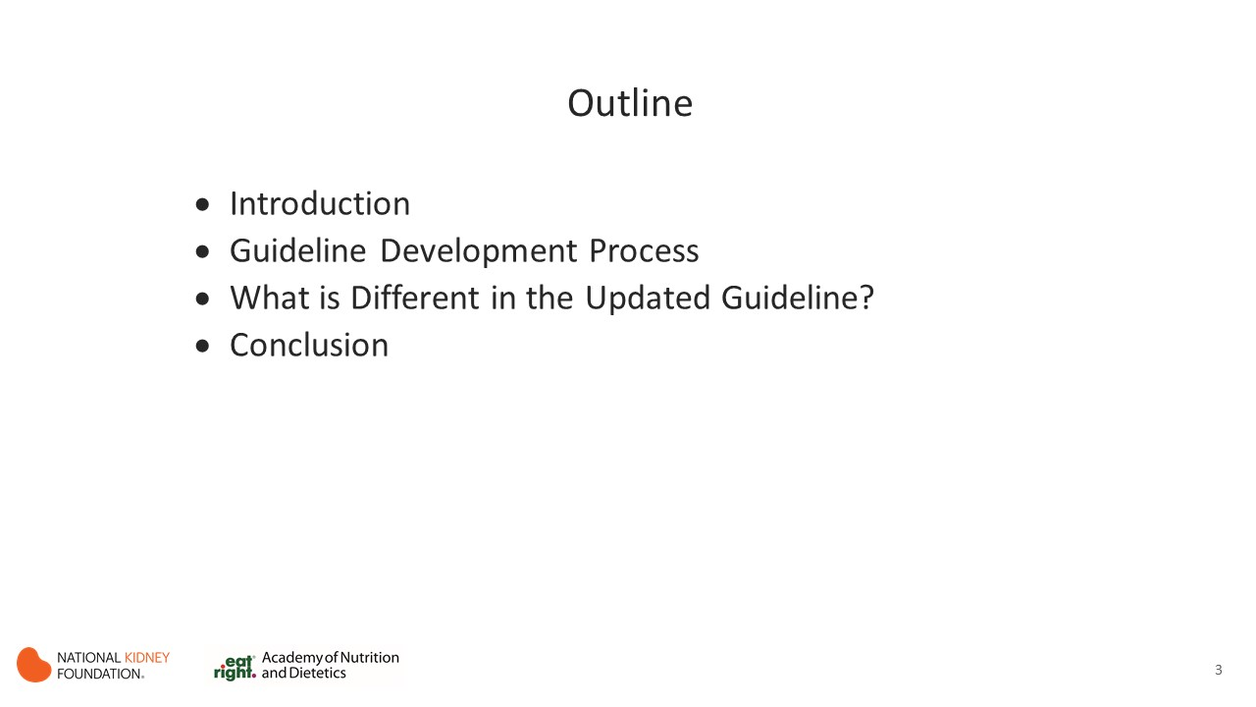

Slide 4


Slide 5
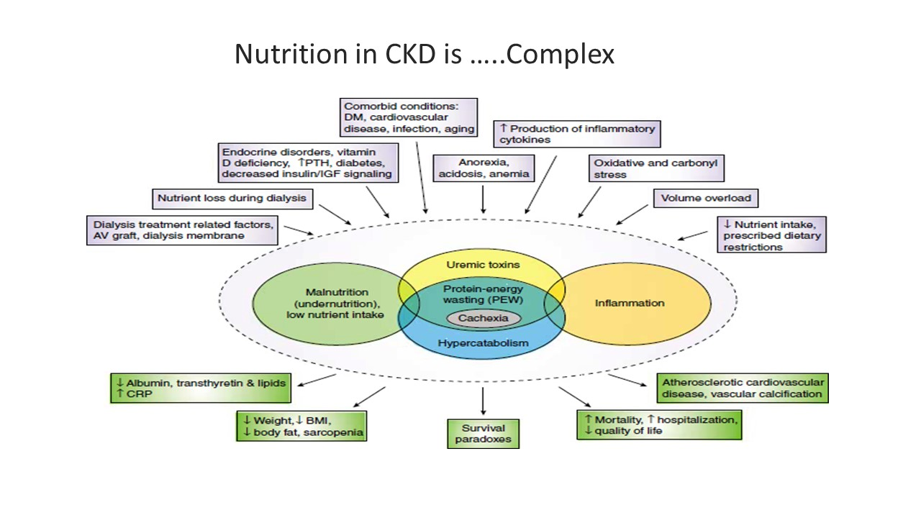

Slide 6
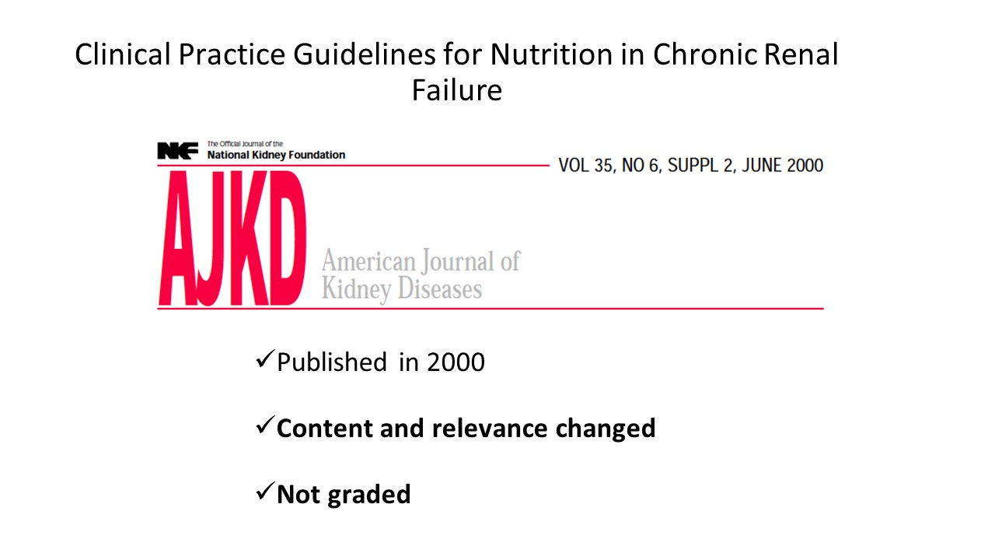
Notes:
Daha fazla detaya girmeden kisaca bu yayinin referens bilgisini de vermk istiyorum. Bu konusmanin otesinde daha detayli bilgi sahibi olmak istiynler bu yayini kisdney internationla veya ISRNM websiteindan ucretsiz indirebilirler.

Slide 7
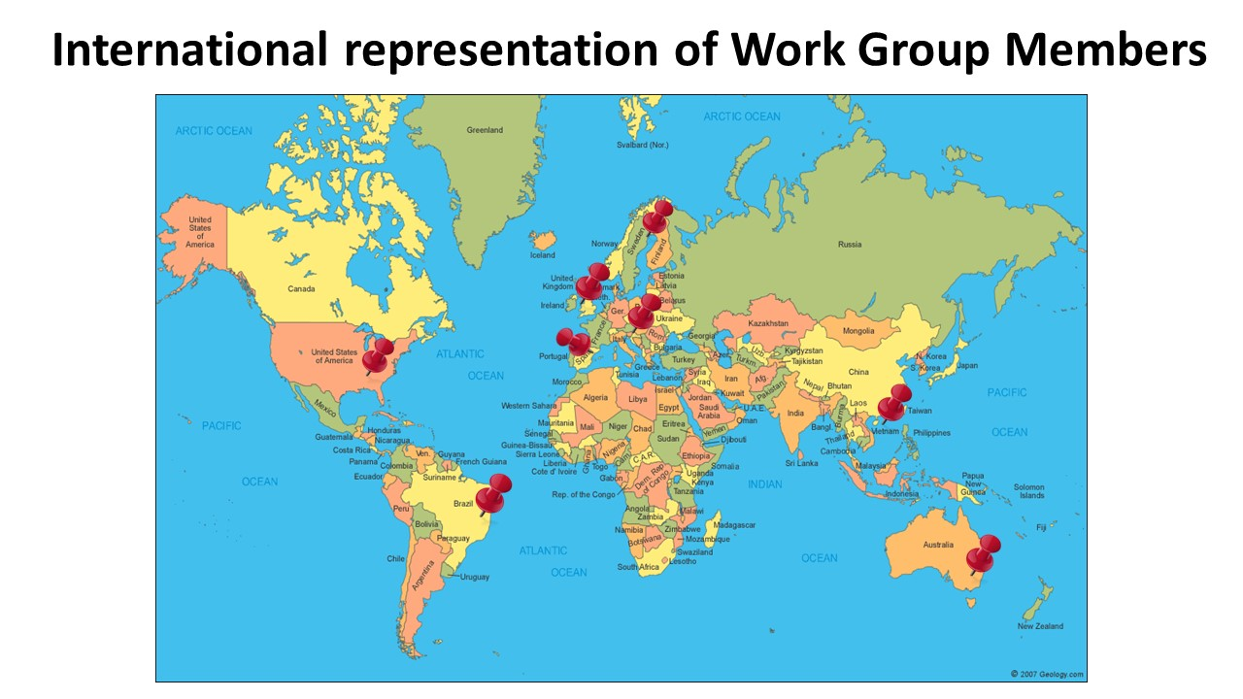
Notes:
The work group is comprised of 15-18 top renal nutrition physicians, dietitians and researchers from Europe, Asia, Australia, South American, and the United States

Slide 8
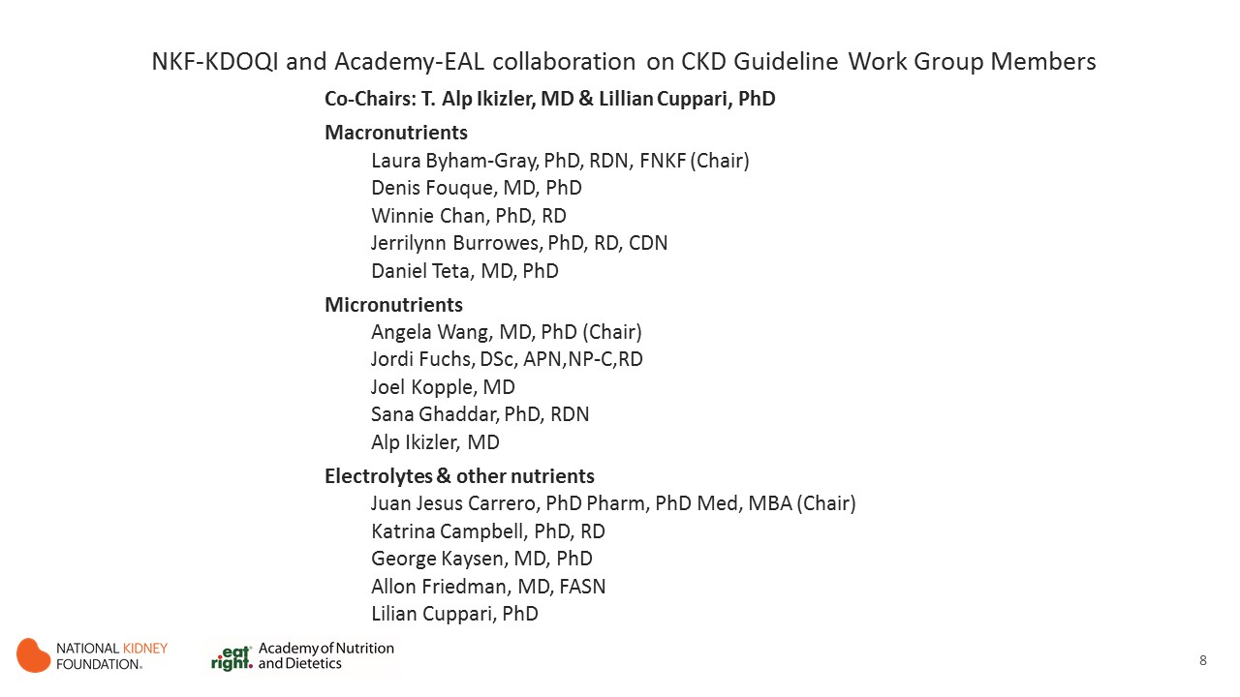

Slide 9
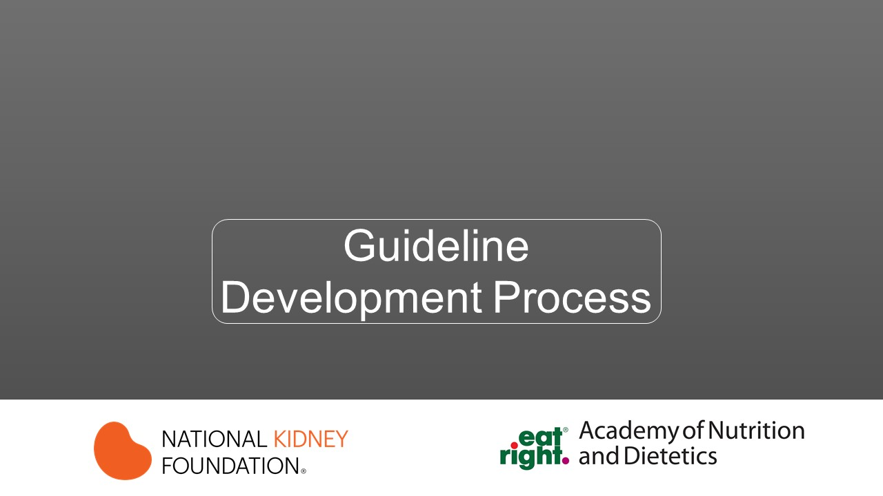

Slide 10
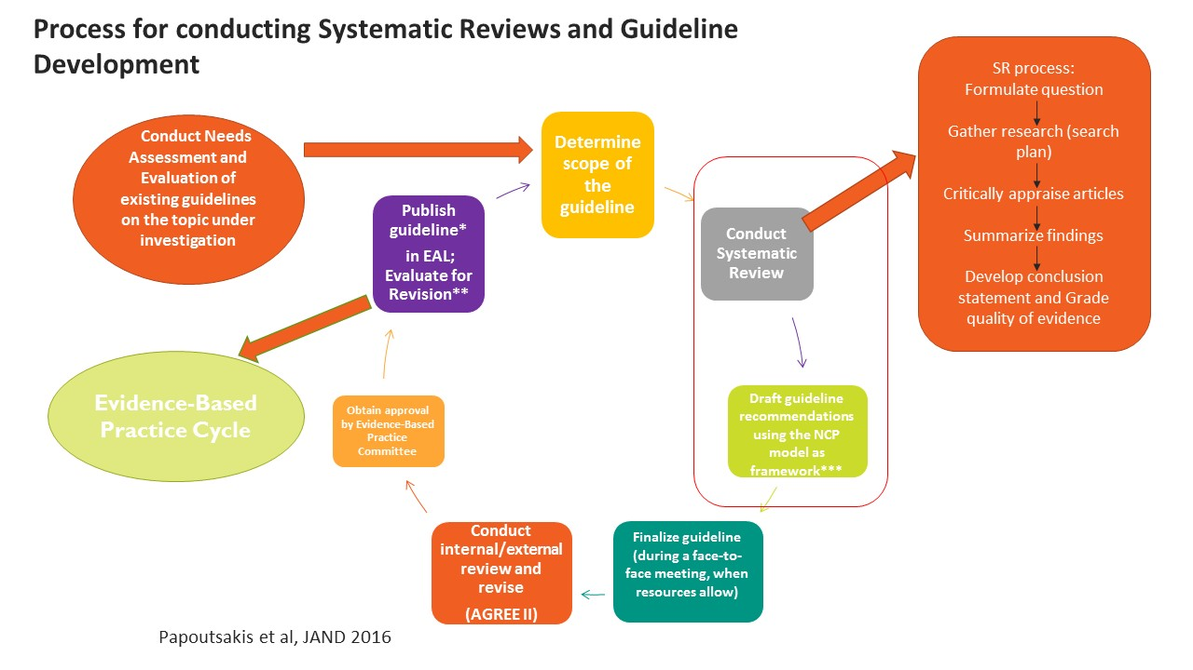

Slide 11
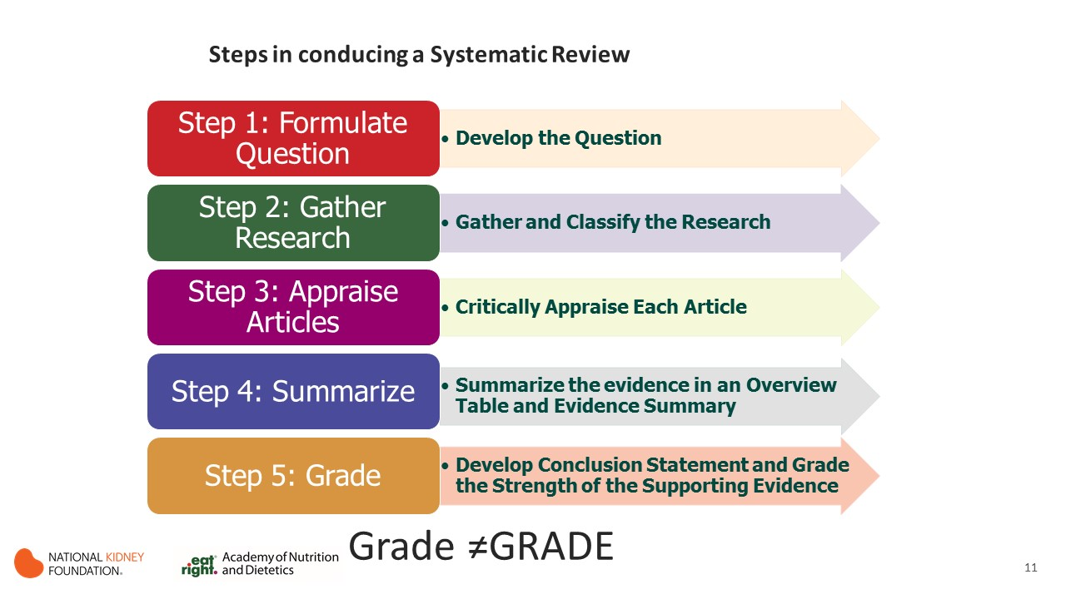
Notes:
AS I mentioned before the EA process is a rigorous and transparent process – here are the steps:
Once an expert workgroup is formed, the first task at hand is to develop the questions for their project…
We will now go through the steps in more detail.

Slide 12
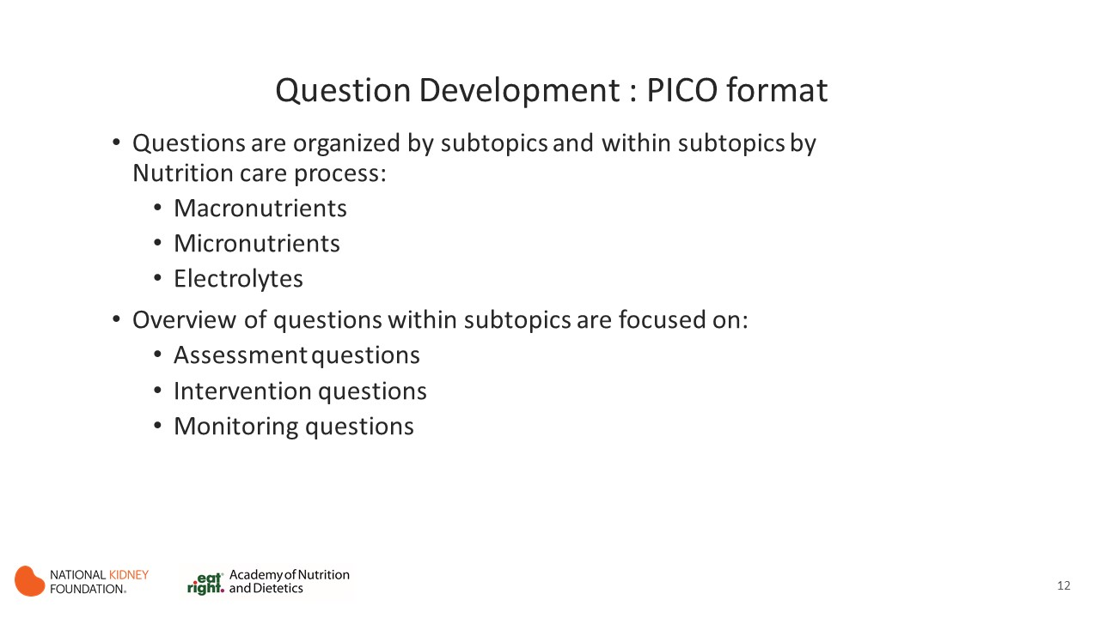
Notes:
NCP: assessment, intervention, monitoring and evaluation.
The focus was 3 subtopics and within each subtopic we tried to address questions focused on assessment, intervention and monitoring

Slide 13
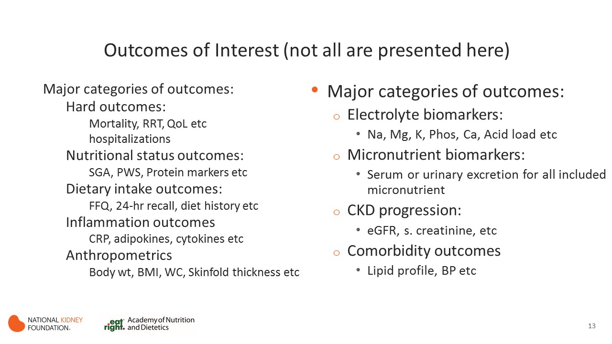

Slide 14
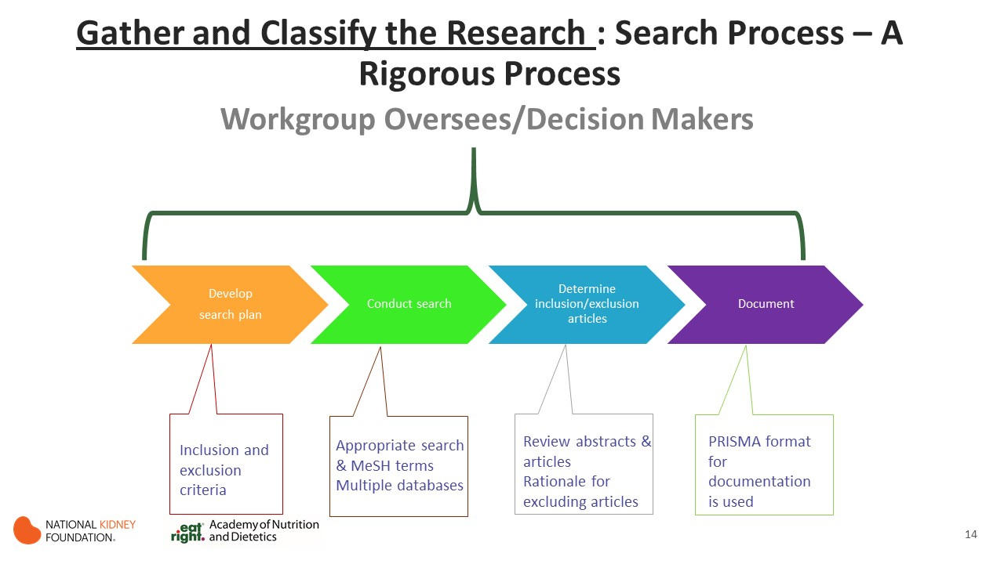

Slide 15
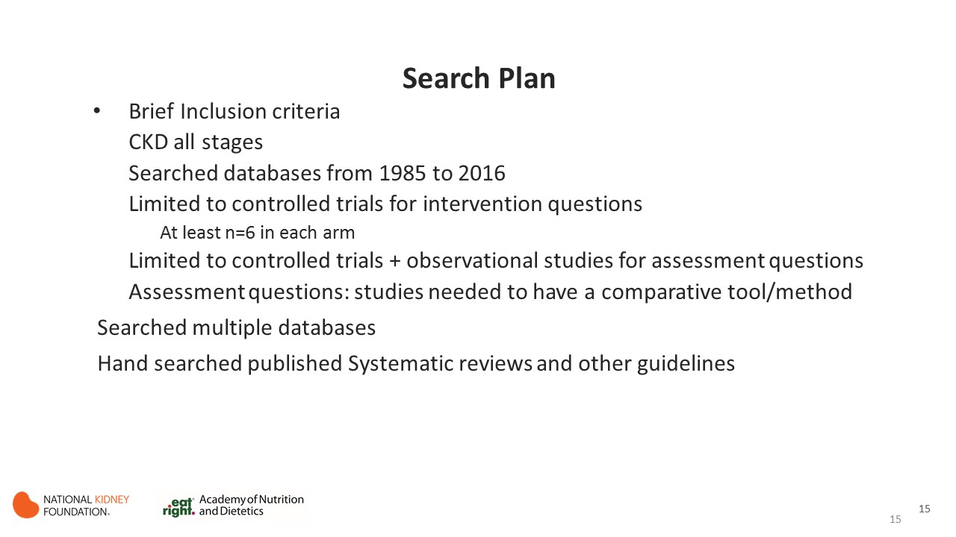
Notes:
EMBASE, PubMed, Medline, Cochrane database of trials
Hand search of citations from SRs, JRN was hand searched due to indexing issues

Slide 16
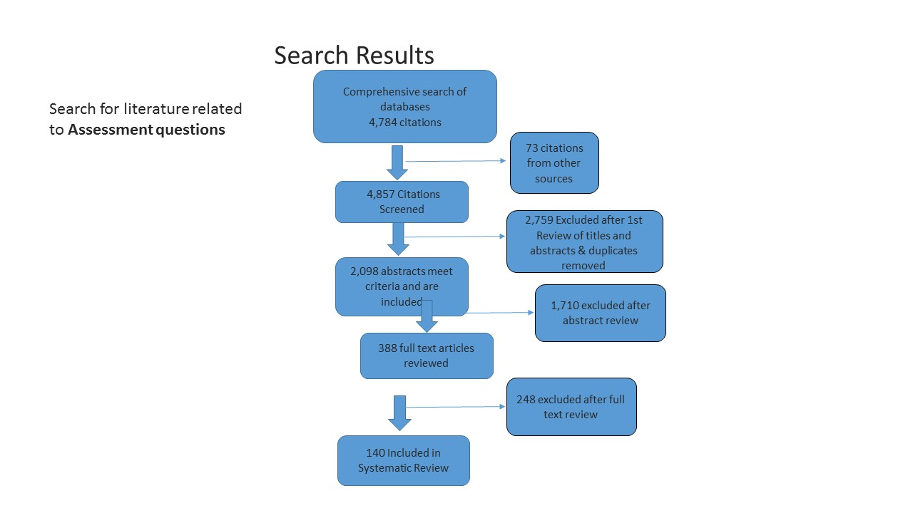
Comprehensive search of databases
4,784 citations
73 citations from other sources
4,857 Citations Screened
2,759 Excluded after 1st Review of titles and abstracts & duplicates removed
2,098 abstracts meet criteria and are included
248 excluded after full text review
140 Included in Systematic Review

Slide 17
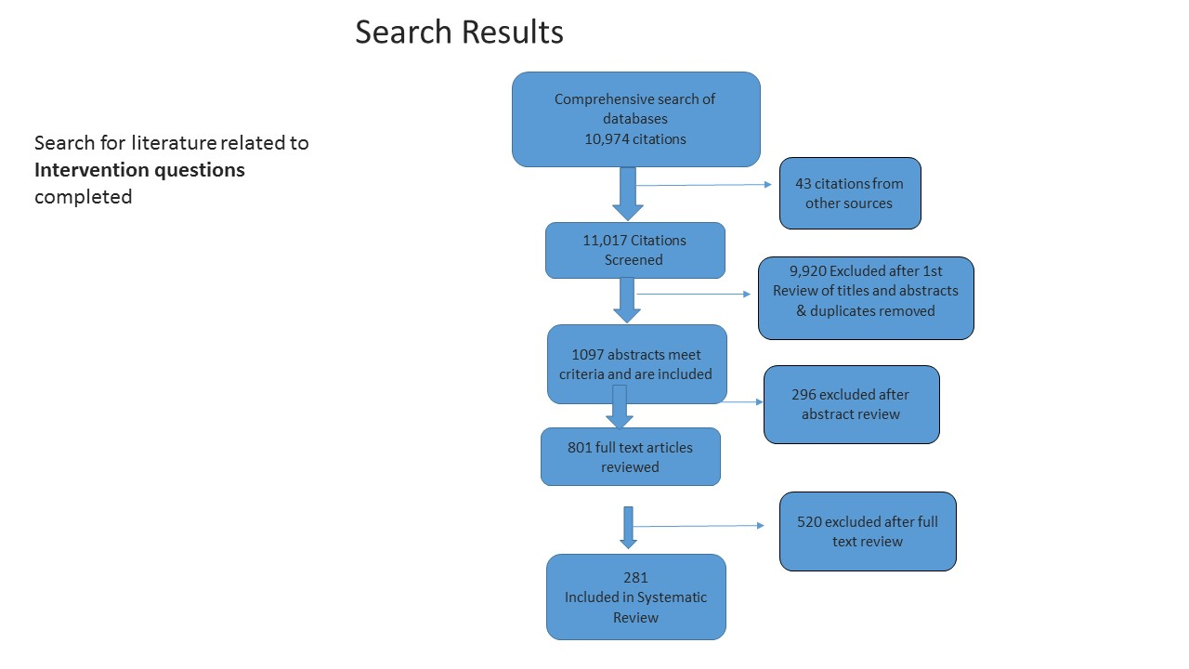
Comprehensive search of databases
10,974 citations
43 citations from other sources
11,017 Citations Screened
9,920 Excluded after 1st Review of titles and abstracts & duplicates removed
1097 abstracts meet criteria and are included
520 excluded after full text review
281
Included in Systematic Review

Slide 18
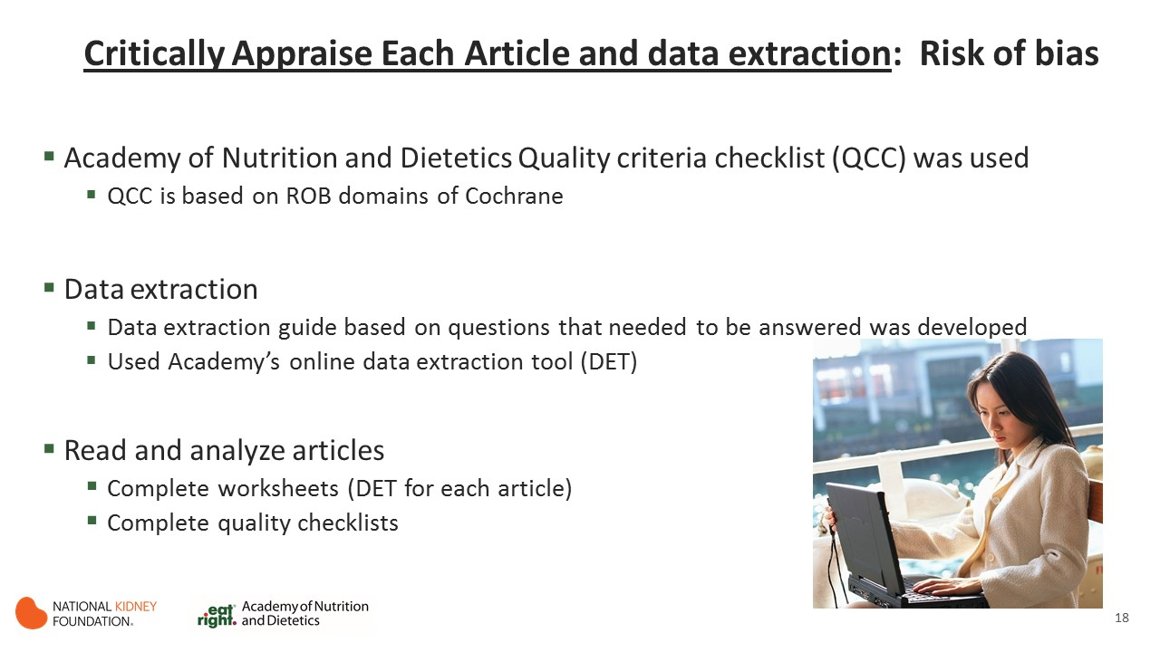

Slide 19
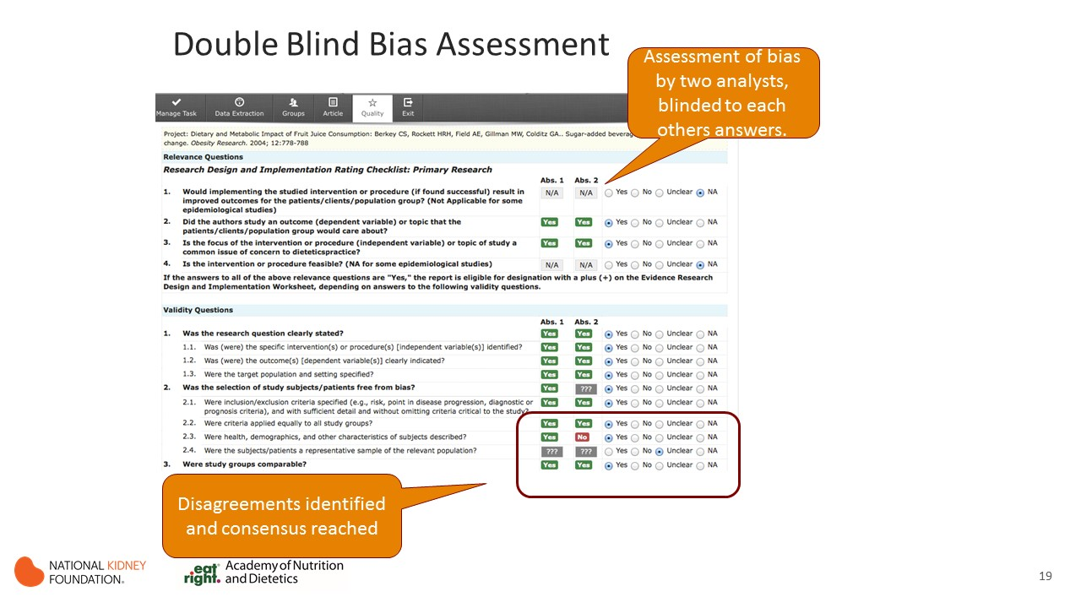

Slide 20
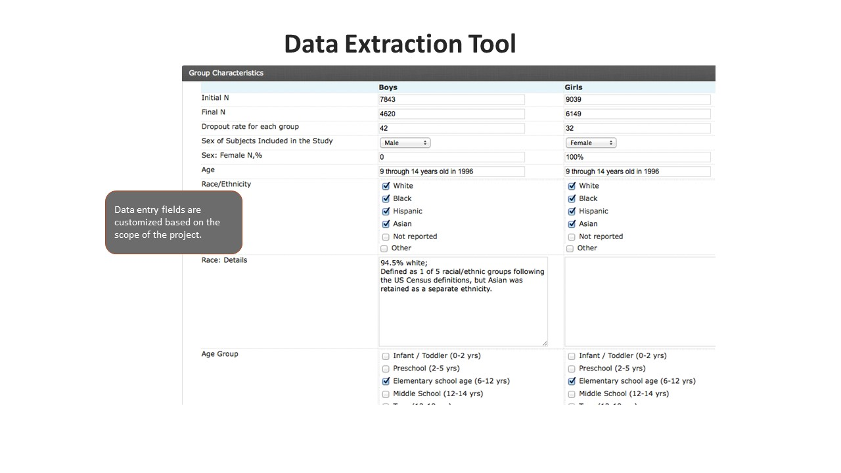
Notes:
Here is a sample of the data extraction tool…………………..having prestructed fields reduces data entry errors

Slide 21
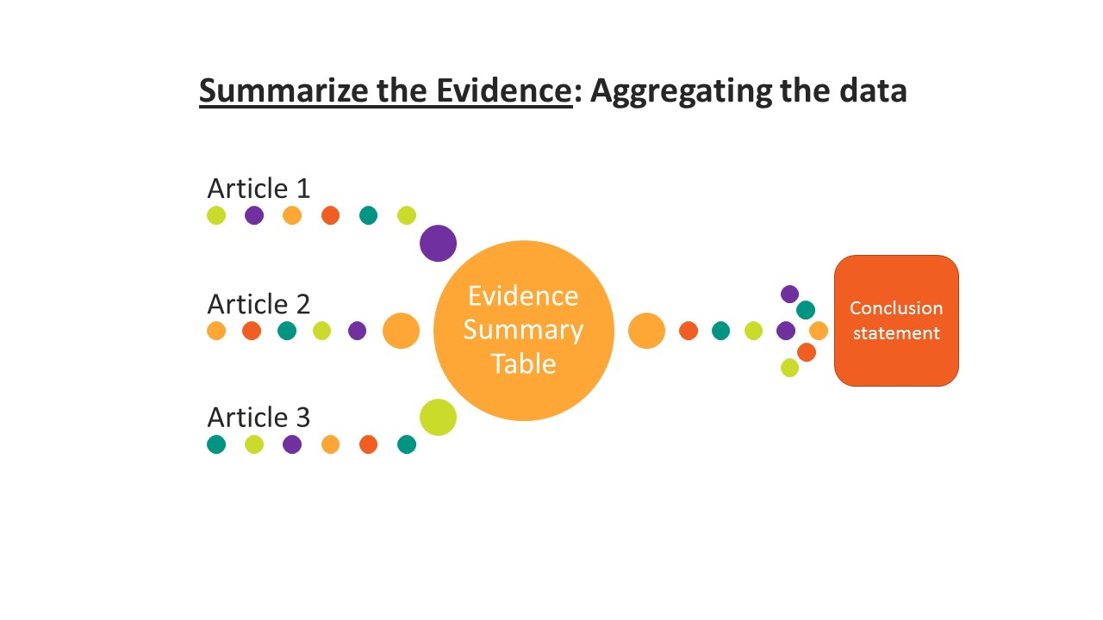

Slide 22
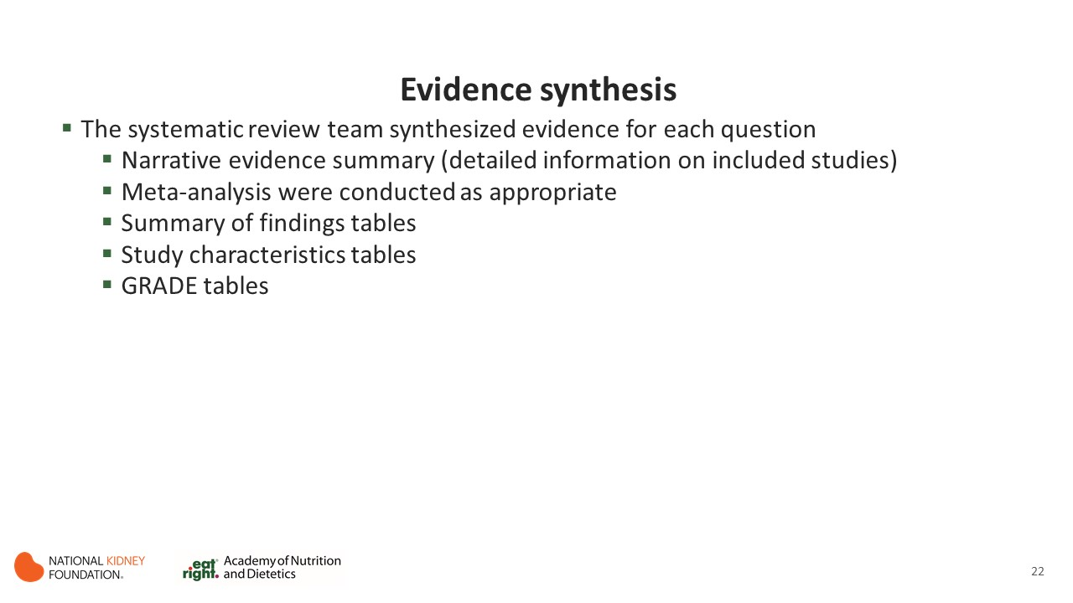

Slide 23
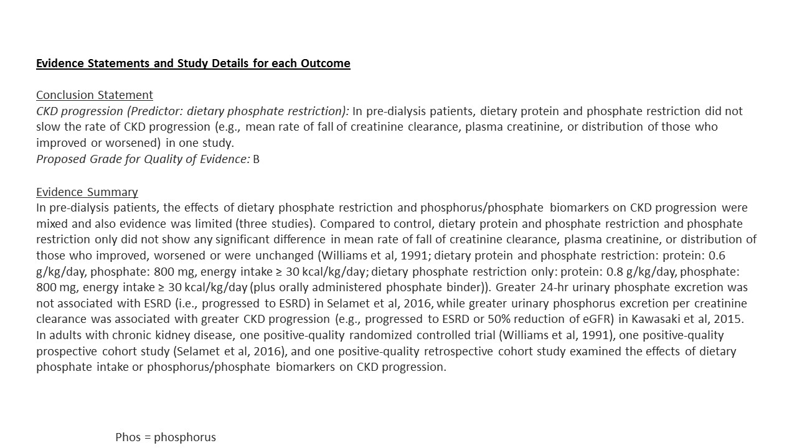
Notes:
As you can see the

Slide 24
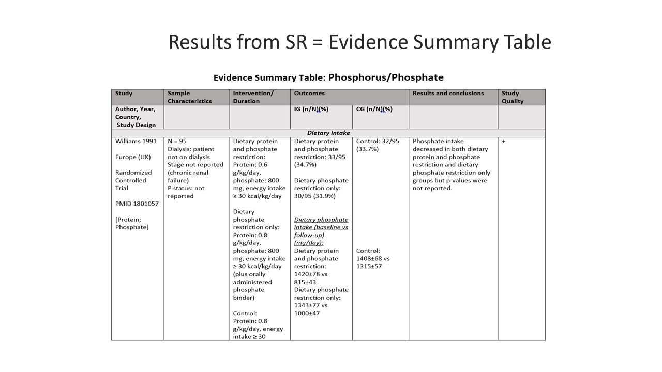
Notes:
This table provides all the information you need to know about the study…………….and it is by outcome and QoFf by outcome
We did a combination of study characteristics tables and intervention and results table to help interpret studies easier for WG: Summary tables are developed to tabulate data from studies pertinent for each treatment question: sample characterics like study size, study population, intervention details, outcomes and results comparison of IV vs CG. Risk of bias

Slide 25
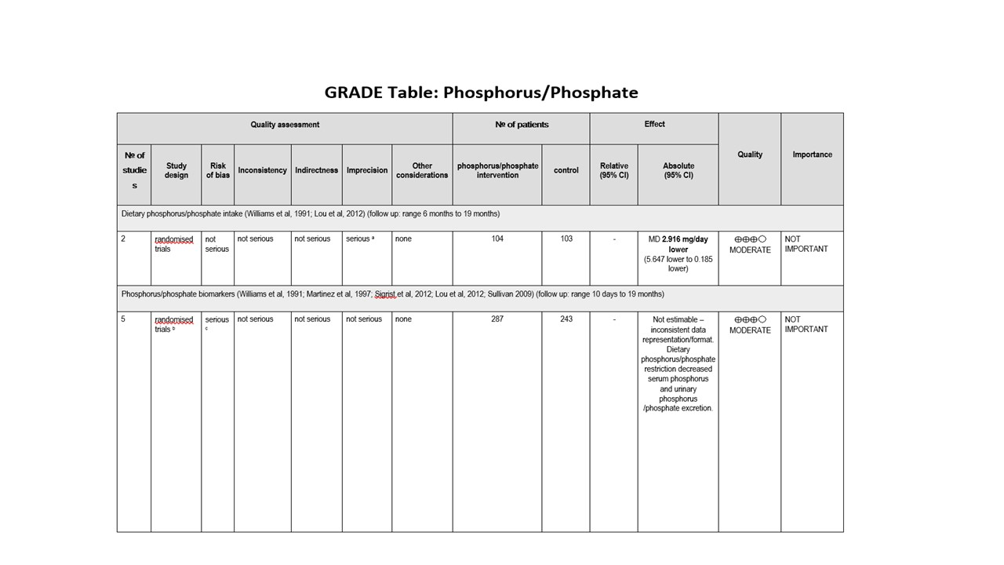
Notes:
GRADE table…………………not estimatable……….

Slide 26
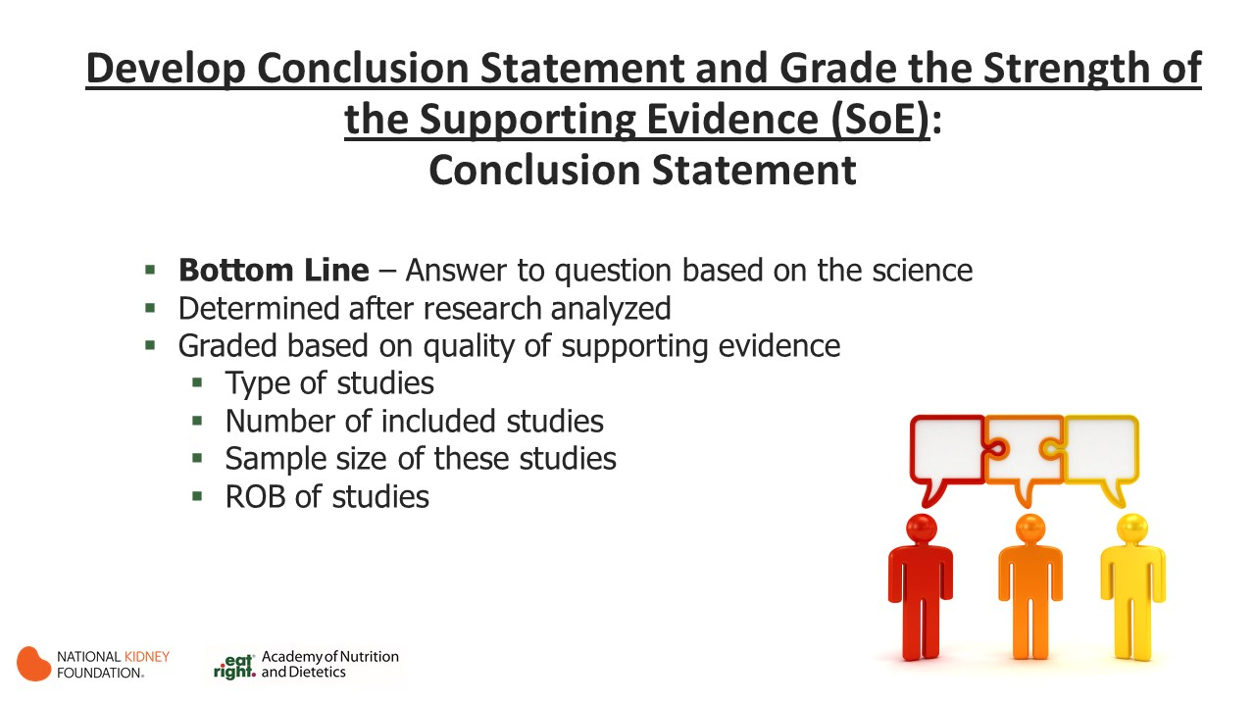
Notes:
This is a little different from traditional SR………………..we do grade our QoE or SoE for each questions……currently a few of SRs do this
Even before GRADE method it was our process

Slide 27
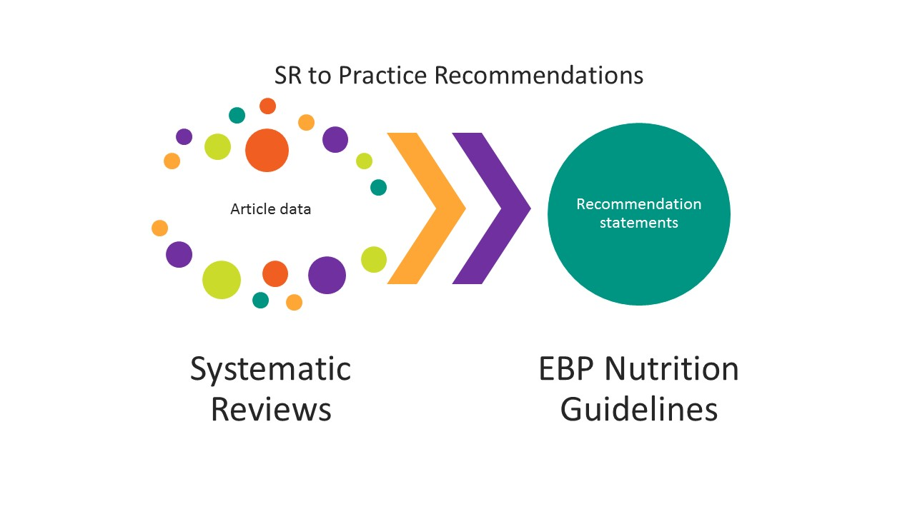
Notes:
After we The had SR completed…………….what method did we follow for guideline development…….
EAL guideline team strives for recommendations that are clear, specic, and actionable. All recommendations are written in an active voice.
Words such as should or strongly recommend are generally used for strong recommendations, while may or consider are used for weaker recommendations.

Slide 28
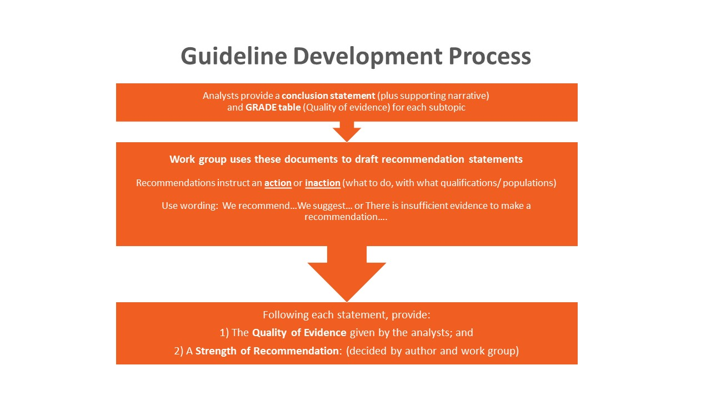
Notes:
KDOQI and the Academy of Nutrition will edit the presentation of statements to comply with policies/needs of respective organizations

Slide 29
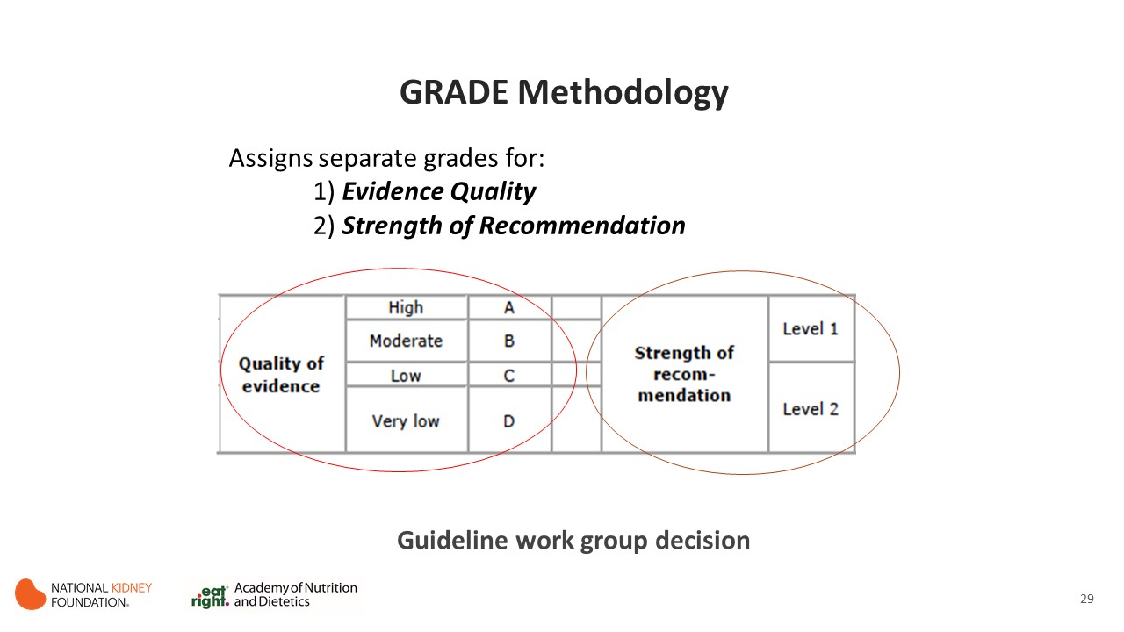
Notes:
Using conclusion statements and GRADE tables for each topic, make a recommendation to take or not to take an action.
Provide GRADE ratings for Quality of Evidence and Strength of Recommendation
Use conclusion statements to compile rationale text to support your statement topic, adding discussion of clinical considerations or limitations where applicable

Slide 30
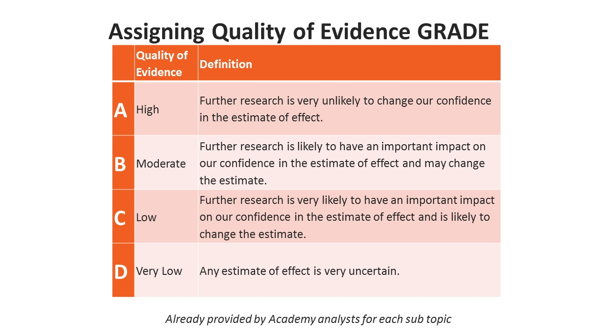
Notes:
Already provided by anaylsts

Slide 31
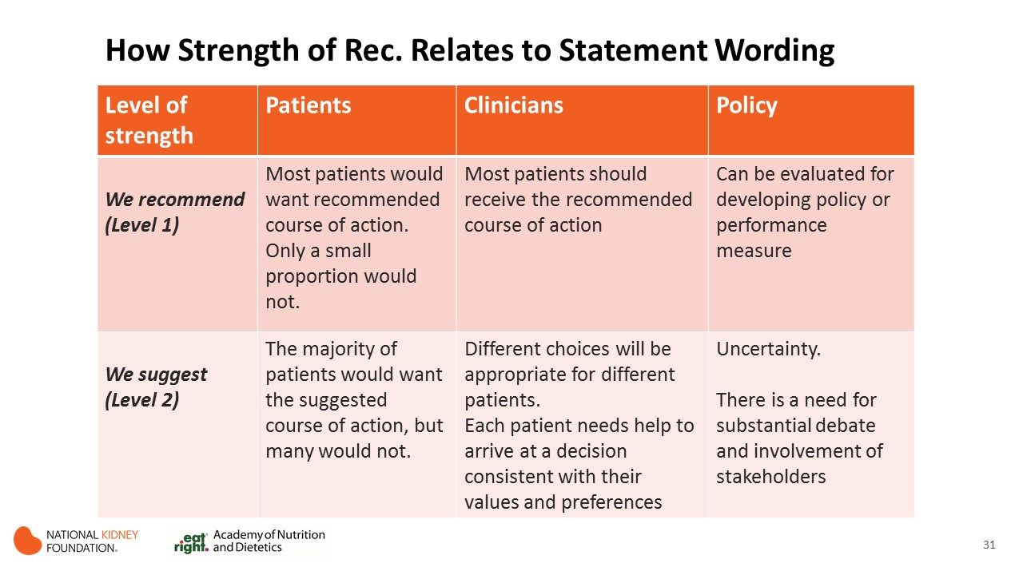

Slide 32
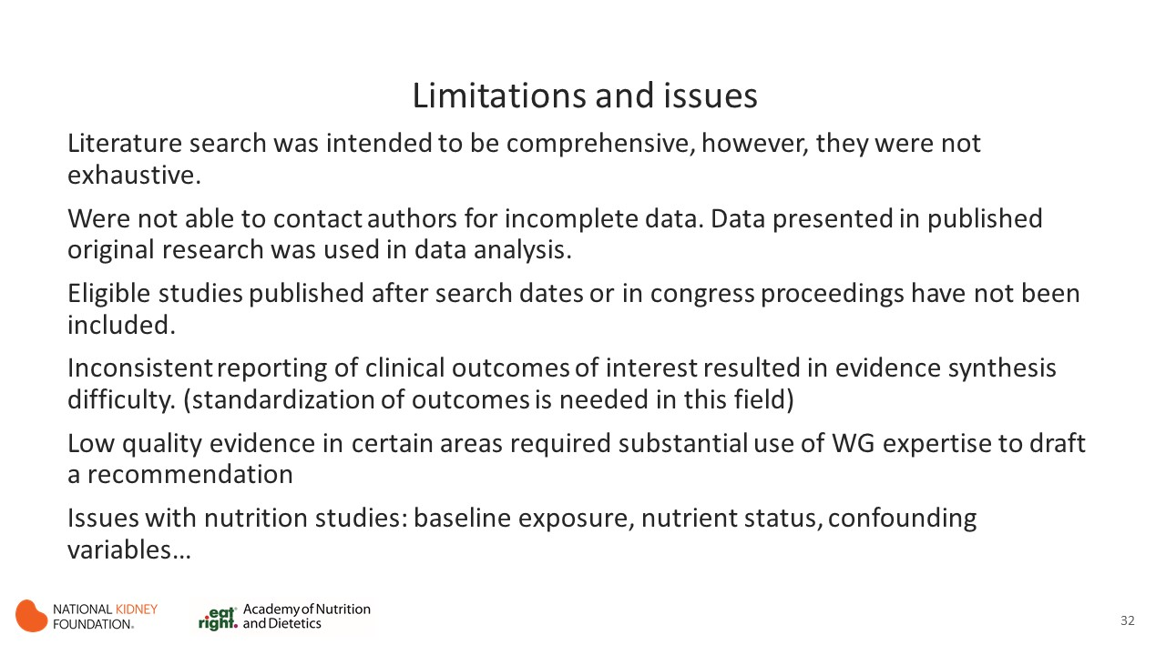

Slide 33
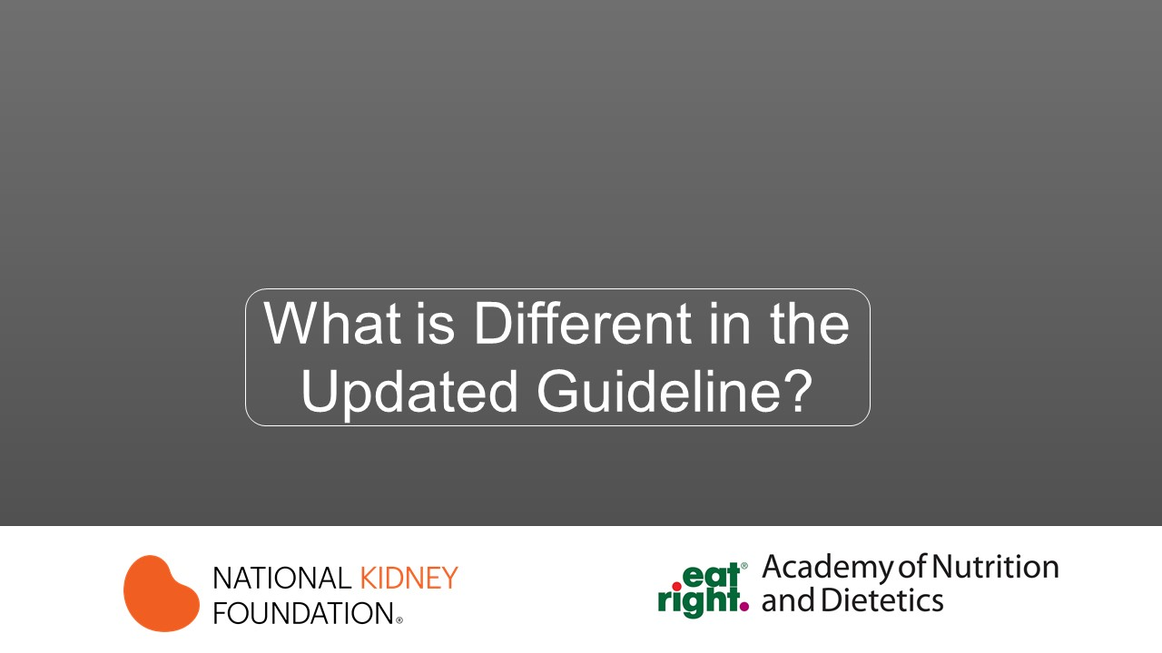

Slide 34
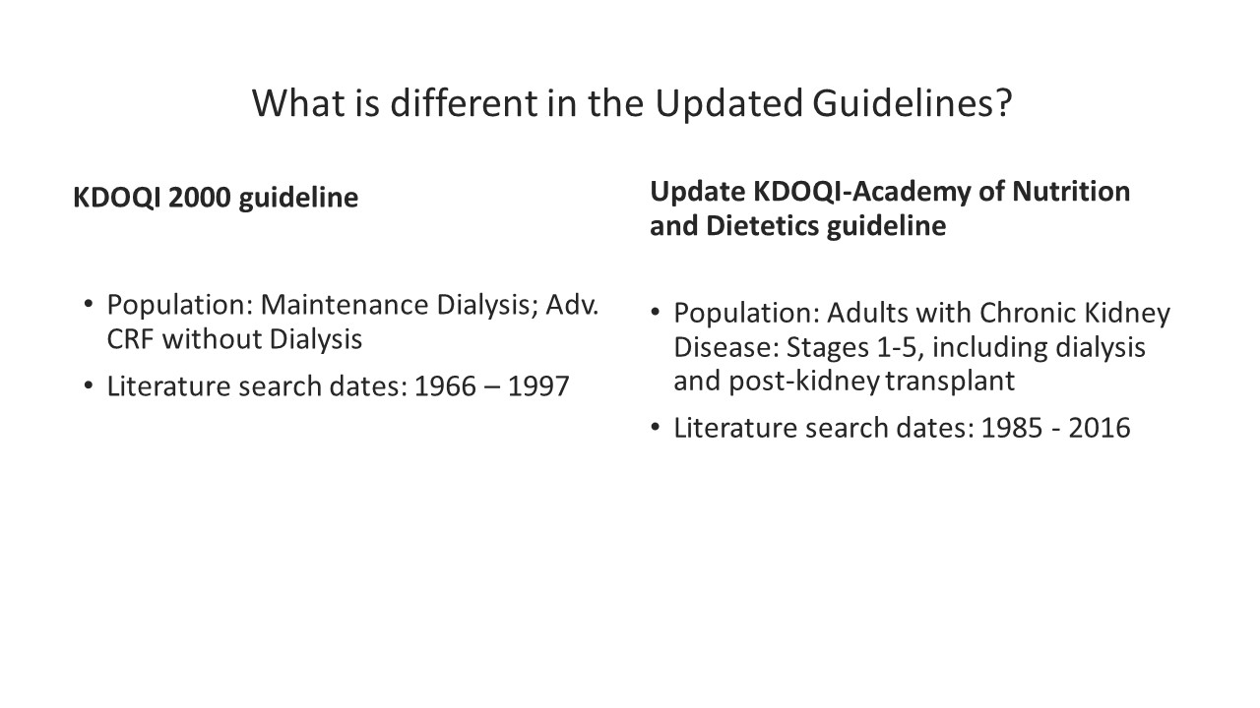

Slide 35
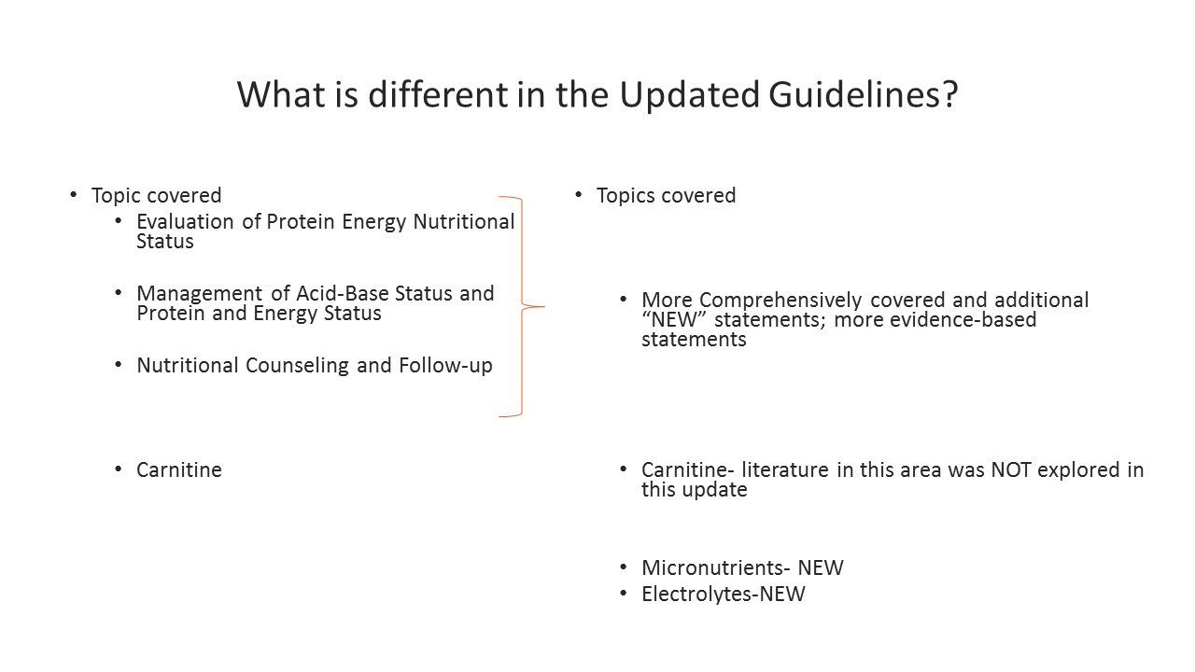

Slide 36
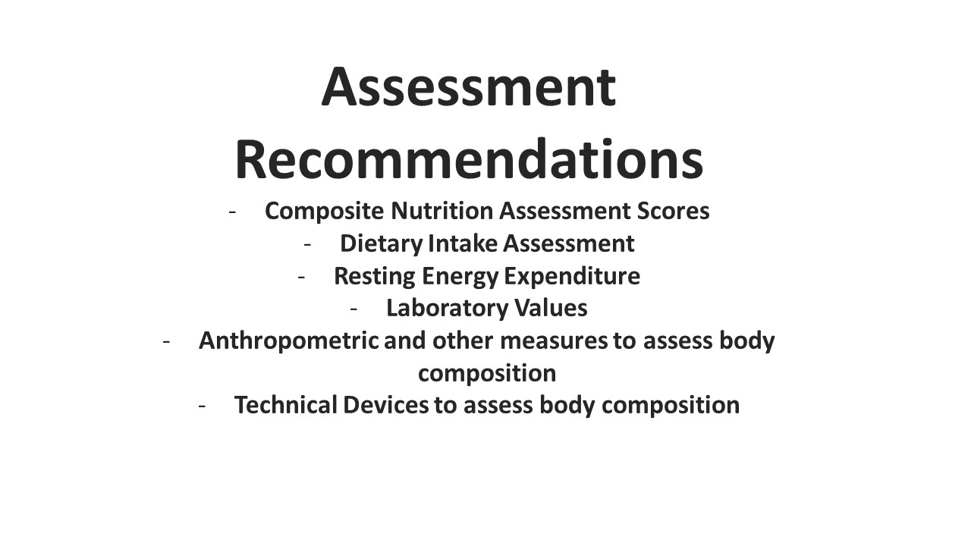

Slide 37
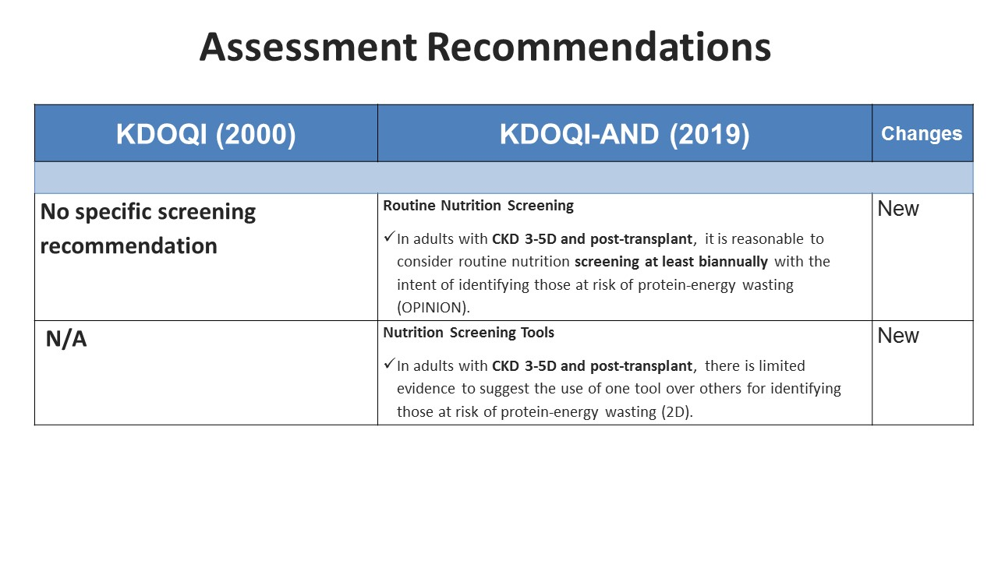

Slide 38
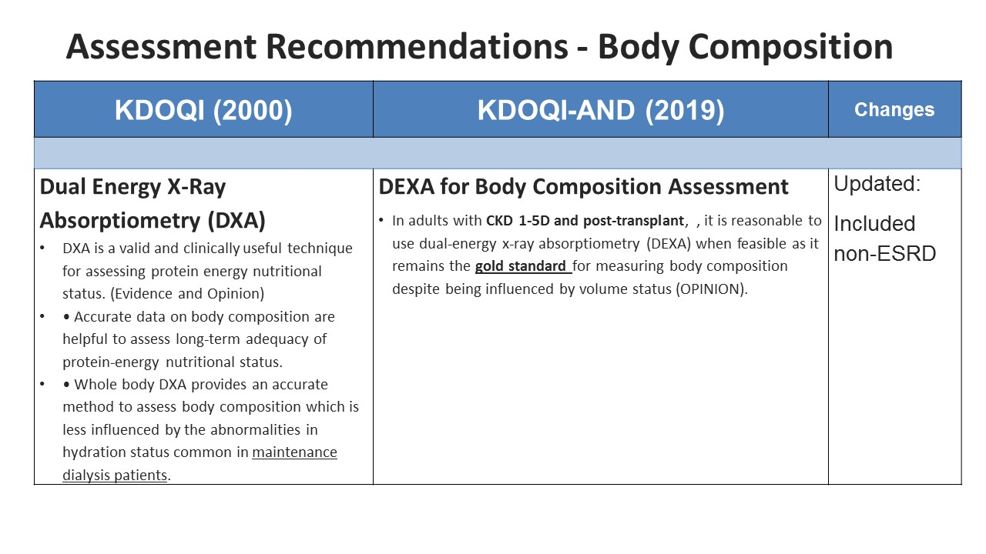

Slide 39
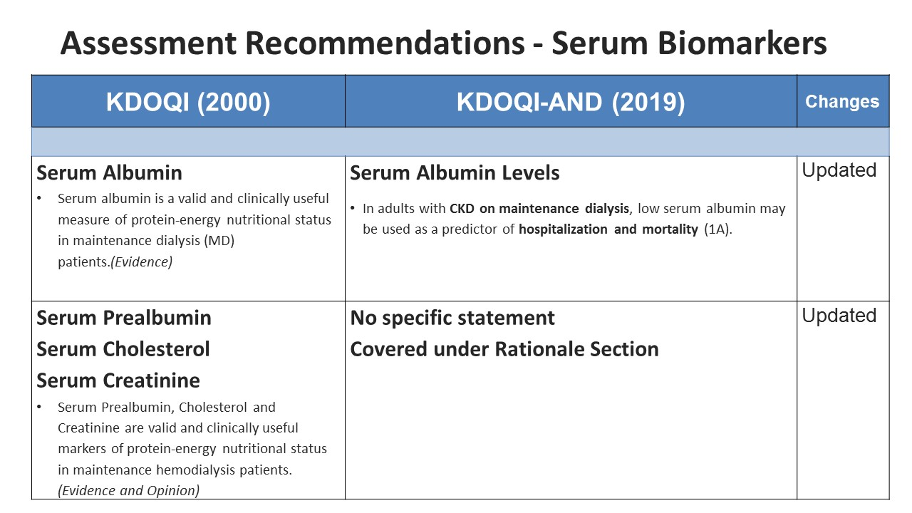

Slide 40
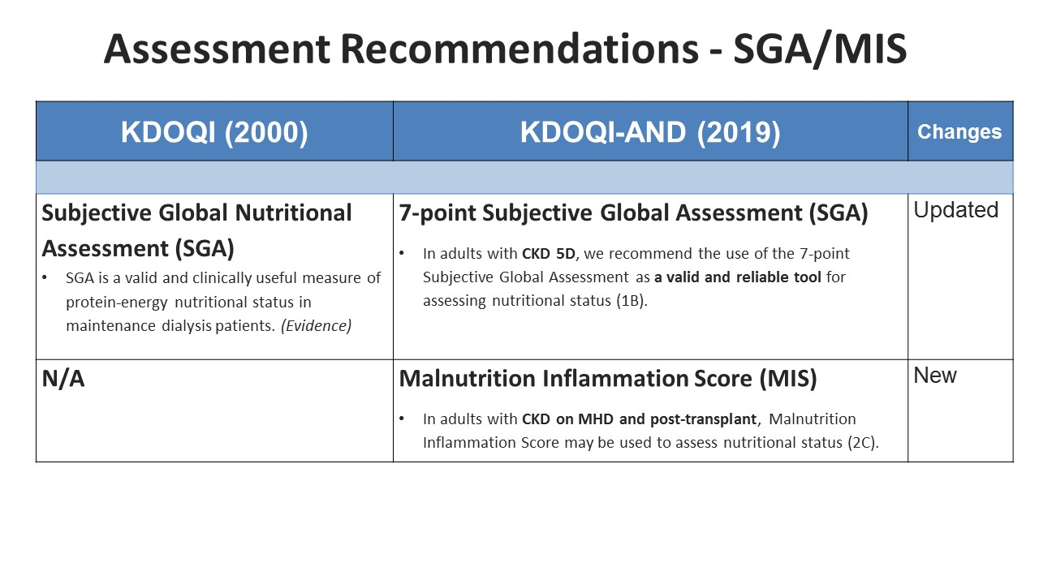

Slide 41
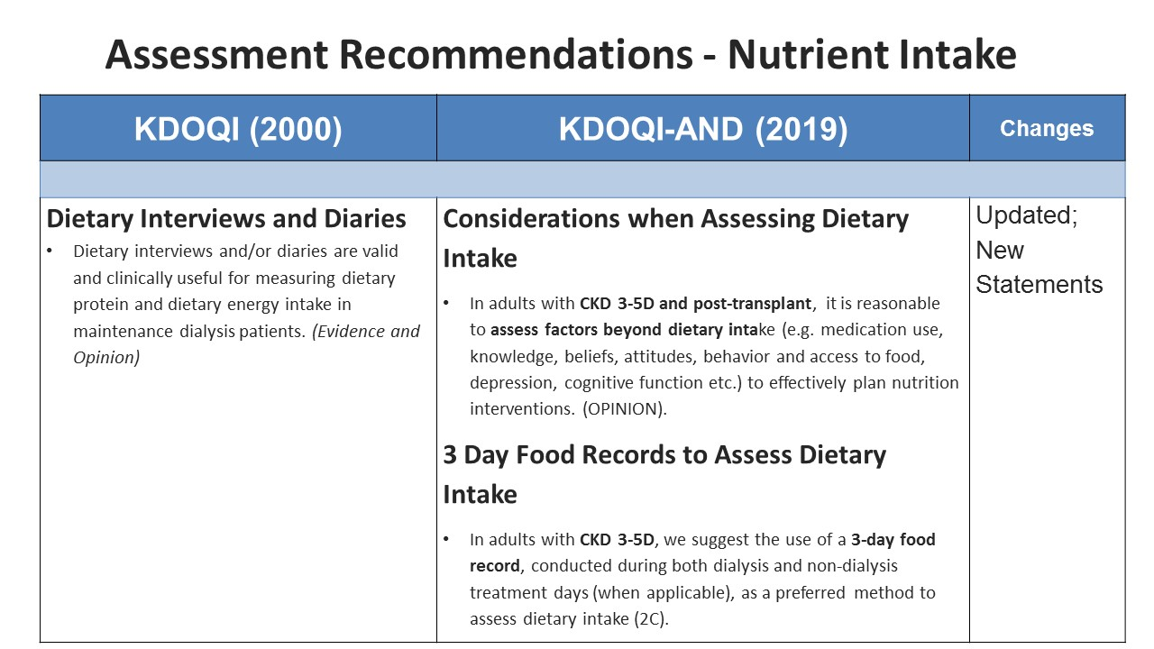

Slide 42
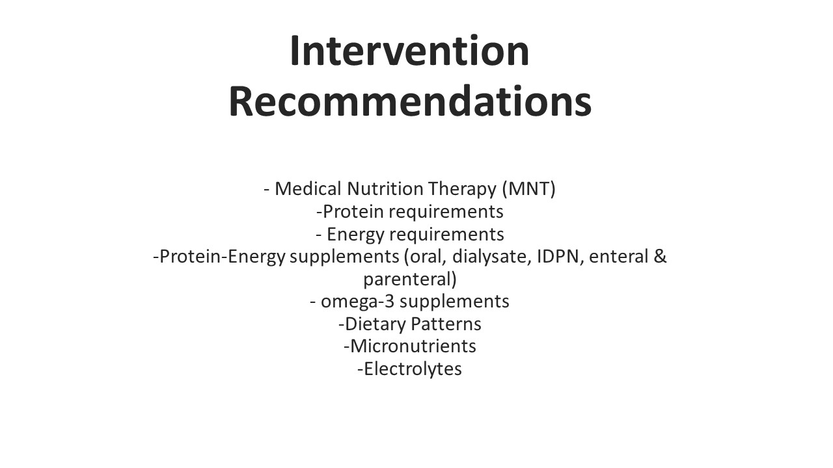

Slide 43
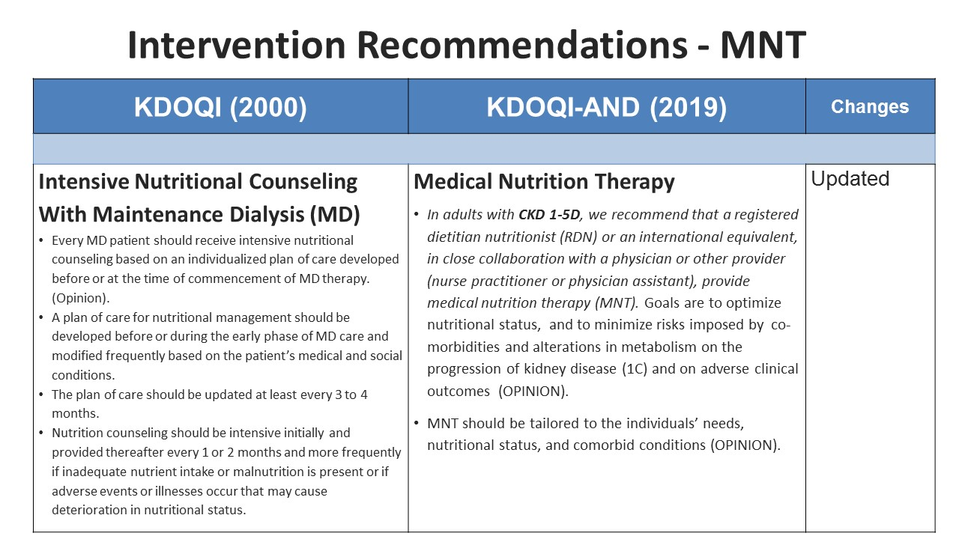

Slide 44
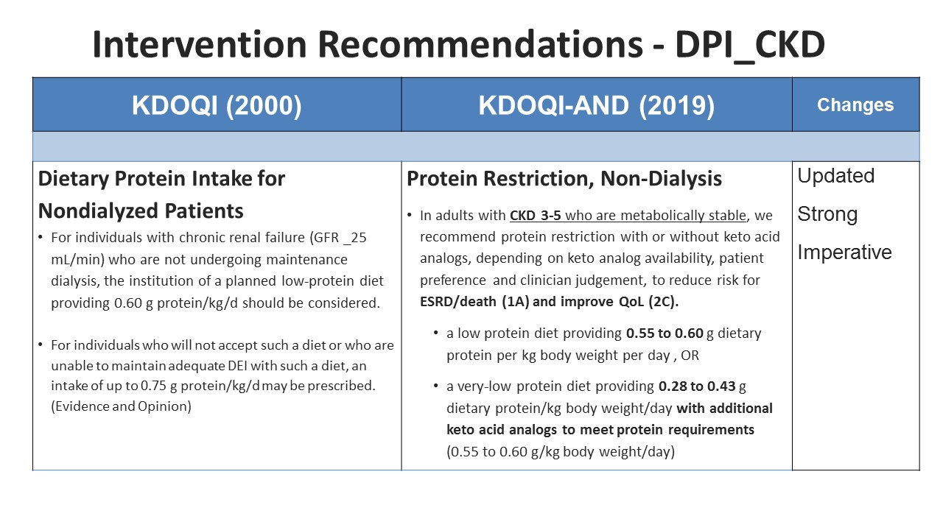

Slide 45
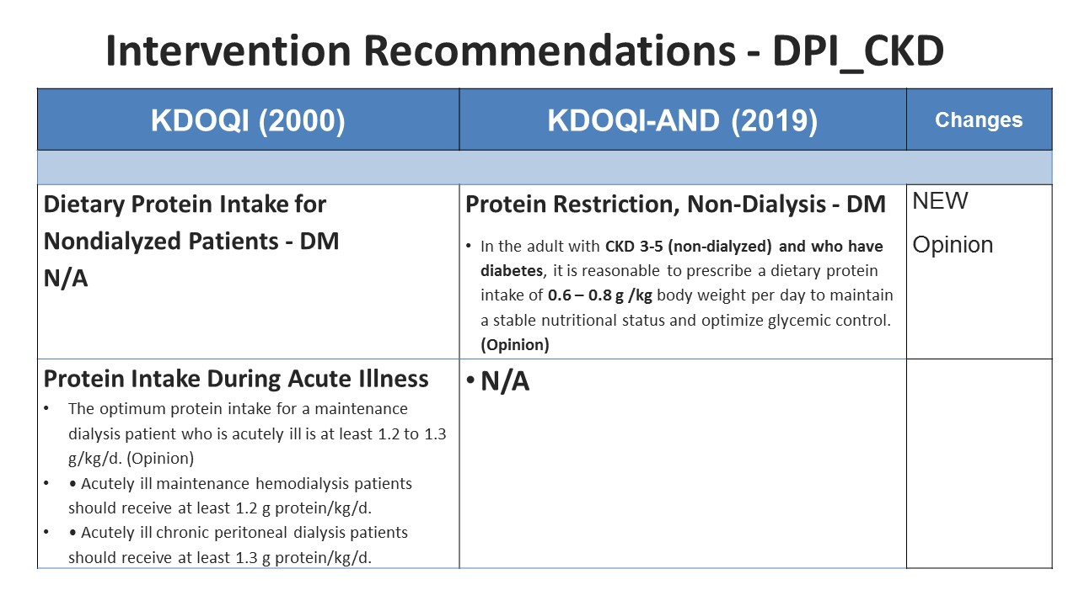

Slide 46
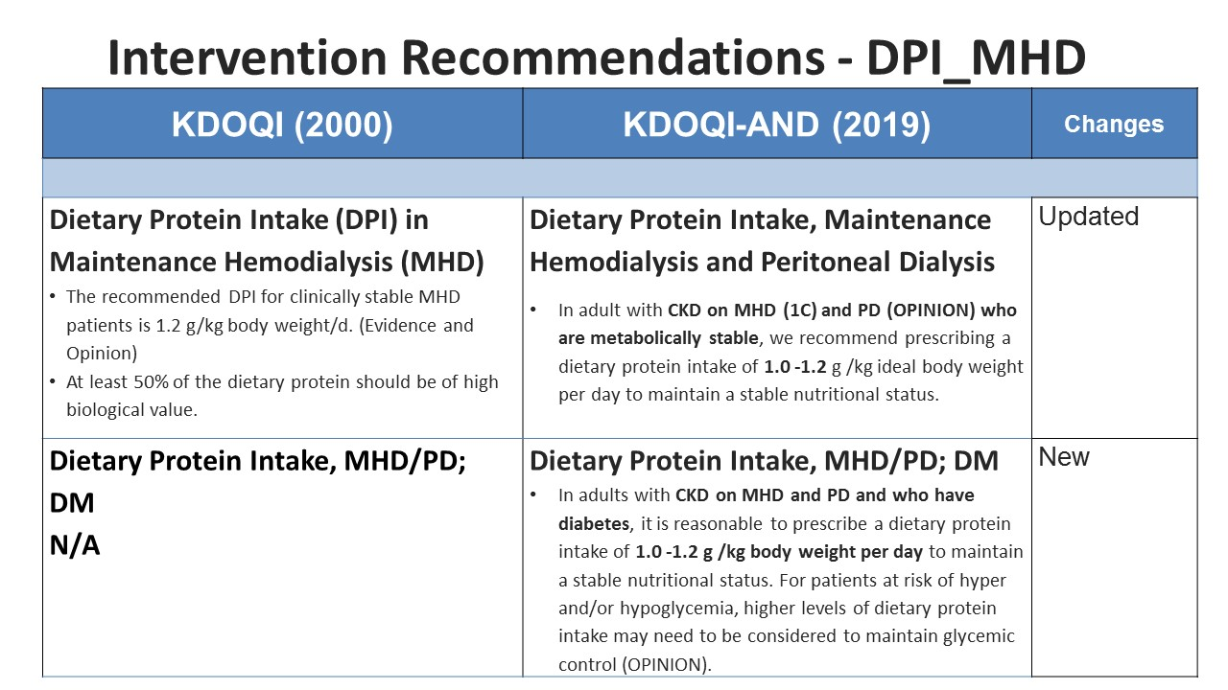

Slide 47
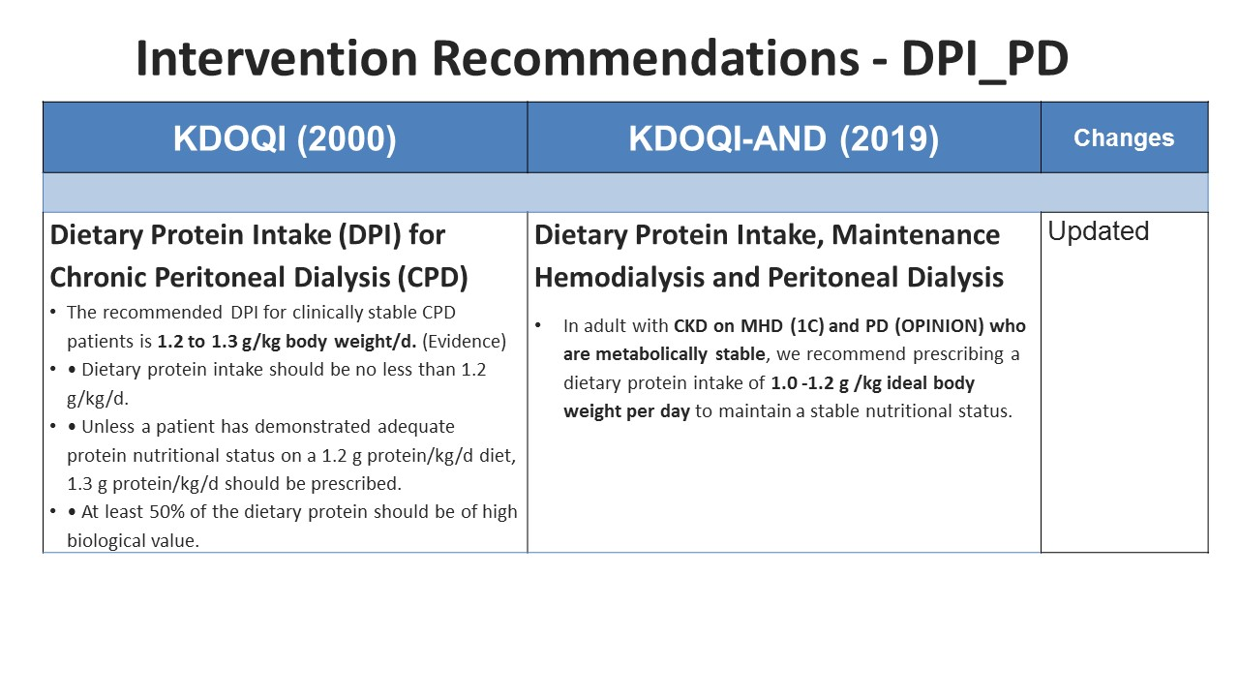

Slide 48
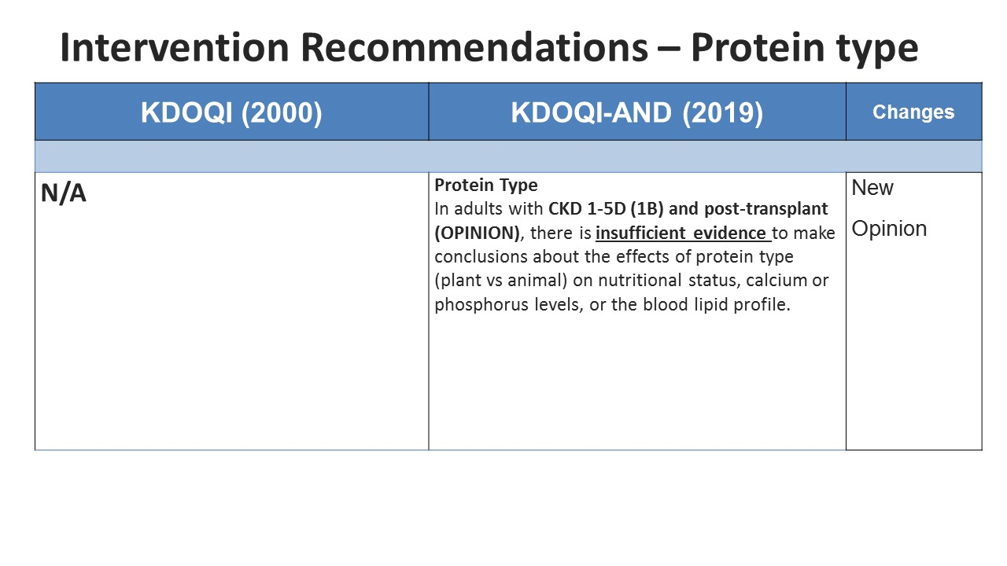

Slide 49
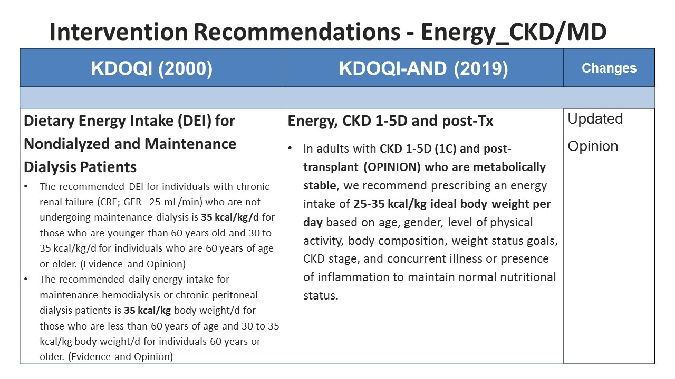

Slide 50
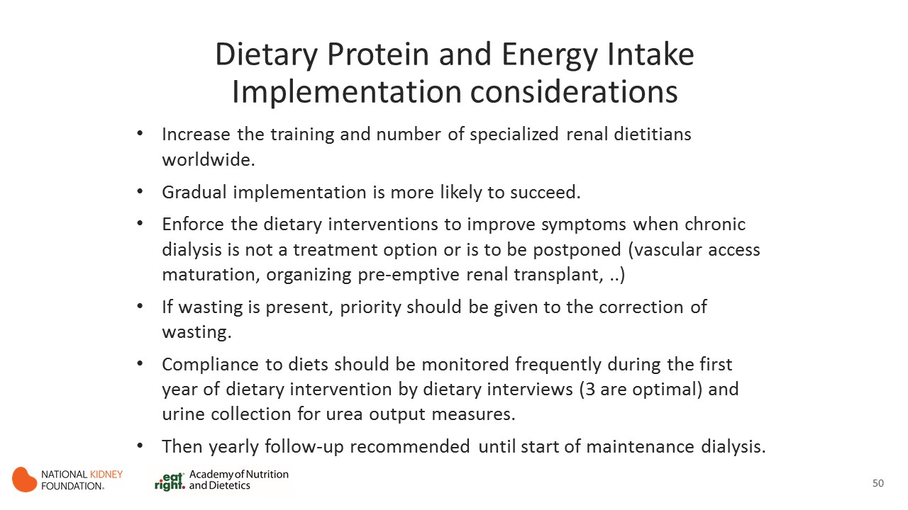

Slide 51
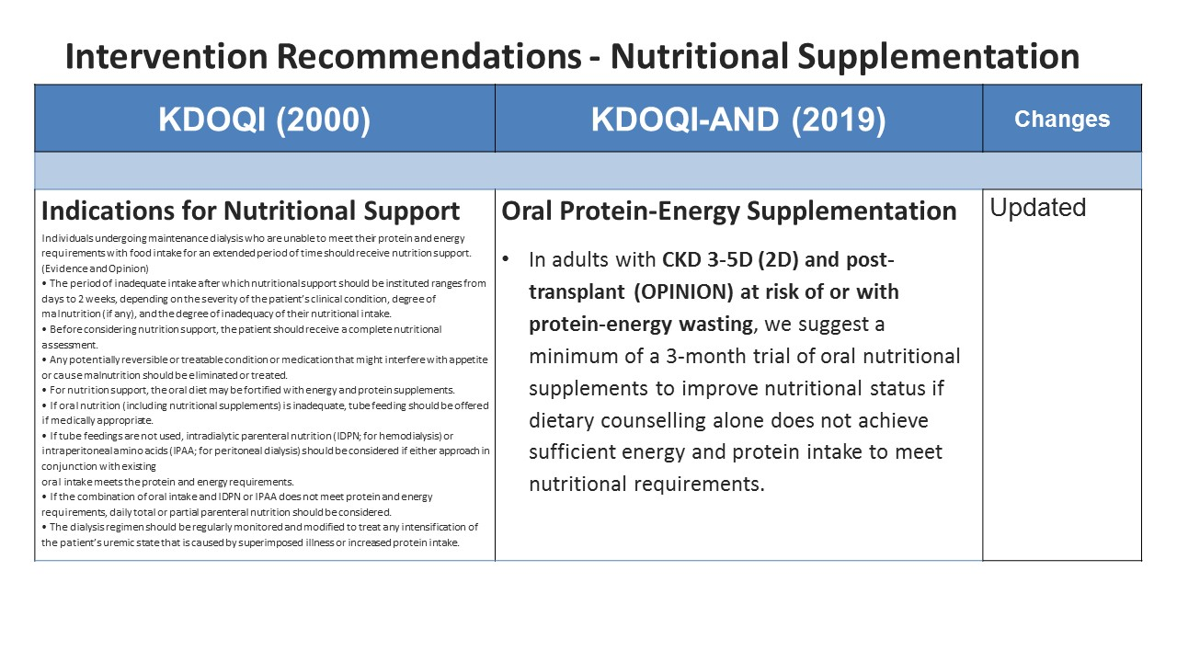

Slide 52


Slide 53


Slide 54


Slide 55


Slide 56

Notes:
Hospitalized or institutionalized CKD patients often ingest even lower amounts of their usual protein and energy intake, as low as 66% and 50%, respectively.¹ If the intestinal tract is functional, enteral tube feeding is considered the next line of nutrition therapy in the CKD patients who are unable to meet their protein and energy requirements with oral food intake or supplementation. It is important to note that oral supplementation is the first choice for these patients. If it is not sufficient, EN should be instituted.
Clinical practice guidelines for nutrition in chronic renal failure. K/DOQI, National Kidney Foundation. Am J Kidney Dis. 2000;35 Suppl 2:S1-140.
Fouque D, Vennegoor M, ter Wee P, et al. EBPG guideline on nutrition. Nephrol Dial Transplant. 2007;22 Suppl 2:ii45-87.
56

Slide 57


Slide 58


Slide 59


Slide 60


Slide 61


Slide 62


Slide 63

K

Slide 64


Slide 65


Slide 66


Slide 67


Slide 68


Slide 69


Slide 70


Slide 71


Slide 72


Slide 73

Notes:
These resources from the Academy of Nutrition and Dietetics and the National Kidney Foundation provide additional information to support implementation of the KDOQI Guideline for Nutrition in CKD.
For NKF resources go to kidney.org
For Academy resources go to eatright.org

