Slide 1
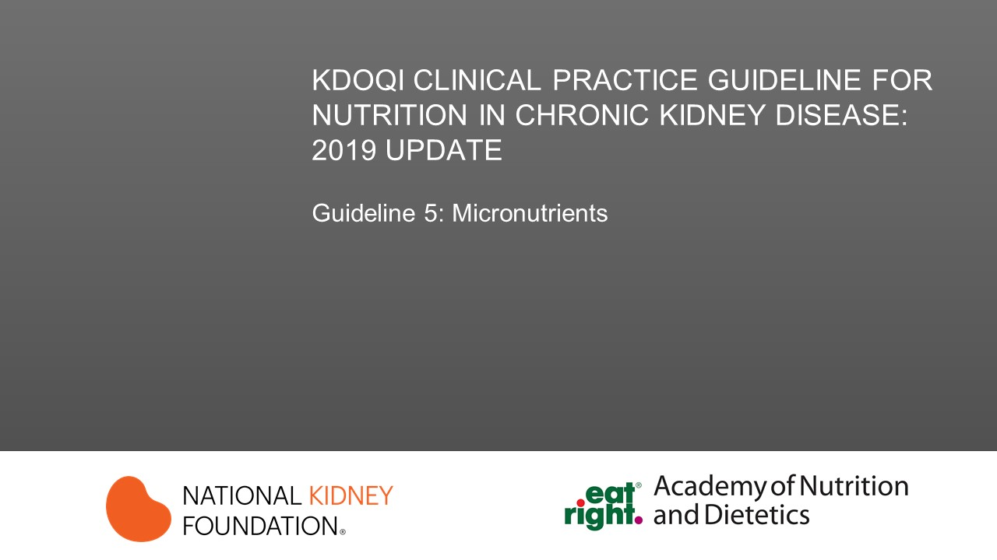

Slide 2
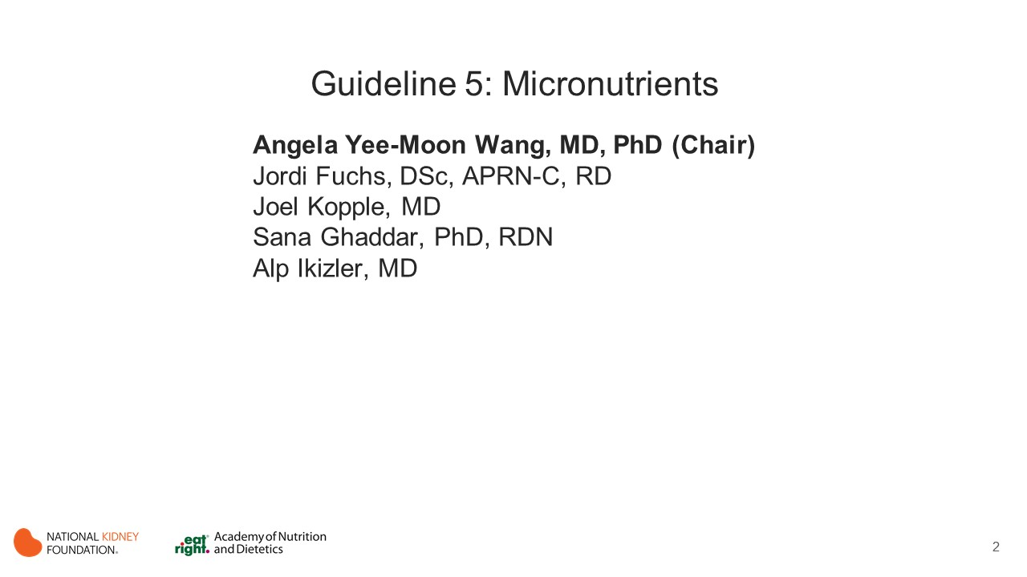
Notes:
Chapter Chair: Angela Wang, MD, PhD
Chapter Committee:
Jordi Fuchs, DSc, APRN-C, RD
Joel Kopple, MD
Sana Ghaddar, PhD, RDN
Alp Ikizler, MD

Slide 3


Slide 4
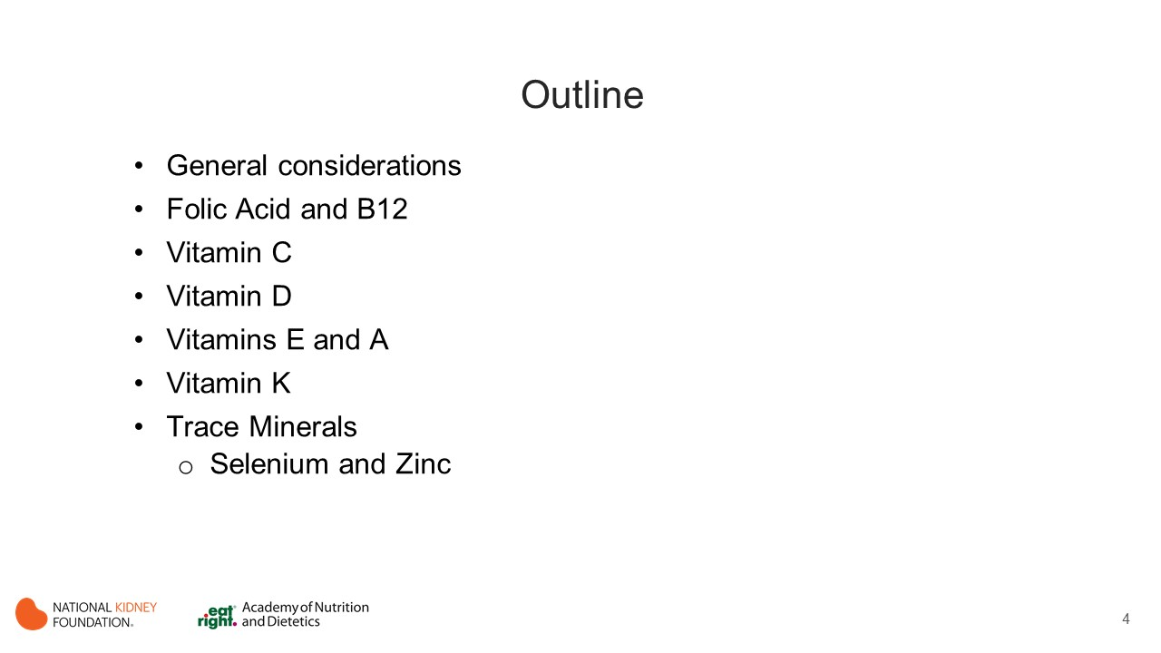
Notes:
Sections
General considerations
Micronutrients general
Folic Acid and B12
Vitamin C
Vitamin D
Vitamins E and A
Vitamin K
Trace Minerals
Selenium and Zinc

Slide 5
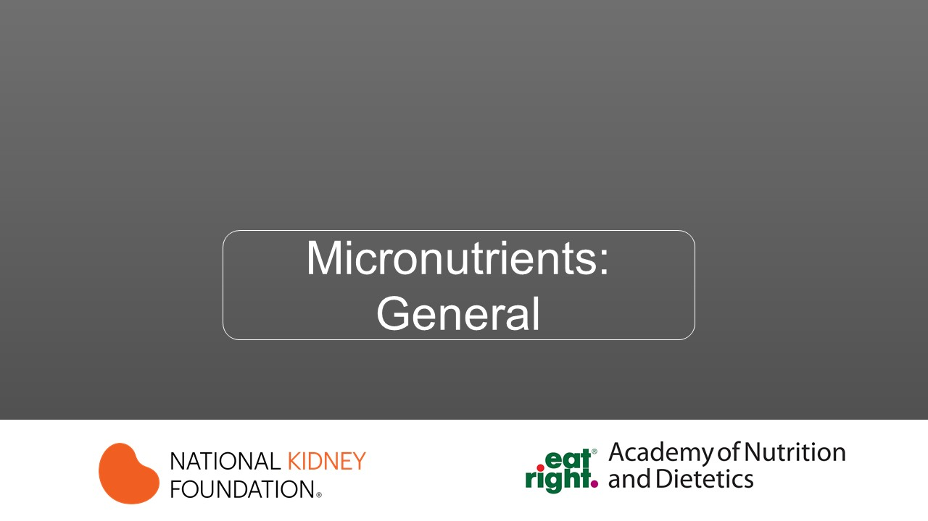

Slide 6
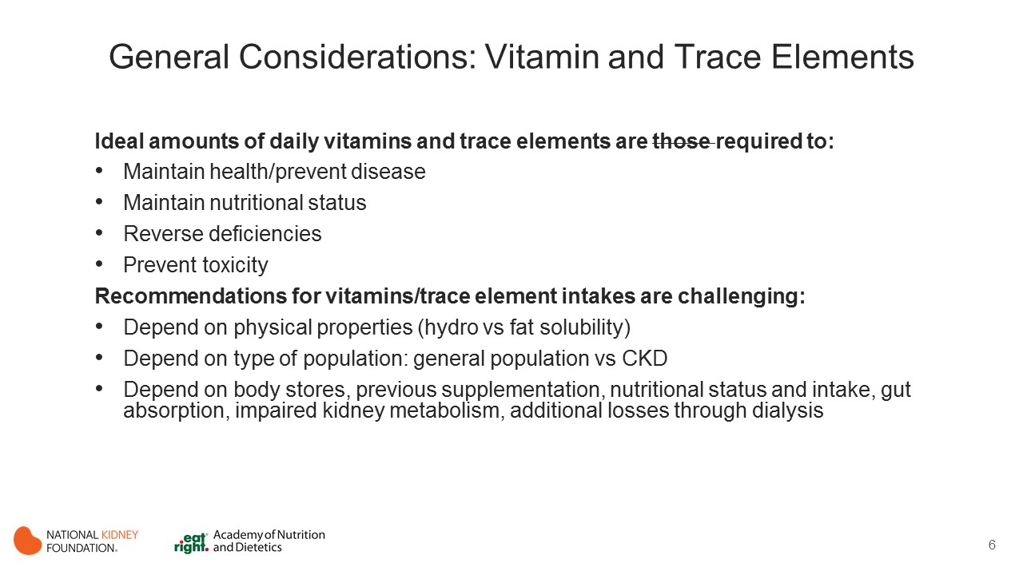

Slide 7
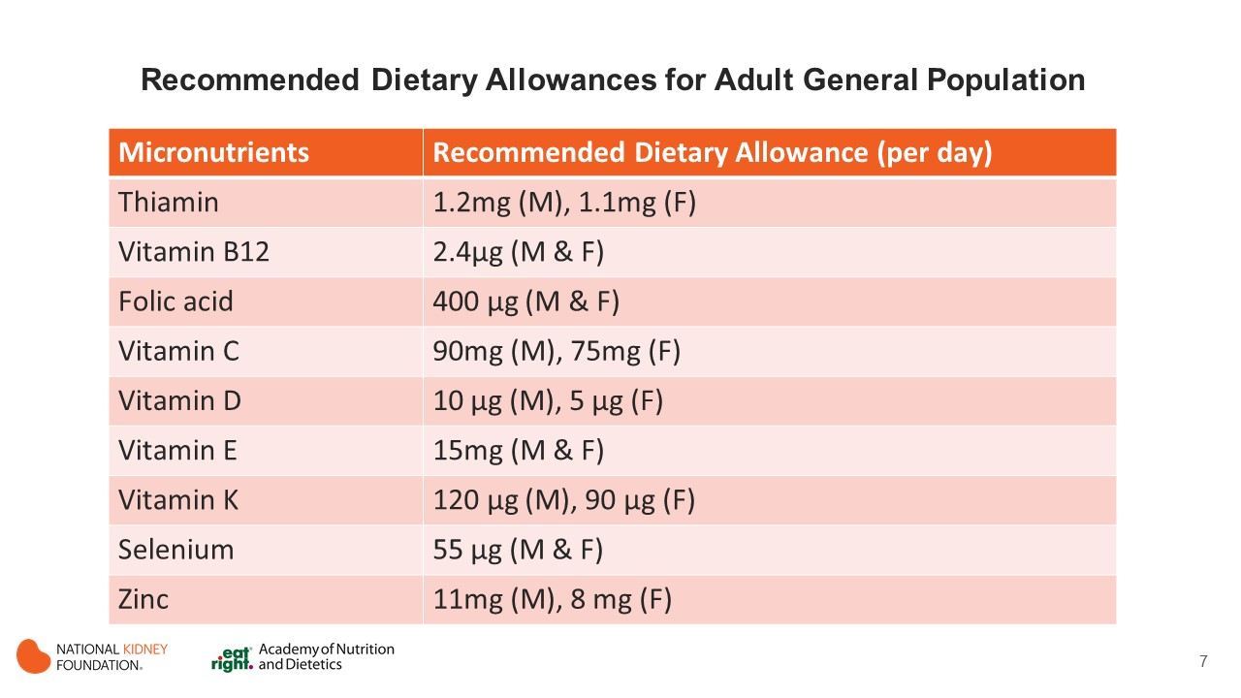

Slide 8
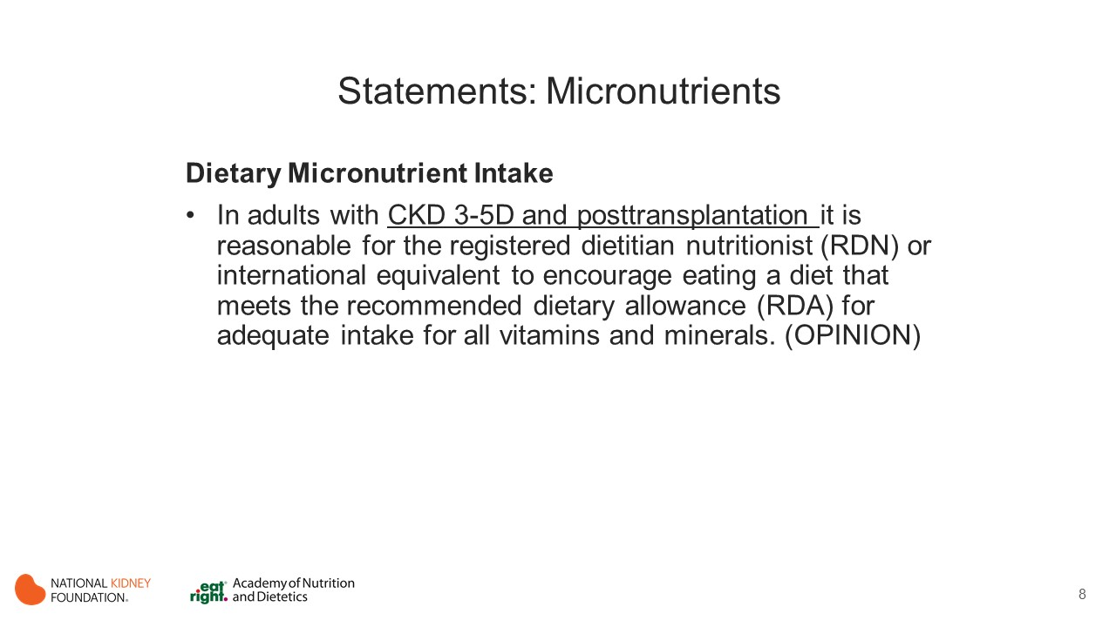
Notes:
Micronutrients are essential for metabolic function and hence maintaining an adequate intake of these micronutrients is important.
There is some evidence to indicate that patients with CKD are likely to be deficient in certain micronutrients.
Some of the common reasons for this include insufficient dietary intake, dietary prescriptions that may limit vitamin-rich foods (particularly water-soluble vitamins), dialysis procedures that may contribute to micronutrient loss, improper absorption of vitamins, and use of certain medications and illness.

Slide 9
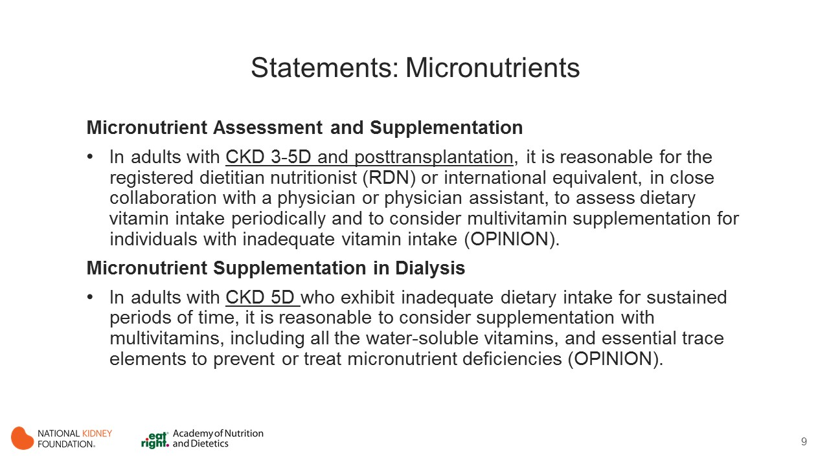
Notes:
For healthy individuals, many countries have established dietary reference intakes for individual micronutrients. However, there is a paucity of guidance regarding appropriate intake for people with chronic diseases.
There is some evidence to indicate that patients with CKD are likely to be deficient in certain micronutrients. Some of the common reasons for this include insufficient dietary intake, dietary prescriptions that may limit vitamin-rich foods (particularly water-soluble vitamins), dialysis procedures that may contribute to micronutrient loss, improper absorption of vitamins, and use of certain medications and illness. Due to these concerns, multivitamin supplements are routinely prescribed.
Findings from the Dialysis Outcomes and Practice Patterns Study (DOPPS) indicate that >70% of MHD patients in the United States take supplements. However, there is insufficient evidence to indicate whether micronutrients or multivitamin supplementation is beneficial or detrimental in this population.

Slide 10
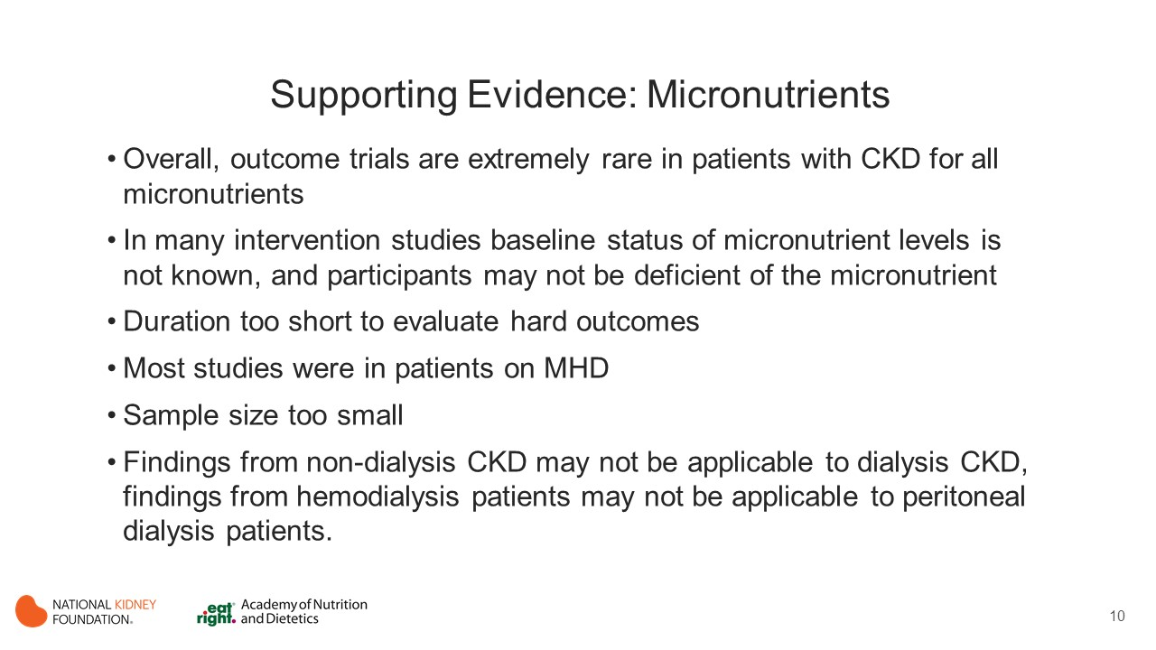
Notes:
Most of the included studies did not report either baseline status of micronutrients examined or dietary intake during the trials.
The outcomes reported by these studies varied significantly across the studies, making it difficult to synthesize evidence.
Dosage of supplementation and duration of intervention varied across studies.
The quality of evidence ranged from very low quality to moderate quality for most micronutrients, hence it is very difficult to provide recommendations regarding the exact levels of supplementation or routine supplementation for all patients with CKD.
However, there is some evidence to support that there might be some individuals who are at higher risk for certain micronutrient deficiencies, therefore the workgroup thought that it was important to draft expert opinion–based recommendation statements to guide practitioners and to emphasize the need for individualization of micronutrient use.

Slide 11
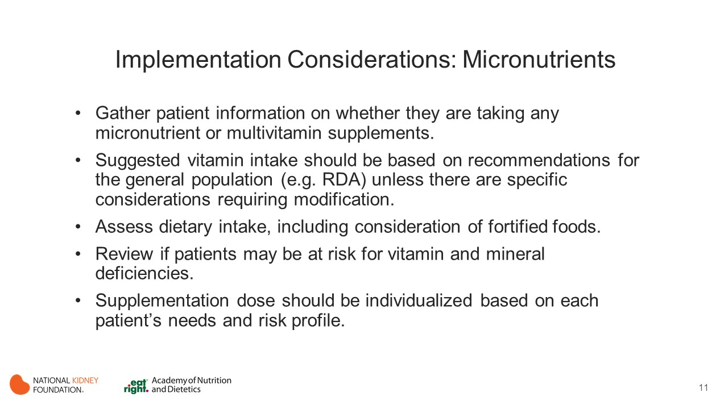
Notes:
Certain CKD populations might be at higher risk for micronutrient deficiencies due to issues such as pregnancy, gastric bypass surgery, anorexia and wasting syndrome, malabsorption conditions, vegetarian diets, and certain medication/nutrient interactions.
Nutrition Focused Physical Examination should be conducted to identify whether signs and symptoms of certain vitamin and mineral deficiency are present. These can be used in combination with laboratory measures to get a complete picture of the problem.
If patients with CKD are not meeting their recommended intake and have poor nutritional status, it is likely that they might be at risk for micronutrient deficiencies and appropriate intervention is required.

Slide 12
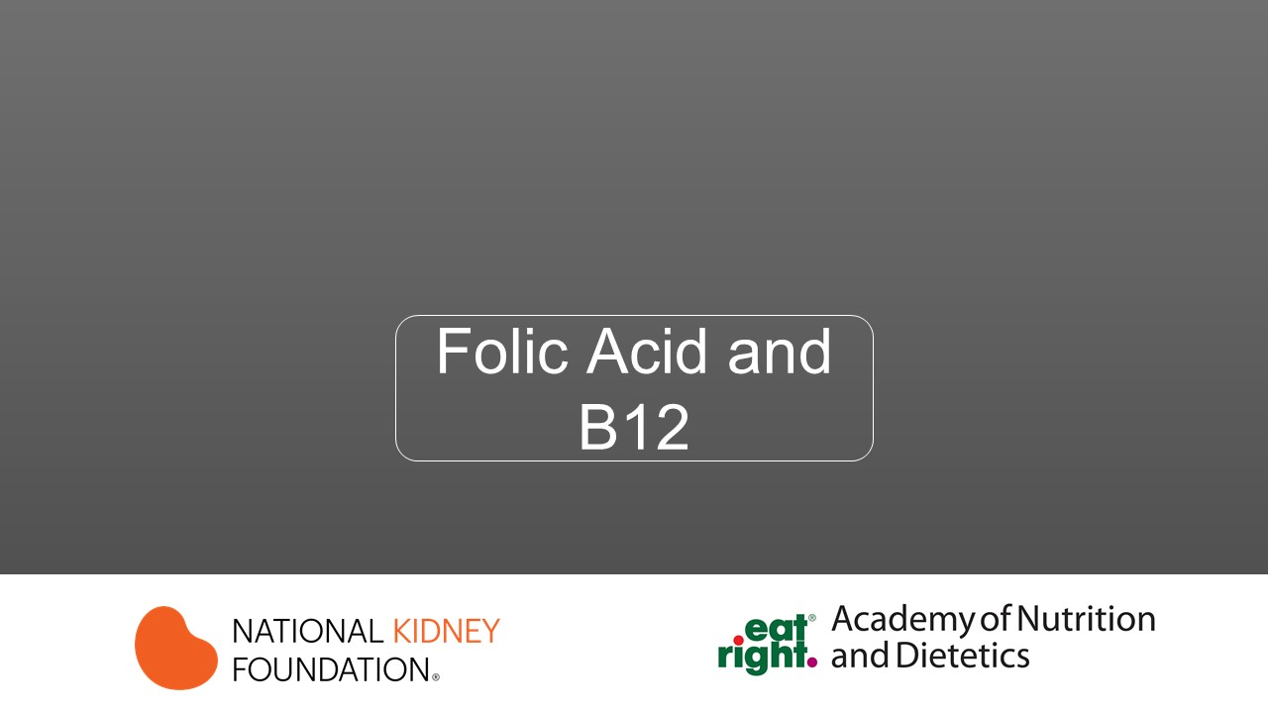

Slide 13
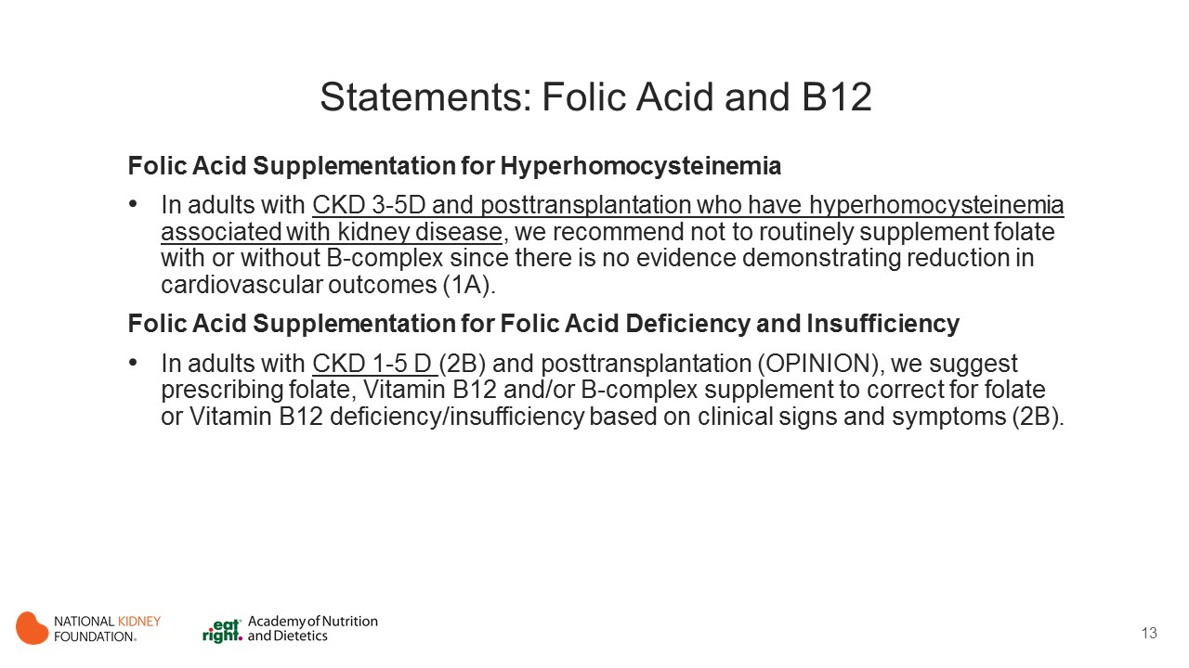
Notes:
Folic acid can be provided by dietary sources as well as over-the- counter nutritional supplements.
Over-the-counter supplements come in various forms, such as folic acid, methyl folate (also known as l-methyl folate, l-5-methyl folate, or MTHF), and folinic acid, among others.
Folic acid’s primary mechanism of action is its role as a 1-carbon donor. Folic acid is reduced to methyl folate, which helps transfer single methyl groups in various metabolic reactions in the body.
Folic acid also plays a role in the functioning of the nervous system, in DNA synthesis, and in cell division.
Food sources rich in folic acid include green leafy vegetables, fruits, yeast, and liver. Although intake of foods naturally rich in folic acid is limited in patients with CKD due to their high potassium content, folic acid deficiency among this patient population seems to be rare. This is especially true since 1996, when folic acid fortification of enriched cereal grain products was mandated in the United States and Canada.
Because folate, vitamin B₁₂, and vitamin B₆ assist in the conversion of homocysteine to methionine (and therefore reduce serum homocysteine levels), they have received considerable attention as a putative treatment for CVD in patients with CKD.

Slide 14
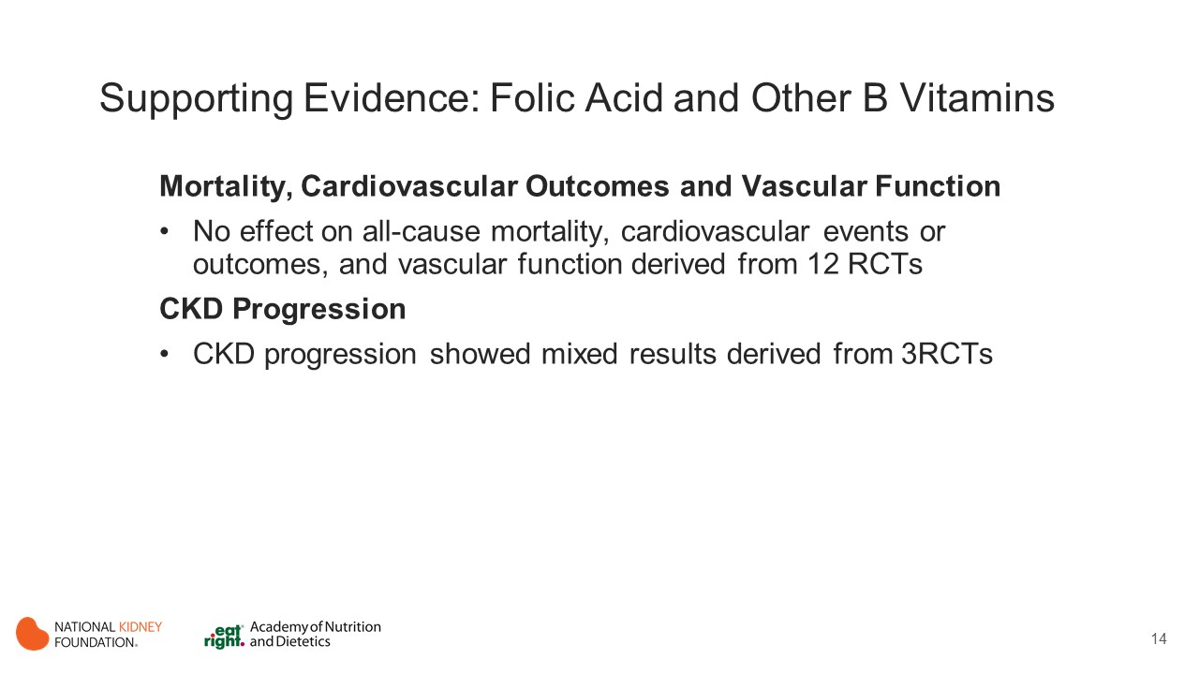
Notes:
Mortality, Cardiovasular Outcomes, Vascular Function
4 RCTs (duration 2-5 years) showed no effect of folic acid (2.5-40 mg/d) with vitamins B6 (1.4-100 mg/d) and B12 (150 µg/wk to 2 mg/d) on all-cause mortality and/or CV events in HD, PD and posttransplant. (Bostom 2011; Heinz 2010; Jamison 2007; Mann 2008)
2 RCTs of folic acid alone (1-5 mg/d for 4-40 weeks) showed not effect on flow-mediated dilation. (Thambyrajah 2000; van Guldener 1998)
4 RCTs of folic acid alone (1-15 mg/d over 1-3.6 years) did not alter risk for CV outcomes CKD stage 3 dialysis and non-dialysis. (Righetti 2003; Vianna 2007; Wrone 2004; Zoungas 2006)
2 RCTs of folic acid with other B vitamins (5-15 mg plus B-complex vitamin for 3-6 months) did not improve TC levels, intima media thickness, or BP in MHD patients. (Chang 2007; Tungkasereerak 2006)
CKD Progression
1 RCT (median duration 4.4 years) showed ACE inhibitor (enalapril) plus folic acid (0.8mg/d) significantly reduced the adjusted risk for CKD progression in CKD stage 3; compared with the group receiving enalapril and placebo. The limitation of this study was that a placebo-alone group (without enalapril) was not included. (Xu 2016)
2 RCTs showed no effect of supplementation with folic acid with vitamins B₆ and B₁₂ on the risk for dialysis initiation/ESRD in participants with stages 3-5 CKD and those post-transplantation. ((Bostom 2011; Jamison 2007)

Slide 15
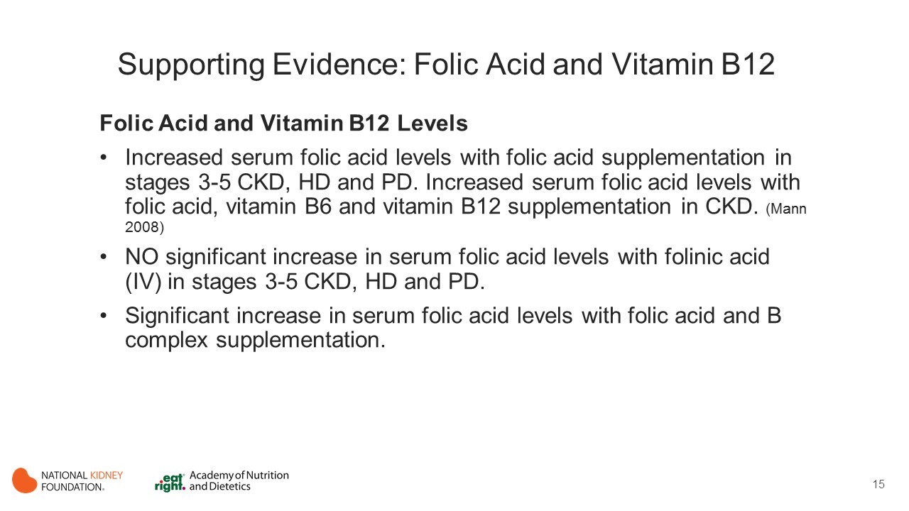
Notes:
Supplementation of Folic Acid
Six RCTs reported that supplementation of folic acid alone increased serum folic acid levels in participants with stages 3-5 CKD and those treated by MHD and PD. (Thambyrajah 2000; Zoungas 2006; Xu 2016; DeVecchi 2001; McCregor 2000; Sunder-Plassmann 2000)
When folic acid with vitamins B₆ and B₁₂ was provided, it is worth noting that serum folic acid levels increased with a daily intake of 5 mg for 3 months or a daily intake of 2.5 mg for a longer time frame.
In the Mann et al. study that included patients receiving MHD, serum folic acid levels significantly increased with an intake of 2.5 mg after 2 years of supplementation as compared with the control group.
In Chiu et al, supplementation of 3 mg of folinic acid weekly IV for 3 months did not result in a significant increase in serum folic acid levels in participants with stages 3-5 CKD or who were treated by MHD and PD.
Of the 10 studies that examined the effect of supplementation of folic acid with B complex, 9 found a significant increase in serum folic acid levels. Doses ranged from 2.5 to 60 mg of folic acid and study duration ranged from 4 weeks to 5 years. (Heinz 2010; Jamison 2007; Mann 2008; Chang 2007; Tungkasereerak 2006; Bostom 1995; Gonin 2003; Trimarchi 2002)

Slide 16
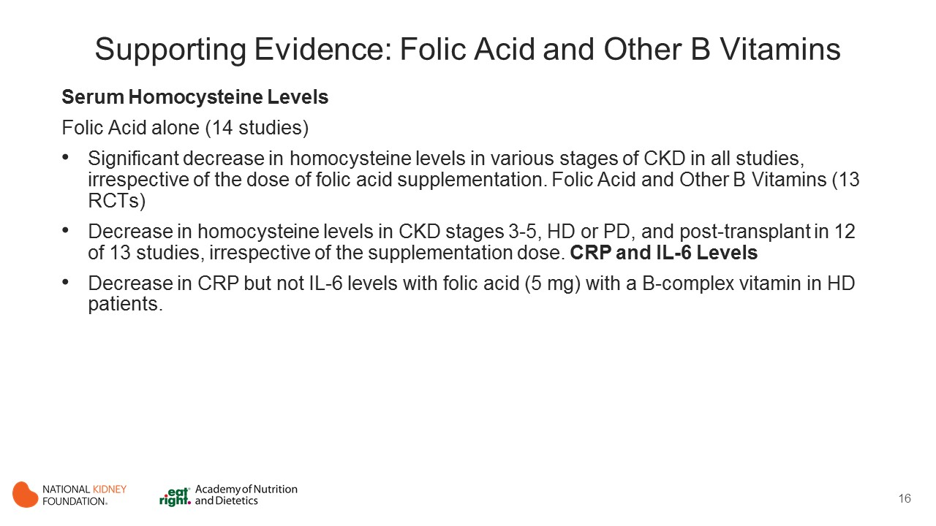
Notes:
Serum Homocysteine Levels
Fourteen studies examined the effect of folic acid supplementation alone on plasma homocysteine levels. Participants included CKD, nondialyzed (4 studies), receiving MHD (10 studies) and PD (4 studies), and posttransplant (1 study). In the 10 RCTs, folic acid supplements ranged from 0.8 to 60 mg/d and duration varied from 4 weeks to 4.4 years in patients with various stages of CKD. All but 1 study concluded that folic acid supplementation significantly decreased homocysteine levels. (Thambyrajah 2000; Righetti 2003; Vianna 2007; Wrone 2004; Zoungas 2006; Xu 2016; Alvares 2007; Bernasconi 2006; DeVecchi 2001; McGregor 2000; Nafar 2009; Ossareh 2009; Sunder-Plassmann 2000) except 1 (van Guldener 1998)
Thirteen RCTs examined the effect of supplementation with folate and other B vitamins on homocysteine levels. Twelve of 13 studies found that folic acid with other B vitamin supplementation decreased homocysteine levels in participants with CKD stages 3-5, treated by MHD or PD, and posttransplant. Supplementation doses in these studies ranged from 2.5 to 40 mg/d of folic acid (1 study used 3 mg of IV folinic acid per week), 1 µg/d of oral to 1,000 mg/wk of IV vitamin B₁₂, and 1.4 to 100 mg of vitamin B₆ and supplementation duration ranged from 8 weeks to 5 years. (Bostom 2011; Heinz 2010; Jamison 2007; Mann 2008; Chang 2007; Tungkasereerak 2006; Azadibakhsh 2009; Bostom 1995; Chiu 2009; Nakhoul 2004; Tamadon 2011; Trimarchi 2002)
CRP and IL-6 Levels
Daily oral folic acid (5 mg) with a B-complex vitamin for 3 months was associated with a decrease in CRP but not IL-6 levels in an RCT that included 121 patients receiving MHD. (Chang 2007)

Slide 17
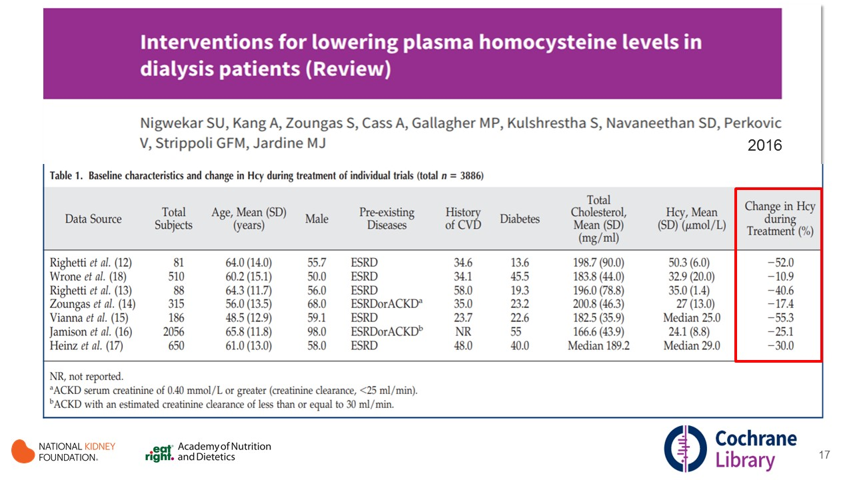
Notes:
Cochrane Database Systematic Review (Nigwekar 2016)
Objective: To evaluate the benefits and harms of established homocysteine lowering therapy (folic acid, vitamin B6, vitamin B12) on all-cause mortality and cardiovascular event rates in patients with ESRD.
Participants' mean age was 48 to 65 years, and proportions of male participants ranged from 50% to 98%.
Homocysteine-lowering therapy probably leads to little or no effect on cardiovascular mortality (4 studies, 1186 participants: RR 0.93, 95% CI 0.70 to 1.22).
There was no evidence of heterogeneity among the included studies (I² = 0%).
Homocysteine-lowering therapy had little or no effect on all-cause mortality or any other of this review's secondary outcomes.

Slide 18
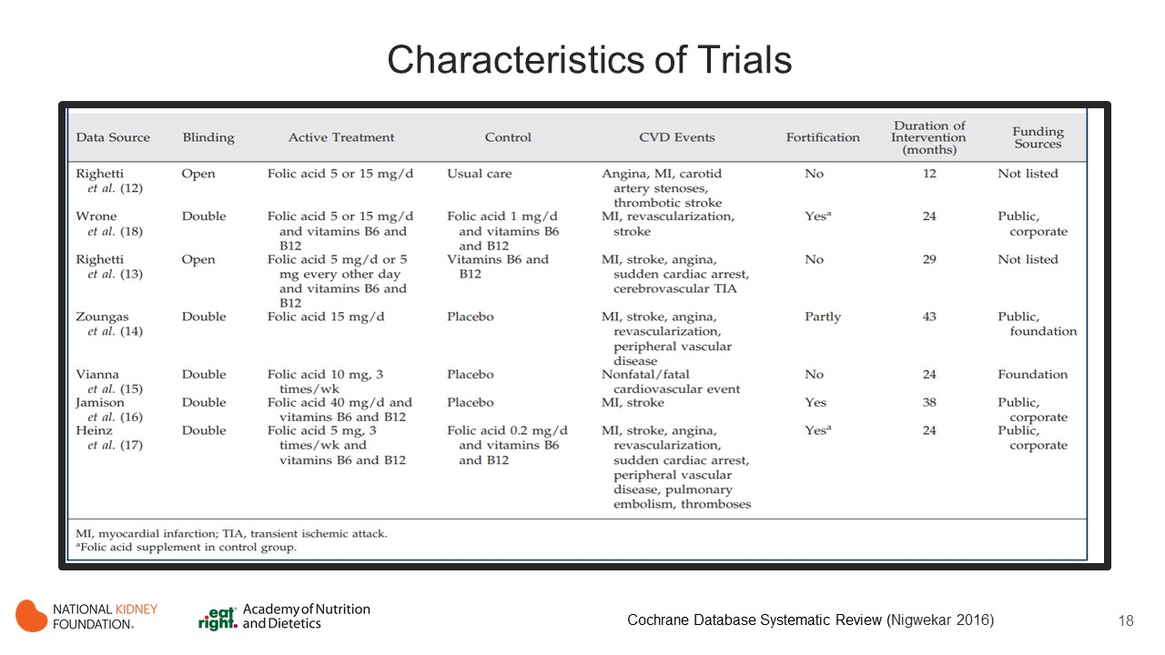
Notes:
Cochrane Database Systematic Review (Nigwekar 2016)
Interventions investigated were folic acid with or without other vitamins (vitamin B6, vitamin B12).
Study durations 12 to 43 months.
Homocysteine-lowering therapies were not found to reduce mortality (cardiovascular and all-cause) or cardiovascular events among patients with ESRD.

Slide 19
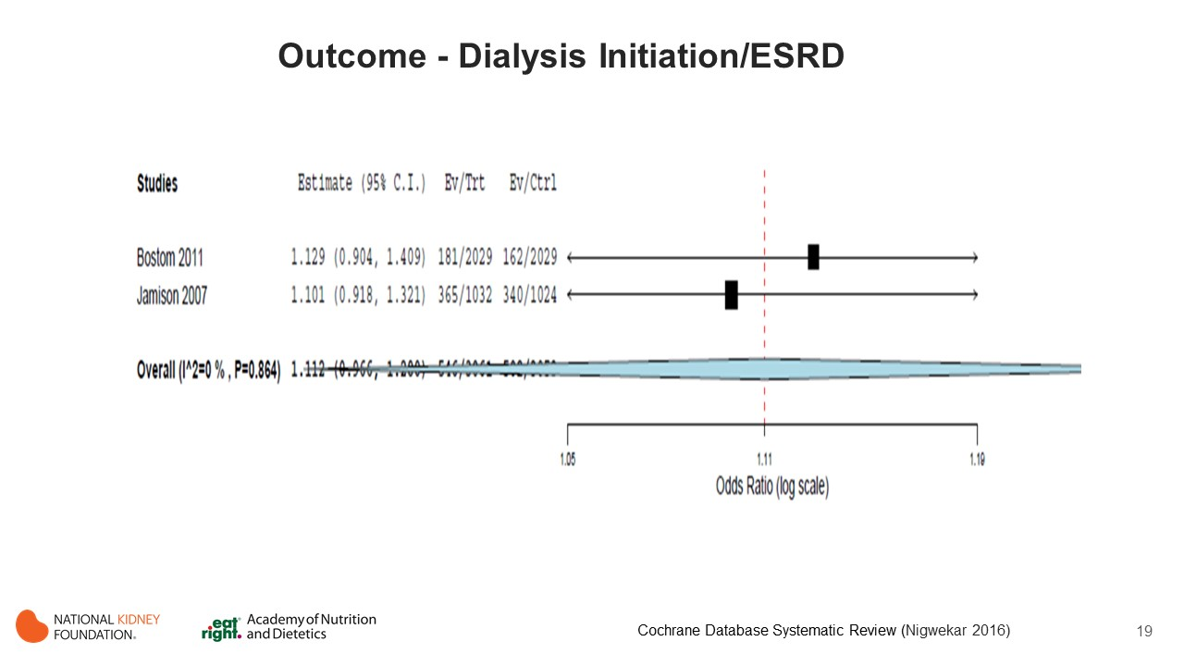
Notes:
Evidence Summary:
Two positive-quality RCTs with folic acid, B6, and B12 did not find any effect of supplementation on dialysis initiation/ESRD in stages 3-5 CKD and post-transplant participants. (Bostom 2011; Jamison 2007)
Intervention in Jamison, et al. consisted of an oral daily capsule of 40 mg folic acid, 100 mg pyridoxine (B6) hydrochloride, 2mg cyanocobalamin (B12) for a median of 3.2 yrs.
Intervention in Bostom, et al. entailed a high dose folic acid (5.0 mg), vitamins B6 (pyroxidine 1.4 mg) and B12 (cyanocobalamin 1.0 mg) for a median of 4 yrs.

Slide 20
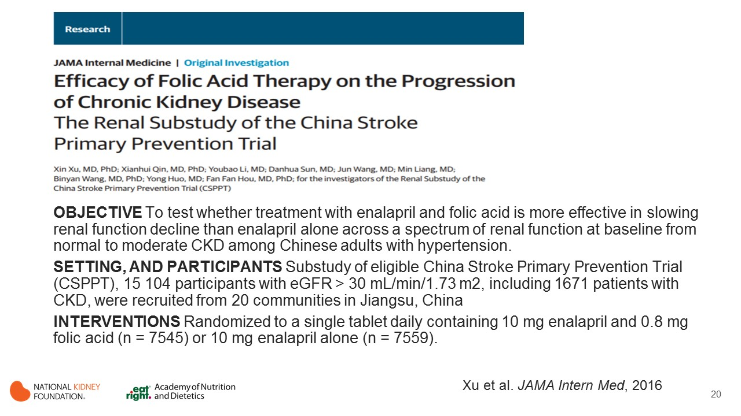
Notes:
Objective: To test whether treatment with enalapril and folic acid is more effective in slowing renal function decline than enalapril alone across a spectrum of renal function at baseline from normal to moderate chronic kidney disease (CKD) among Chinese adults with hypertension.
Design, setting, and participants: In this substudy of eligible China Stroke Primary Prevention Trial (CSPPT), 15 104 participants with an estimated glomerular filtration rate (eGFR) 30 mL/min/1.73 m2 or greater, including 1671 patients with CKD, were recruited from 20 communities in Jiangsu province in China.
Interventions: Participants were randomized to receive a single tablet daily containing 10 mg enalapril and 0.8 mg folic acid (n = 7545) or 10 mg enalapril alone (n = 7559).

Slide 21
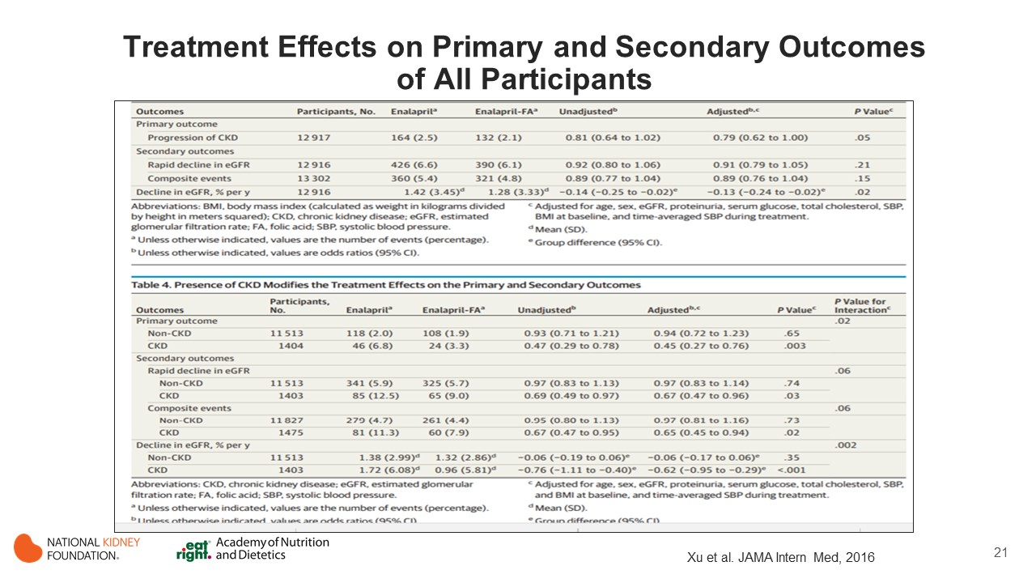
Notes:
Main outcomes and measures: The primary outcome was the progression of CKD, defined as a decrease in eGFR of 30% or more and to a level of less than 60 mL/min/1.73 m2 if the baseline eGFR was 60 mL/min/1.73 m2 or more, or a decrease in eGFR of 50% or more if the baseline eGFR was less than 60 mL/min/1.73 m2; or end-stage renal disease. Secondary outcomes included a composite of the primary outcome and all-cause death, rapid decline in renal function, and rate of eGFR decline.
Results: Overall, 15,104 Chinese adults with a mean (range) age of 60 (45-75) years were recruited; median follow-up was 4.4 years. There were 164 and 132 primary events in the enalapril group and the enalapril-folic acid group, respectively. Compared with the enalapril group, the enalapril-folic acid group had a 21% reduction in the odds of the primary event (odds ratio [OR], 0.79; 95% CI, 0.62-1.00) and a slower rate of eGFR decline (1.28% vs 1.42% per year; P = .02). Among the participants with CKD at baseline, folic acid therapy resulted in a significant reduction in the risks for the primary event (OR, 0.44; 95% CI, 0.26-0.75), rapid decline in renal function (OR, 0.67; 95% CI, 0.47-0.96) and the composite event (OR, 0.62; 95% CI, 0.43-0.90), and a 44% slower decline in renal function (0.96% vs 1.72% per year, P < .001). Among those without CKD at baseline, there was no between-group difference in the primary end point.
Conclusions and relevance: Enalapril-folic acid therapy, compared with enalapril alone, can significantly delay the progression of CKD among patients with mild-to-moderate CKD.

Slide 22
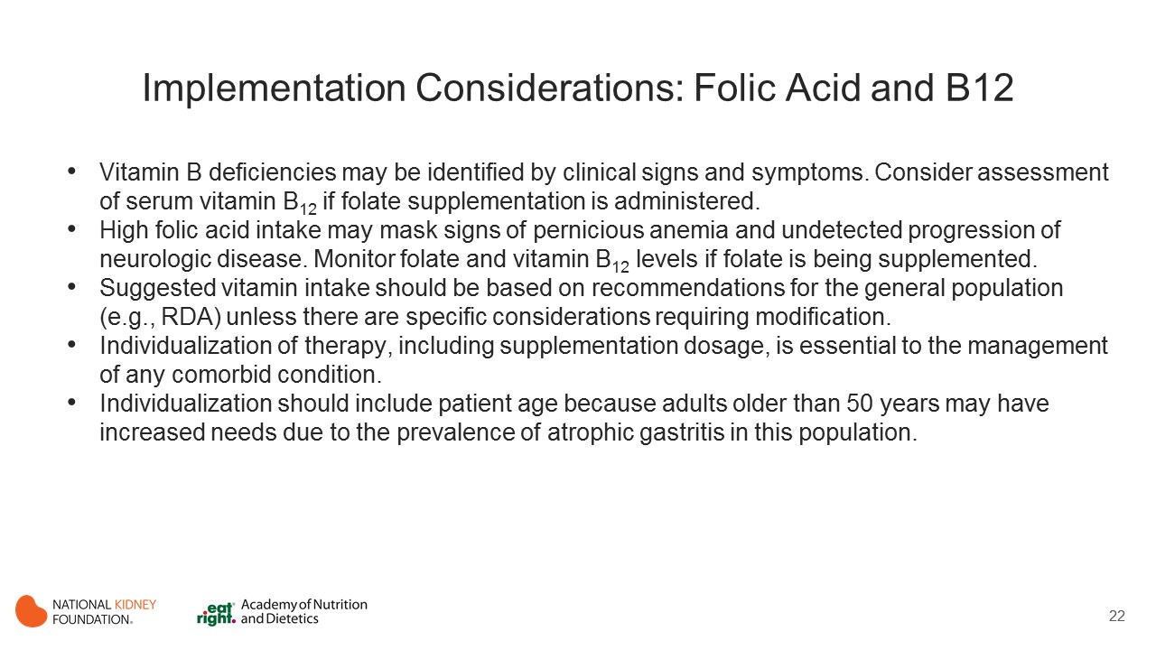
Notes:
Folate status is most often assessed through measurement of folate levels in plasma, serum, or red blood cells (RBCs).
Serum or plasma folate levels reflect recent dietary intake, so deficiency must be diagnosed by repeated measurements of serum or plasma folate. RBC folate levels are more reflective of folate tissue status than serum folate and represent vitamin status at the time the RBC was synthesized (i.e., longer-term folate status).
Excessive folate intake inhibits zinc absorption in the gut by forming a complex with zinc in the intestinal lumen.
High intake of folic acid may mask signs of pernicious anemia, leading to undetected progression of neurologic disease.
Older people have a higher risk for impaired GI function. Because absorption of vitamin B₁₂ is dependent on intrinsic factor and normal gut function and the latter is often at least partially impaired in older individuals, assessment of serum vitamin B₁₂ may be necessary if folate supplementation is considered.
Serum homocysteine, vitamin B₁₂, and folate level monitoring may be considered for patients who take certain medications such as methotrexate, nitrous oxide, 6-azaridine, phenytoin, carbamazepine, and oral contraceptives and have excessive alcohol intake that can interfere with folate absorption.

Slide 23
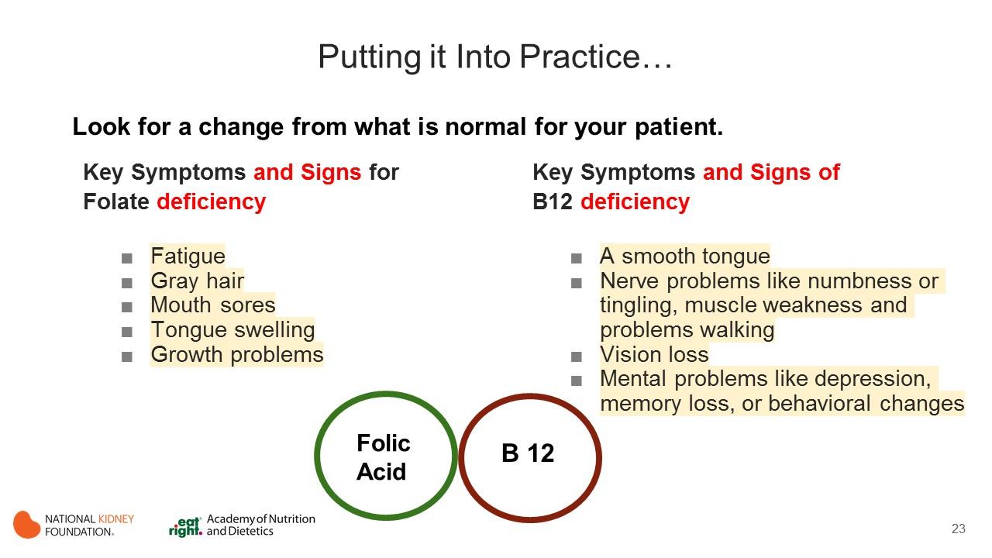
Notes:
Look for a change from what is a baseline for your patient if they are not currently being supplemented.
Signs of Folate Deficiency can be subtle
fatigue
gray hair
mouth sores
tongue swelling
growth problems
Signs of B12 deficiency are extensive as well and often overlap symptoms for other things.
Keep watch for the not so common symptoms such as.
A smooth tongue
Nerve problems like numbness or tingling, muscle weakness and problems walking
Vision loss
Mental problems like depression, memory loss, or behavioral changes

Slide 24
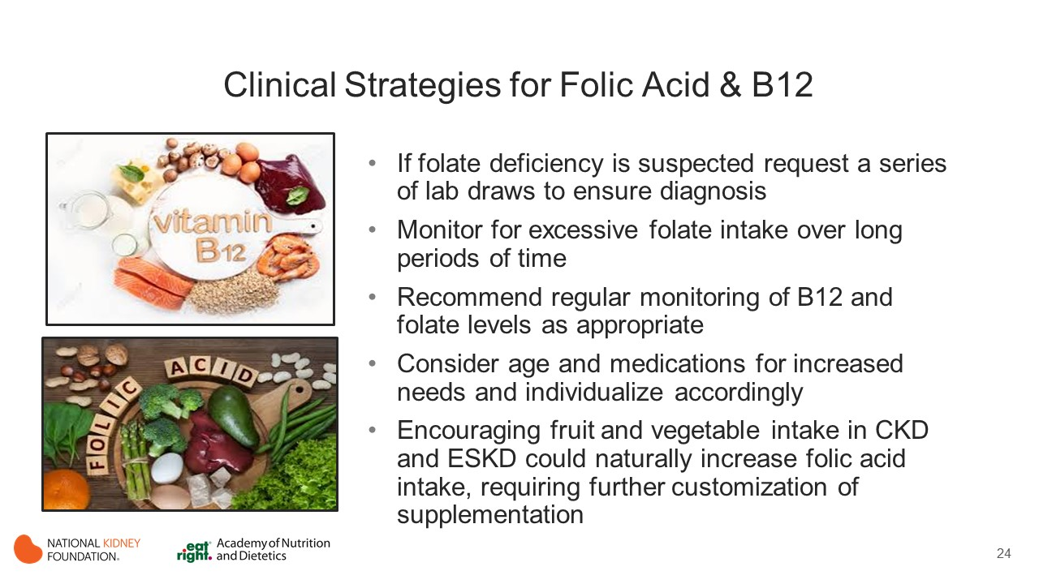
Notes:
Folic Acid and B12 go hand in hand.
If folate deficiency is suspected request a series of lab draws to ensure diagnosis
Monitor for excessive folate intake and over long periods of time. Patients often get prescribed supplementation but then re-evaluation can be overlooked.
Remember the RDA is 400 micrograms, and many renal vitamins provide at least 800mcg up to 1 mg. In some cases supplementing just folate and B 12 separately could be beneficial if intakes are high.
Recommend regular monitoring of folate and B12 when supplementing especially if anemia is not already diagnosed, due to the masking of pernicious anemia by high folate intake.
Review pertinent co-factors such as age, medications (i.e. antacids, anti-inflammatory medications, antibiotics, anticonvulsants antidiabetic, birth control, cholesterol-lowing, diuretics, ulcer medication) and alcohol use when recommending supplementation.
As more fresh fruits and vegetables are encouraged in CKD and in ESKD intake of these could naturally increase as well, potentially calling for further customization in supplementation.

Slide 25


Slide 26
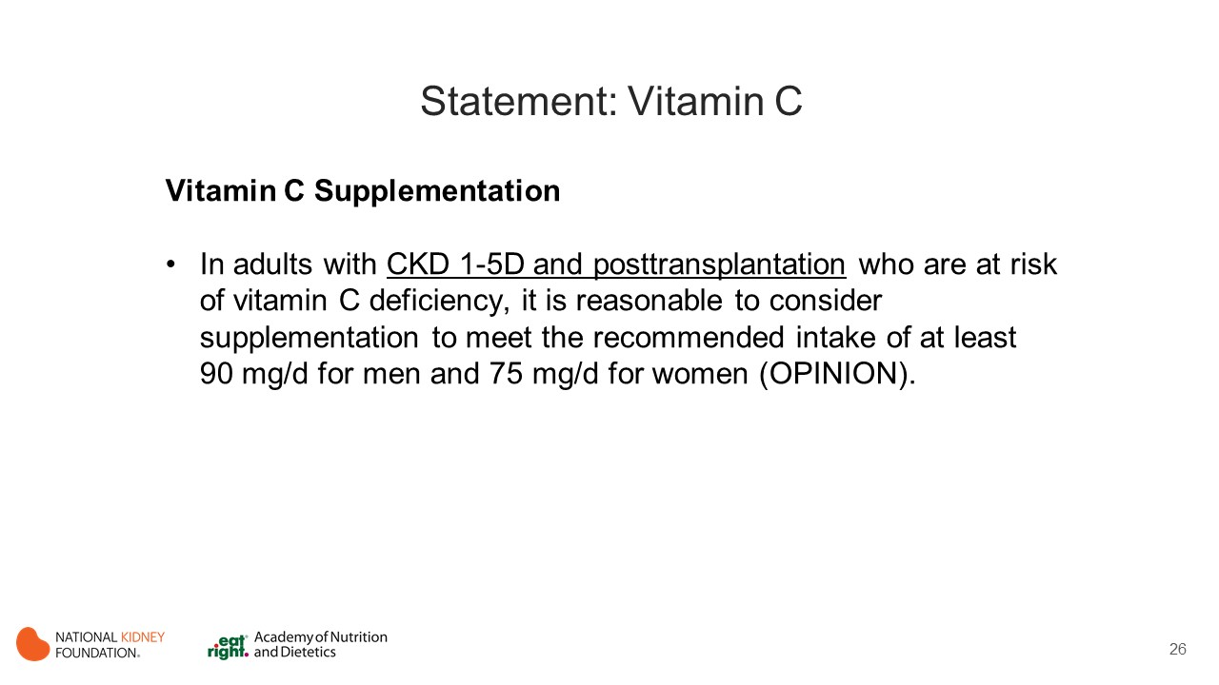
Notes:
A daily supplement of 75–90 mg vitamin C is reasonable to consider.
Rationale:
Vegetables and fresh fruit are the main sources of vitamin C, but these foods are often restricted or need to be avoided in a potassium restricted diet, resulting in an inadequate intake.
Vitamin C is inactivated by heat during cooking.
Vitamin C is readily removed by dialysis as reported by Wang et al. [6]. Serum levels fell by 30–40% after a single dialysis session and losses from 80 to 280 mg per dialysis session have been reported [3].
Vitamin C deficiency contributes to a mild form of scurvy sometimes seen in MHD patients, may lead to abnormal amino acid metabolism and disturbances in folic acid metabolism.
High doses of vitamin C (e.g. 500–1000 mg daily) should be avoided in MHD patients because of tissue oxalate deposition in response to increased oxalates levels which may deposit in tissues.

Slide 27
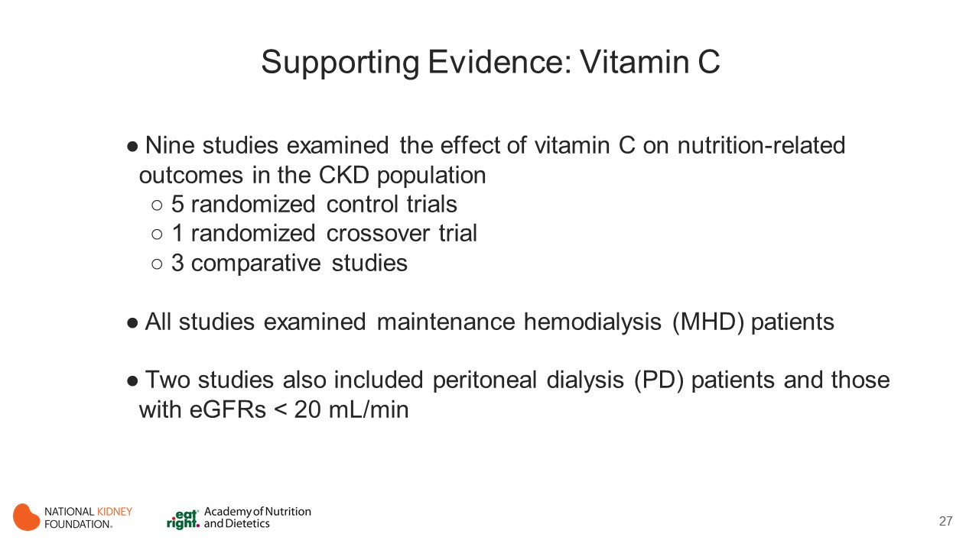
Notes:
Nine studies examined the effect of vitamin C on nutrition-related outcomes in the CKD population, including 5 RCTs,1 randomized crossover trial and 3 comparative studies.
All studies examined MHD patients.
Two studies also included PD patients and those with eGFRs < 20 mL/min.

Slide 28
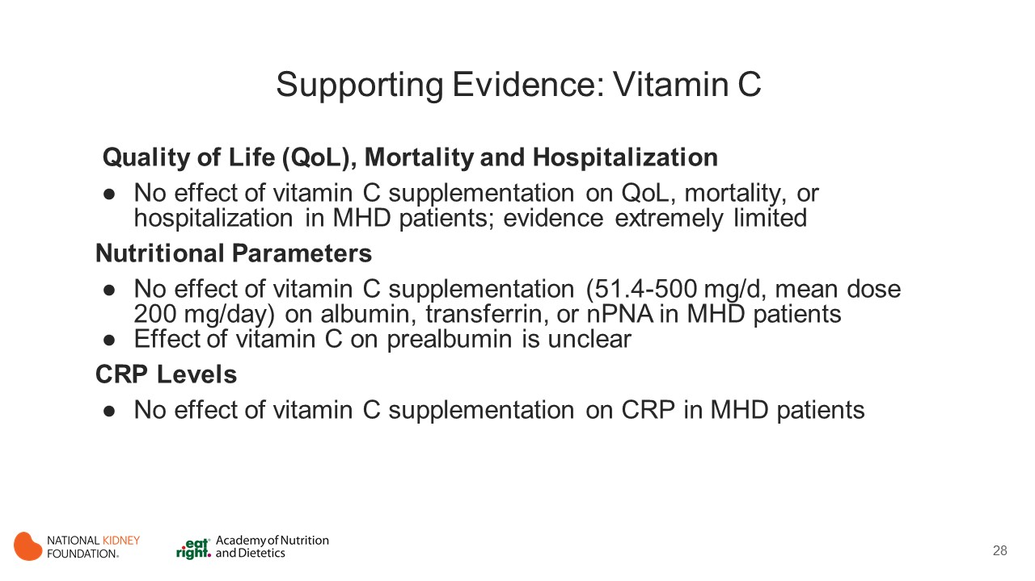
Notes:
QoL, Mortality and Hospitalization
In adults with CKD, 1 RCT [250 mg of oral ascorbic acid 3 times per week for 3 months] (Singer 2011) and 1 comparative study [500 mg of oral vitamin C per day for 2 years] (Ono 1989) measured the effect of vitamin C supplementation, compared with either a placebo or control, on hard outcomes, including all-cause mortality, QoL or hospitalization events.
Singer reported no changes in symptom, cognitive, or nausea subscales of the Kidney Disease Quality of Life Short Form (KDQOL-SF) in either the vitamin C–supplemented or placebo groups in MHD/PD participants. QoL was the primary outcome of interest.
Approximately 40% of participants were vitamin C deficient at baseline. In a comparative study by Ono, there were no differences in mortality rates or hospitalization events between vitamin C–supplemented and non supplemented periods in MHD participants. Mortality was a primary outcome measure. Baseline vitamin C status was not reported.
In summary, vitamin C supplementation did not affect QoL, mortality, or hospitalizations in MHD patients, but evidence was extremely limited. Evidence-based recommendations for the use of vitamin C in this patient population for these endpoints could not be provided.
Nutritional Parameters
Three studies examined the effect of vitamin C supplementation on nutritional status in MHD participants: 1 RCT (Fumeron 2005), 1 randomized crossover trial (Zhang 2013) and 1 comparative study (DeVries 2008). However, nutritional status was not the primary outcome of interest.
In Zhang et al, all patients were vitamin C deficient at baseline, while in De Vriese et al, 44% of participants were deficient at baseline. In Fumeron (2005) et al, vitamin C deficiency status at baseline was unclear.
All 3 studies reported no effect of supplementation on albumin levels, as did pooled analysis of 2 of the RCTs.
Zhang (2013) et al measured the effect of vitamin C supplementation on prealbumin levels in a randomized crossover trial with MHD participants. Although 1 supplemented group experienced an increase in prealbumin levels after 3 months of supplementation with 200 mg of vitamin C, prealbumin levels did not change in the other group after the same intervention. Therefore, the effect of vitamin C supplementation on prealbumin levels is unclear.
Fumeron et al supplemented MHD participants with 750 mg/wk of vitamin C for 2 months. There were no significant changes in transferrin levels in either group.
De Vriese et al measured normalized protein nitrogen appearance (nPNA) in an NRCT and found no effect of vitamin C supplementation on nPNA following supplementation with 360 mg/wk or 1,500 mg/wk for 9 months in MHD patients.
CRP Levels
Three studies examined the effect of oral vitamin C supplementation on CRP levels in MHD participants and found no significant effects compared with the placebo or control groups, but evidence was limited (Fumeron 2005; Zhang 2013; DeVries 2008).

Slide 29
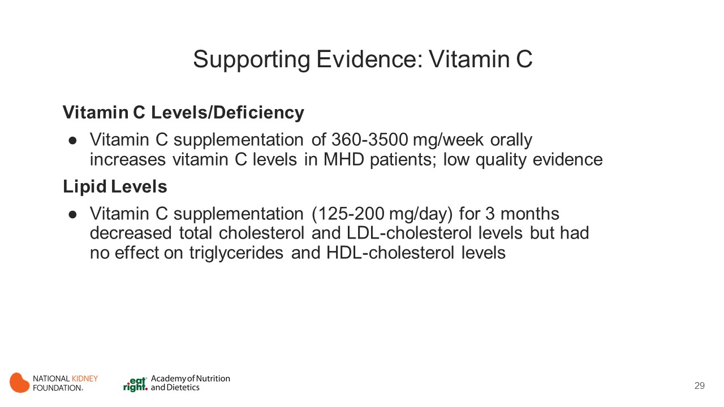
Notes:
Vitamin C Levels/Deficiency
Four RCTs (Zhang 2013; Abdollahzad 2009; Fumeron 2005; Singer 2011) and 2 comparative studies (De Vries 2008; Ono 1989) examined the effect of vitamin C supplementation in doses ranging from 360 to 3,500 mg/wk and duration ranging from 3 months to 2 years.
In summary, oral vitamin C supplementation increased serum vitamin C levels in MHD patients and decreased the proportion of participants who were vitamin C deficient/insufficient (cutoffs were 11.44 and 23.0 µmol/L).
However, in pooled analysis of 3 RCTS, the increase in vitamin C levels may not be clinically significant. The quality of evidence in this regard remains low. Other CKD populations such as nondialysis CKD 1-5, PD, and posttransplant participants remain poorly studied.
These studies did not analyze the effects of vitamin C supplementation on optimal dosing or thresholds for toxicity. The potential for toxicity was acknowledged with dosage ranges maintained at 200 to 250 mg daily or 3 times weekly in most studies. The study by Ono that dosed MHD patients with 500 mg of oral vitamin C daily for 2 years reported an aggravation of hyperoxalemia. De-Vriese et al. had participants dosed at 360 mg/wk for 0 to 3 months followed by 1,500 mg/wk dosing for 3 to 6 months and then no supplementations for 6 to 9 months in MHD patients. This study reported an increase in plasma malondialdehyde levels. Supplementation with vitamin C increased the low levels, but there is a potential risk for toxicity that requires monitoring.
Lipid Levels
The results of 3 trials demonstrated that vitamin C supplementation of 125 to 200 mg/d for 3months may decrease TC and LDL-C levels, but there was no effect on TG or HDL-C levels. Vitamin C supplementation of 125 to 200 mg/d decreased the LDL-C:HDL-C ratio or prevented the increase seen in the placebo group. (Abdollahzad 2009; Khajehdehi 2001; DeVriese 2008)
There were several limitations to this evidence, including a small number of studies, small sample sizes, and low evidence quality.
It is important to note that the study by Khajehdehi et al (2001) included supplementing patients with potentially toxic doses of ergocalciferol, 50,000 IU, daily for 3 months. The impact of this amount of vitamin D on study outcome parameters, if any, cannot be ascertained.

Slide 30
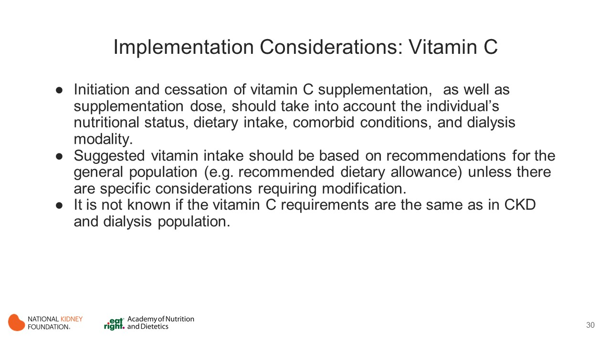
Notes:
Limited number of studies are available and those that are have no hard outcome data. These findings do not preclude the importance of assessing for vitamin C supplementation or when to discontinue supplementation.
Current nutritional requirements or Recommended Dietary Intake of vitamin C for individuals with CKD stages 1-5D and posttransplant are not known and are based on those from the general population - 90 mg/day for men and 75 mg/day for women.
The prevalence of vitamin C deficiency may vary according to CKD stage and dialysis modality.
Individualized decision-making approach is required to decide if vitamin C supplementation is required. The decision to supplement or discontinue supplementation should take into account patient’s overall nutritional status, vitamin C intake, their comorbid conditions, medications and any losses via dialysis.

Slide 31
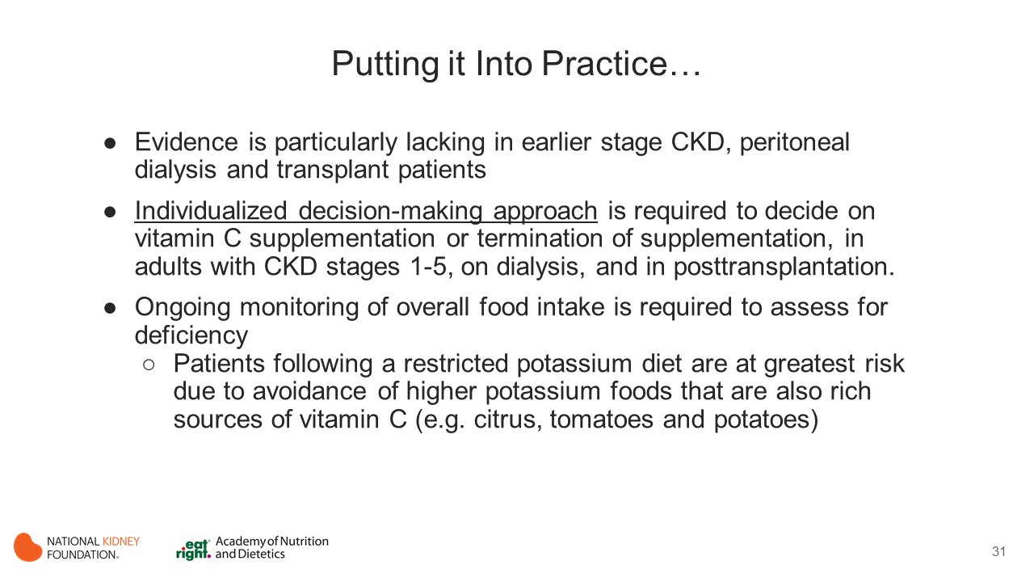

Slide 32
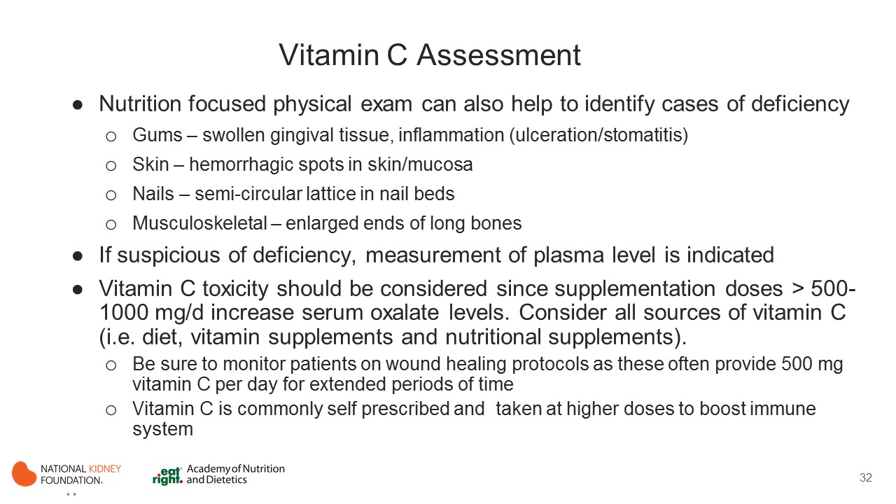
Notes:
Ongoing monitoring of overall food intake is required to assess for vitamin C deficiency. Careful review of usual food intake is necessary to make this decision. Keep in mind that those following lower potassium diets are at greatest risk of insufficient vitamin C intake as higher potassium foods are also typically the richest sources of vitamin C in the diet (e.g. citrus, tomatoes and potatoes).
An individualized approach to evaluation and monitoring of vitamin C status is ideally accomplished by a multidisciplinary care team that includes healthcare provider and RDN. Nutrition focused physical exam is helpful in identifying deficiency.
If suspicious of deficiency, measurement of plasma level is indicated. Note that administration of vitamin C appears to correct for deficiency/insufficiency but no clear evidence for improved outcomes.
Toxicity is a possible concern of excessive vitamin C supplementation as oxalate is a metabolite of vitamin C and can lead to hyperoxalemia. (Baxmann 2003) All sources of vitamin C intake must be considered. In addition to diet, inquiry regarding vitamin supplements and nutritional supplements is needed. Note that patients with wounds may be prescribed higher doses of vitamin C to promote wound healing. Also, vitamin C is commonly self prescribed to boost immune function, especially during cold and flu season (e.g. vitamin C taken in supplement form or as a key ingredient in over the counter preparations such as Emgern-C or Airborne).

Slide 33


Slide 34
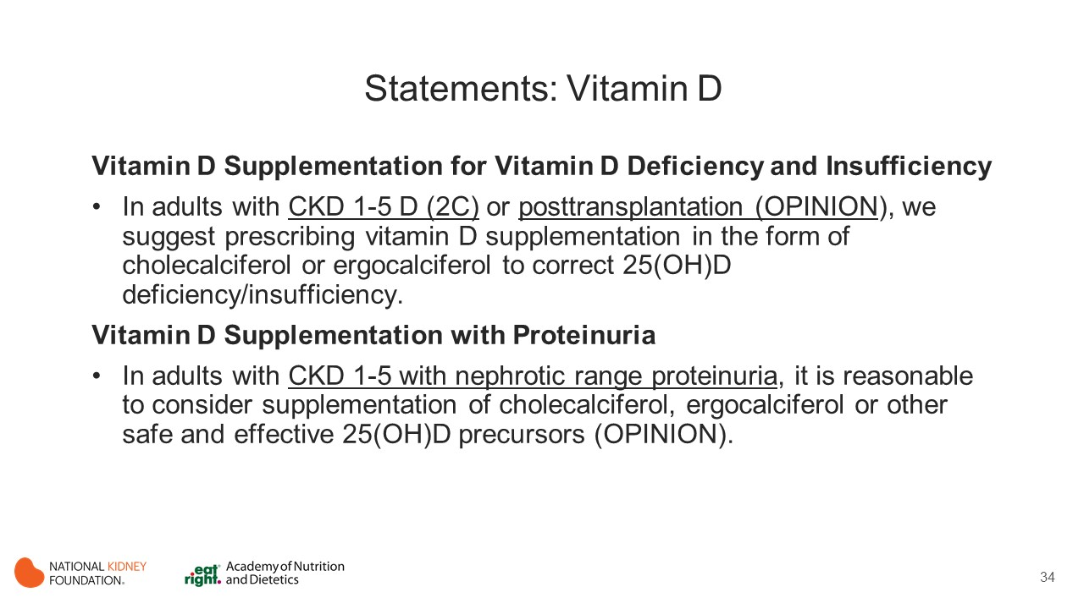
Notes:
A number of factors or conditions are implicated in suboptimal vitamin D status in patients with CKD, including aging, diabetes mellitus, obesity, reduced sun exposure, loss of urinary/dialysate vitamin D binding protein, impaired tubular 25(OH) reabsorption, and dietary restrictions.
Considering the high prevalence of vitamin D deficiency/insufficiency in CKD/ESRD and the potential benefits of restoring vitamin D status, the KDIGO (2017) clinical practice guidelines and KDOQI Commentary (2017) for CKD–mineral and bone disorder (CKD-MBD) have proposed ergocalciferol or cholecalciferol supplementation.

Slide 35
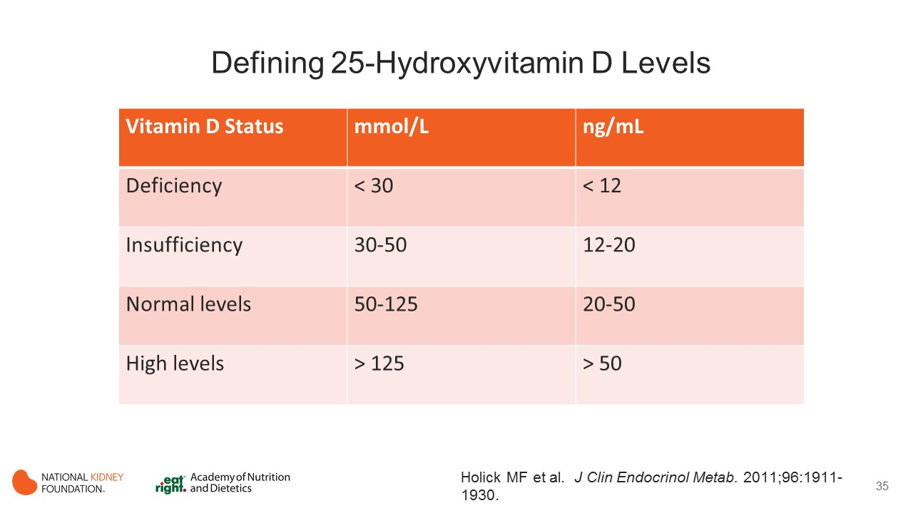
Notes:
Insufficiency/deficiency of vitamin D, assessed by serum concentration 25(OH)D, has been found to be common in the general population and even more prevalent in patients with CKD stages 3-5D.
For most experts, vitamin D insufficiency is defined as serum 25(OH)D level between 20 and 29 ng/mL, deficiency is considered as 25(OH)D levels < 20 ng/mL, and sufficiency as serum 25(OH)D levels ≥ 30 ng/mL. (Hollick 2011)

Slide 36
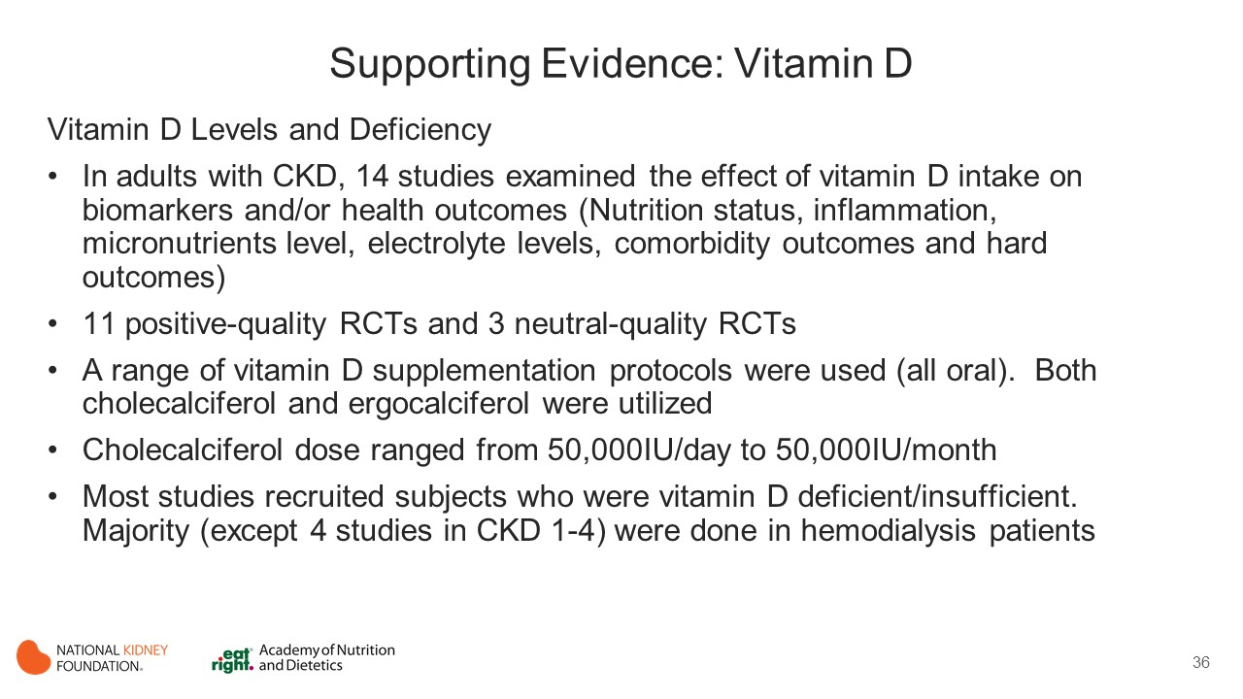
Notes:
14 RCTs examining the effect of vitamin D intake on biomarkers and/or health outcomes
11 positive-quality RCTs (Alvarez 2012; Alvarez 2013; Armas 2012; BCholhan 2015; Chandra 2008; Dalanaye 2013; Hewitt 2013; Marckmann 2012; Massart 2014; Miskulin 2016 and Seibert 2013) and 3 neutral-quality RCTs (Khajehdehi 2000; Mager 2016 and Tokmak 2008).
Vitamin D supplementation protocols varied. Both cholecalciferol and ergocalciferol were utilized.
Most studies recruited subjects who were vitamin D deficient/insufficient.

Slide 37
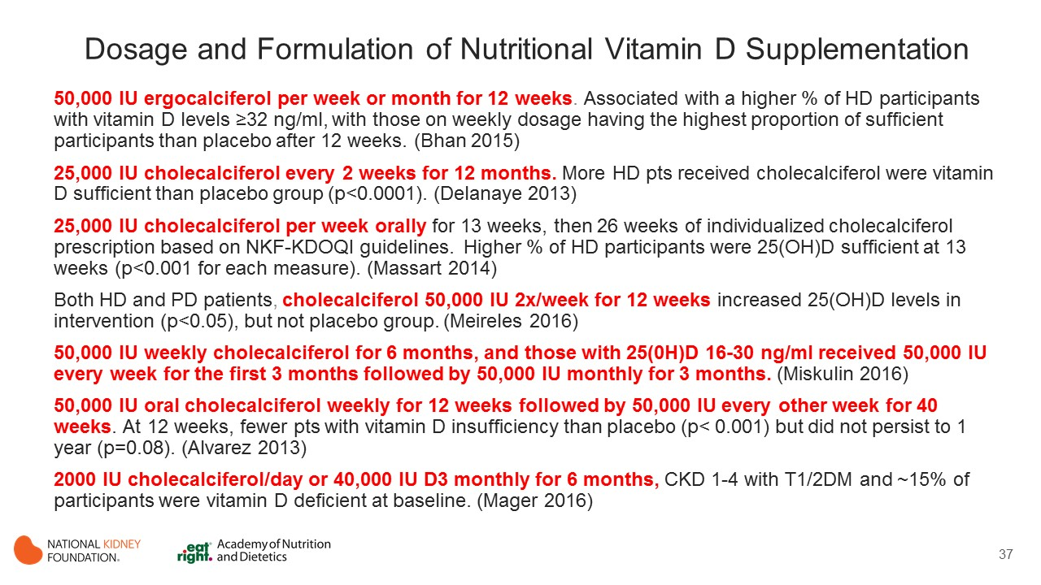
Notes:
A meta-analysis was conducted to determine the odds of vitamin D sufficiency according to vitamin D supplementation, which included Bhan et al (each group compared with the placebo group), Delanaye et al, Massart et al, and Alvarez et al.
Participants who were supplemented with vitamin D had an odds ratio (OR) of 9.31 (95% CI, 3.38-24.7; P < 0.001) of being vitamin D sufficient (defined as either >30 or 32 ng/mL), though there was moderate heterogeneity in the data (I² = 51.84; P = 0.08).

Slide 38
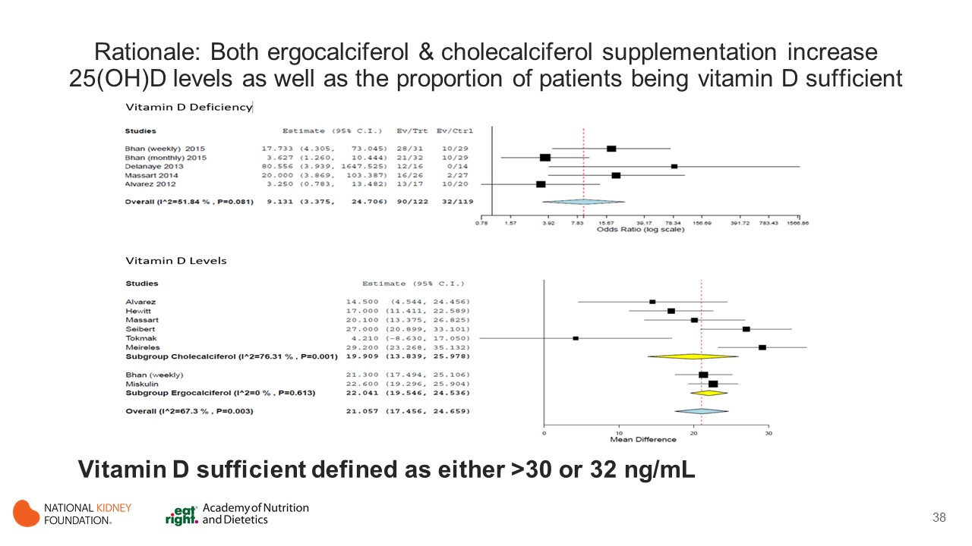
Notes:
Additionally, data from 8 studies were pooled to determine the mean difference in vitamin D levels according to vitamin D supplementation. There was a mean increase of 21.06 (95% CI, 17.46-24.66) ng/mL in the vitamin D–supplemented groups compared with the placebo groups, but heterogeneity was moderate (I² = 67.3%; P = 0.003), so results should be interpreted with caution.

Slide 39
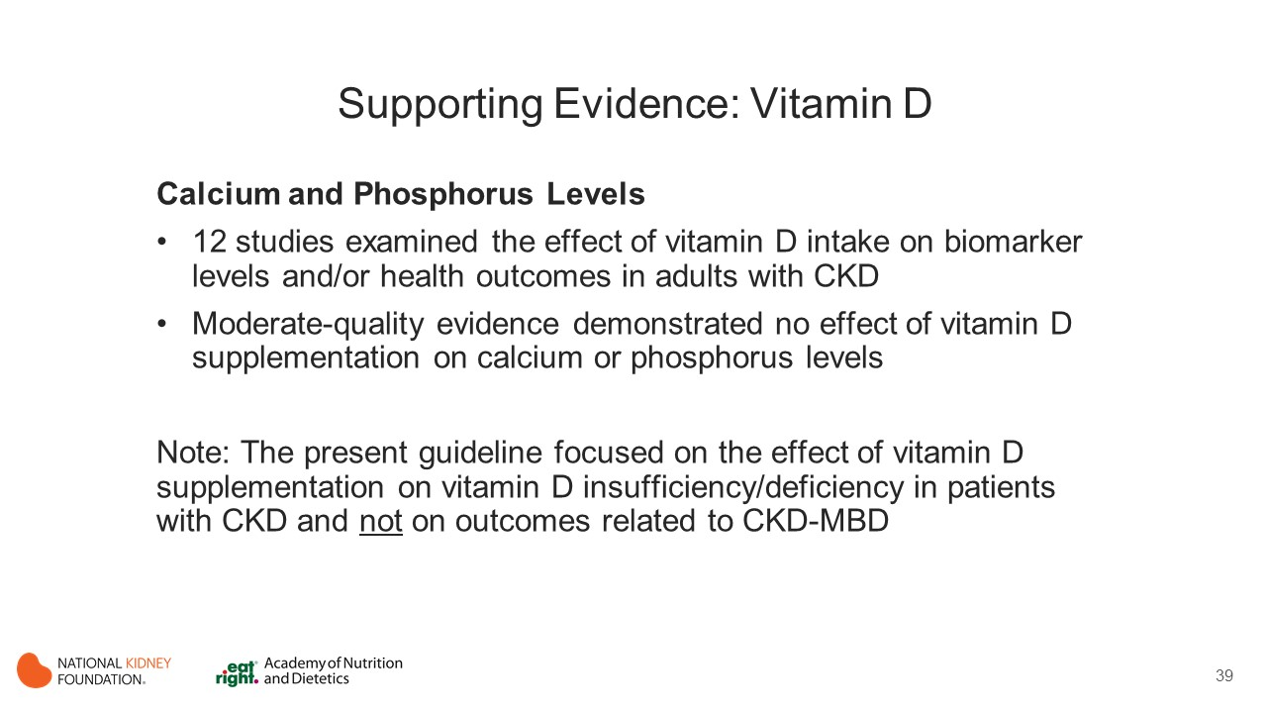
Notes:
Calcium
12 studies (Khajehdehi 2000; Bhan 2015; Miskulin 2016; Alvarez 2012; Armas 2012; Chandra 2008; Delanaye 2013; Mager 2017; Marckmann 2012; Massart 2014; Meireles 2016; and Seibert 2017)
In predominantly vitamin D–deficient participants, there was no effect of ergocalciferol supplementation on calcium levels in doses of 50,000 IU per week or per month or in individualized doses. (Bhan 2015; Miskkulin 2016)
The effect of cholecalciferol on calcium levels was unclear, with 7 studies finding no effect on calcium levels and 3 studies determining that supplementation increased calcium levels.
In Massart et al (2014) , there was no effect of 25,000 IU weekly of cholecalciferol on proportion of HD participants reaching target levels at 3 months. There was no clear pattern of effect according to participant population, deficiency status, or vitamin D dosage.
In pooled analysis of 4 studies in which data could be combined, there was no effect of vitamin D supplementation on calcium levels (mean difference, 0.07 [95% CI, −0.18 to 0.31] mg/dL).(Khajehdehi 2000; Miskulin 2016; Delanaye 2013; Seibert 2017)
Phosphorus
Vitamin D supplementation had no effect on phosphorus levels with ergocalciferol supplementation (2 studies with doses of 50,000 IU per week or per month or in individualized doses) or cholecalciferol doses ranging from 50,0000 IU/d to 50,000 IU/mo (10 studies).
In pooled analysis of 5 RCTs, there was no effect of vitamin D supplementation on phosphorus levels (mean difference, −0.15 [95% CI, −0.44 to 0.15] mg/dL). (Khajehdehi 2000; Miskulin 2016; Delanaye 2013; Seibert 2017)
Due to the complex nature of vitamin D, the present guideline focused on the effect of vitamin D supplementation on vitamin D insufficiency/deficiency in patients with CKD and not on outcome related to CKD-MBD (such as PTH) or other clinical disturbances.

Slide 40
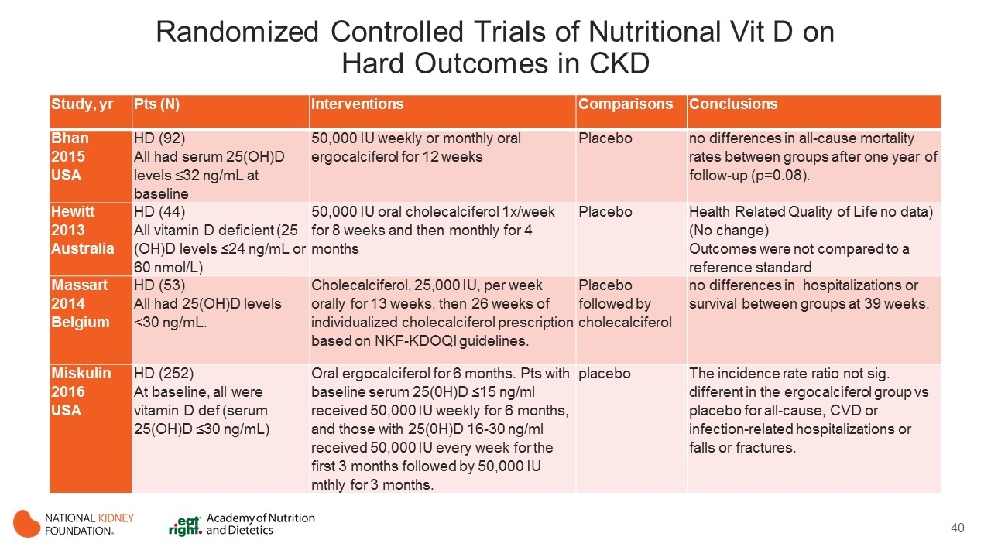
Notes:
Four randomized controlled trials of nutritional vitamin D supplementation (ergocalciferol or cholecalciferol showed not difference on hard outcomes (including all-cause mortality, quality of life, hospitalizations or survival, and all cause CVD or infection-related hospitalizations or falls or fractures).

Slide 41
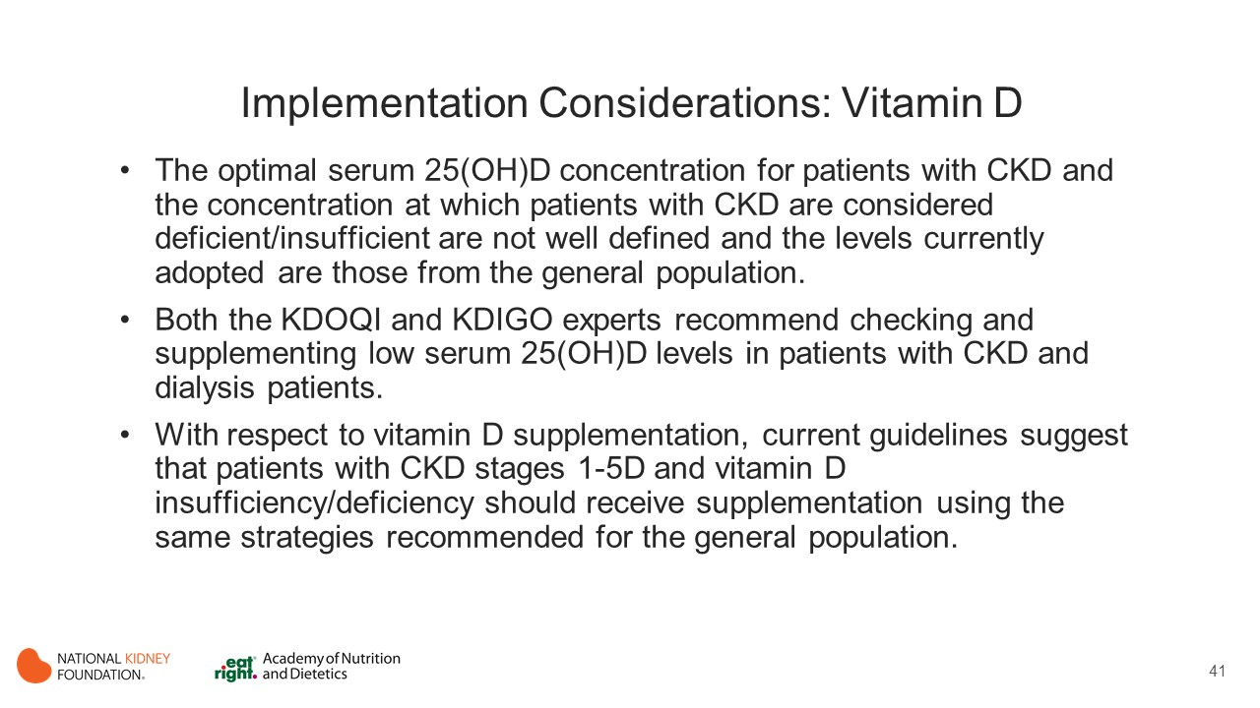
Notes:
The optimal serum 25(OH)D concentration for patients with CKD and the concentration at which patients with CKD are considered deficient/insufficient are not well defined but are generally considered to be the same as in the general population, although there is no absolute consensus about the definition of vitamin D sufficiency.
Both the KDOQI and KDIGO experts recommend checking and supplementing low serum 25(OH)D levels in patients with CKD and dialysis patients. In the most recent update of the KDIGO guideline on CKD-MBD it is suggested based on low-quality evidence that patients with CKD stages 1-5D have 25(OH)D levels measured, and repeated testing should be individualized according to baseline values and interventions. However, there was no clear suggestion on how frequently 25(OH)D levels should be reviewed.³⁴⁰
With respect to vitamin D supplementation, current guidelines suggest that patients with CKD stages 1-5D and vitamin D insufficiency/deficiency should receive supplementation using the same strategies recommended for the general population. However, even for the general population, the optimal dosage of supplementation varies among the main guidelines. It has been recommended for 1,000 to 2,000 IU/d of cholecalciferol for vitamin D repletion for the general population. However, KDOQI acknowledges that patients with CKD may require a more aggressive therapeutic plan.

Slide 42
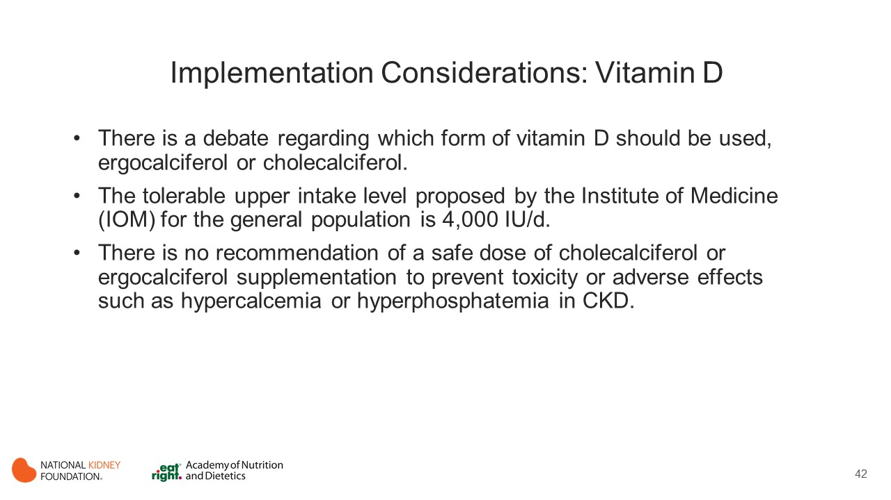
Notes:
There is also a debate regarding which form of vitamin D should be used, ergocalciferol or cholecalciferol. In the general population, there appears to be some advantage of using cholecalciferol over ergocalciferol.³⁶² Because in CKD there is no clear evidence about the superiority of cholecalciferol, clinicians should use the form commercially available in the context of their clinical practice.
The tolerable upper intake level proposed by the IOM for the general population is 4,000 IU/d.³⁶³ There is no recommendation of a safe dose of cholecalciferol or ergocalciferol supplementation to prevent toxicity or adverse effects such as hypercalcemia or hyperphosphatemia in CKD. However, periodical measurement of serum calcium and phosphorus should be considered, especially for patients who are using calcium-containing phosphate binders and/or vitamin D active analogues.

Slide 43
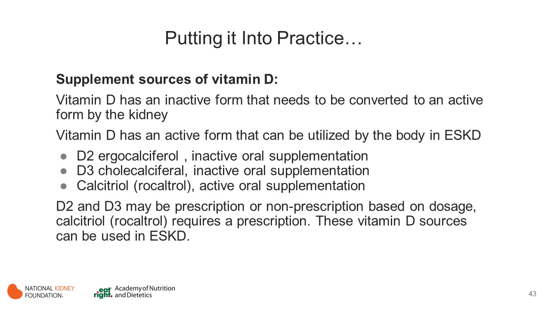

Slide 44
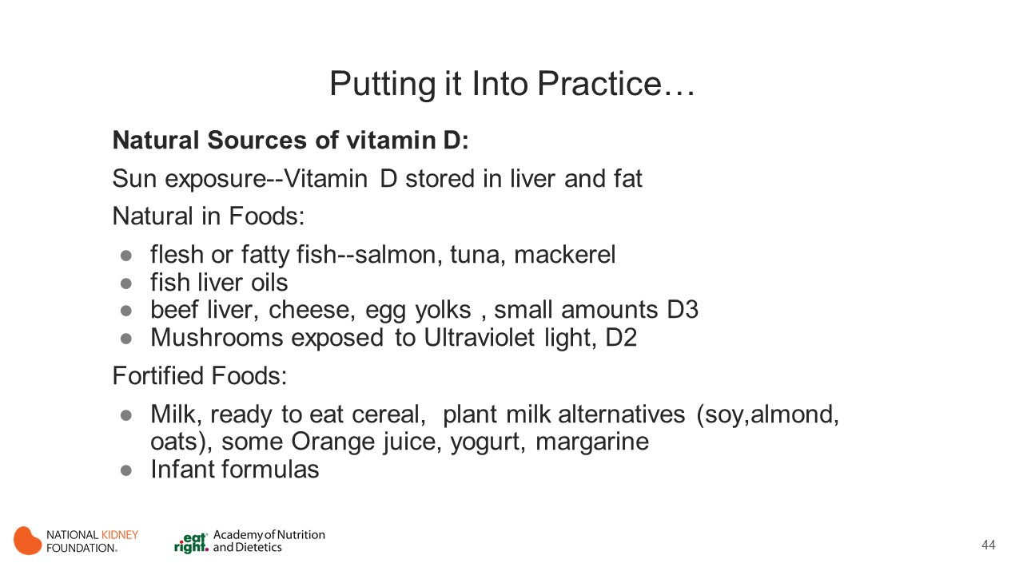

Slide 45


Slide 46
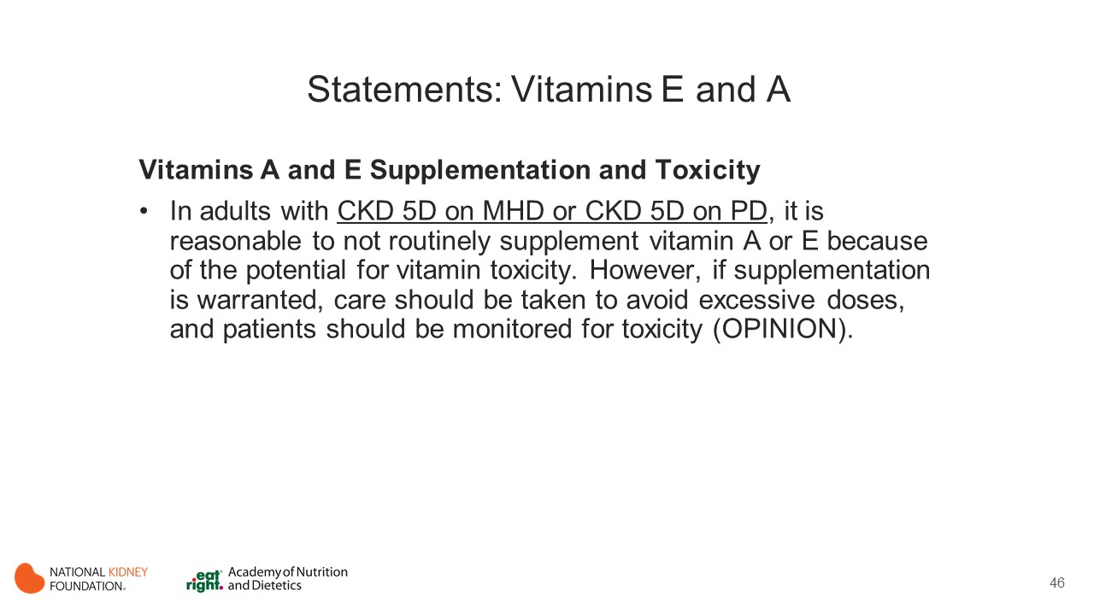
Notes:
There are eight known naturally occurring forms of vitamin E: alpha, beta, gamma, delta-tocopherol and the tocotrienol form : alpha, beta, gamma and delta-tocotrienol (IOM, 2000). Alpha-tocopherol is the only known form of vitamin E that meets human requirements and is the identified form in plasma. Therefore, Dietary Reference Intakes (DRI) for vitamin E is only available for alpha-tocopherol. The RDA for vitamin E was determined by identifying serum levels of vitamin E that provided protection to erythrocyte survival when exposed to hydrogen peroxide
Vitamin E is a fat-soluble vitamin, the potential for vitamin E toxicity by dietary intake of food and supplements has been studied (Miller 2005; IOM 2000). The risk for toxicity is primarily related to the use of supplements. High doses of vitamin E supplements in the form of alpha-tocopherol have been reported to cause hemorrhage and/or disrupt blood coagulation in vivo and there are some in vivo data that suggest alpha-tocopherol inhibits platelet aggregation (Miller, Ann Intern Med). The RDA for vitamin E for normal adult men and woman is 15mg (22.4 IU). The Food and Nutrition Board has defined an upper level of intake for vitamin E for alpha-tocopherol and the stereoisomer forms in synthetic vitamin E supplements; 1500 IU and 1100 IU/day respectively. While not definitive, these amounts appear to be safe in regard to the potential of vitamin E to confer hemorrhagic effects.
Studies examining daily vitamin A requirements for individuals with various stages of CKD are lacking.
Optimal serum vitamin E levels are not defined for the CKD population. Daily vitamin E required to maintain nutritional health, reverse deficiency, and avoid toxicity in CKD populations are unclear.
Vitamin A was initially investigated in the systematic review, but there were no dietary trials available, only trials in which vitamin A was delivered IV, which was considered beyond the scope of this guideline.

Slide 47
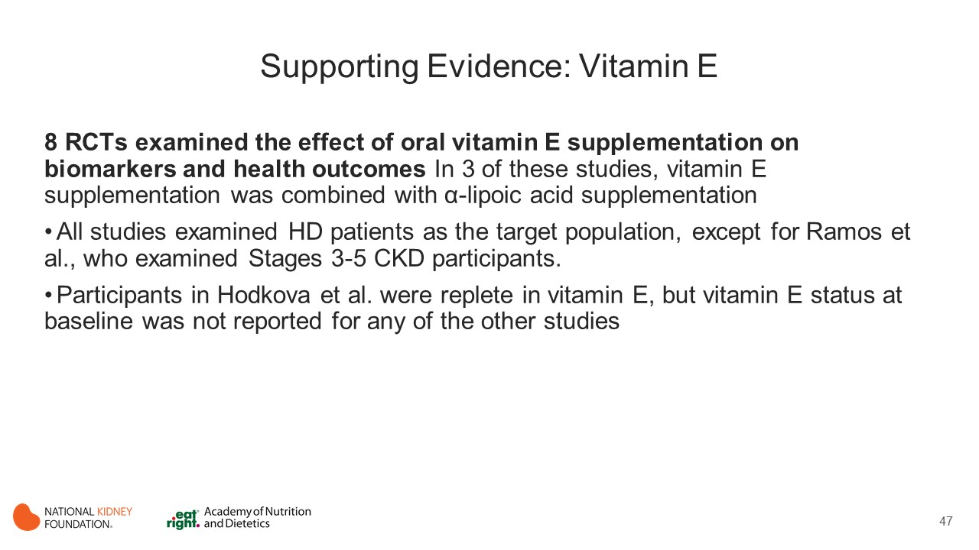
Notes:
The 8 studies included for this review examined the effect of oral vitamin E supplementation in adults with CKD on serum indices and health outcomes. (Ahmadi 2003; Boaz 2000; Daud 2013; Himmelfarb 2014; Mann 2004; Ramos 2011; Hodkova 2006 and Khajehdehi 2000)
In 3 of these studies, vitamin E supplementation was combined with α-lipoic acid supplementation (ALA supplementation).
All studies examined MHD patients as the target population except for Ramos et al, who examined individuals with stages 3-5 CKD.
Participants in Hodkova et al. (2006) were vitamin E repleted, but baseline vitamin E status was not reported for any of the other studies.

Slide 48
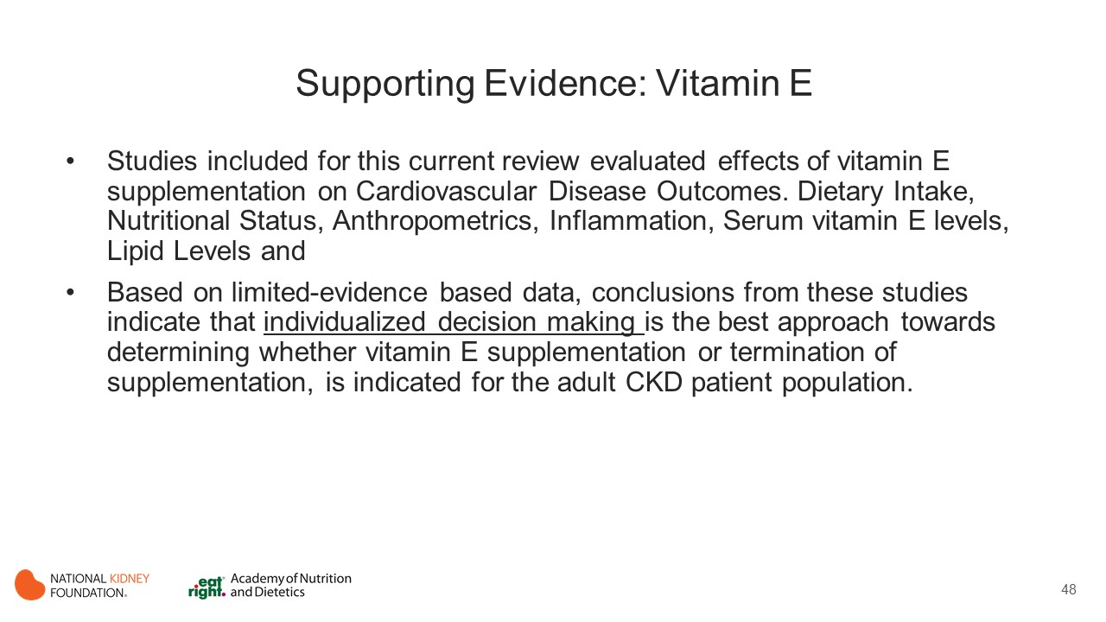
Notes:
As a result of the limited number of high-quality studies (see study selection criteria) and the variability in the outcomes reported in these trials, there is insufficient evidence to make recommendations on vitamin E intake for patients with CKD.
The nutritional requirements or Recommended Dietary Intake of vitamin E for individuals with CKD stages 1-5, those undergoing maintenance dialysis, and those posttransplant are unknown.
Dose-response studies identifying the relation between vitamin E intake and serum vitamin E levels are not available.
The prevalence of vitamin E deficiency in the CKD population is unclear.
The potential of vitamin E toxicity with supplementation is a concern for this fat-soluble vitamin.

Slide 49
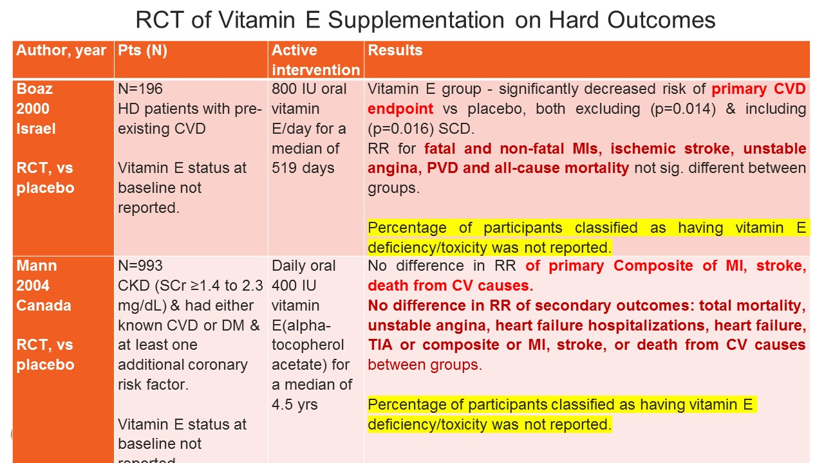
Notes:
Boaz et al examined the effect of vitamin E supplementation on CVD end points (primary outcome) and all-cause mortality. MHD participants with pre-existing CVD were supplemented with daily oral 800 IU of oral vitamin E for a median of 519 days. Risk for all-cause mortality was not significantly different between groups. The vitamin E group had a significantly decreased risk for experiencing a CVD end point compared with the control group, but the risk ratio for fatal and nonfatal MIs, ischemic stroke, and peripheral vascular disease were not significantly different between groups.
In the study by Mann et al. participants with CKD (serum creatinine ≥ 1.4 to 2.3 mg/dL) and high risk for cardiovascular events were given 400 IU daily of oral vitamin E for a median of 4.5 years. Compared with the placebo group, there was no difference in total mortality between groups. Additionally, there was no difference in the relative risk for MI, stroke, death from cardiovascular causes, unstable angina, heart failure hospitalizations, heart failure, transient ischemic attack, or composite of MI, stroke, or death from cardiovascular causes between groups.

Slide 50
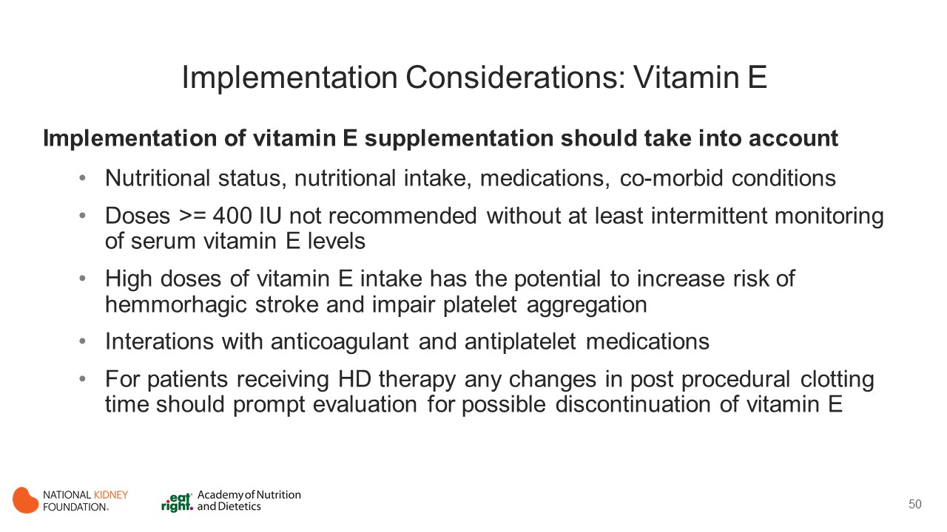
Notes:
There is a potential for toxicity in patients who are being supplemented. High doses of vitamin E supplementation have the potential to increase the risk for hemorrhagic stroke and impair platelet aggregation. Vitamin E interacts with anticoagulant and antiplatelet medications and therefore caution is advised on vitamin E supplementation for patients with CKD already receiving these medications.
Vitamin A was investigated in this systematic review. However, there were no trials examining dietary intake of vitamin A, and supplementation trials included IV vitamin A, which the work group determined qualified as a medication versus a nutritional supplement. However, the same concerns regarding toxicity of vitamin E supplementation apply to vitamin A supplementation.
Recommendations cannot be made with regard to vitamin A or E supplementation in the CKD population. An individualized approach is required in considering the need to supplement vitamins A or E or terminate supplementation in the adult CKD population and there is also a need to monitor for toxicity with supplementation.

Slide 51
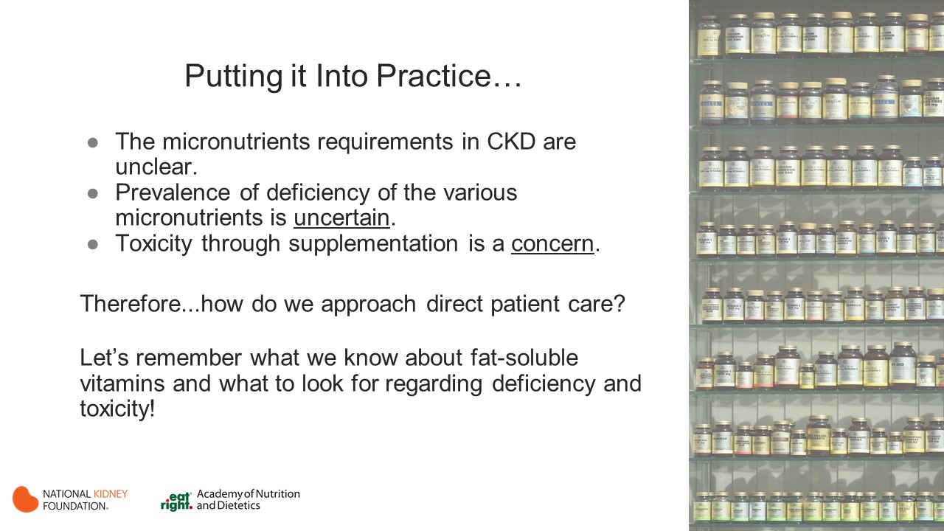
Notes:
Takeaways from 2019 KDOQI Guidelines

Slide 52
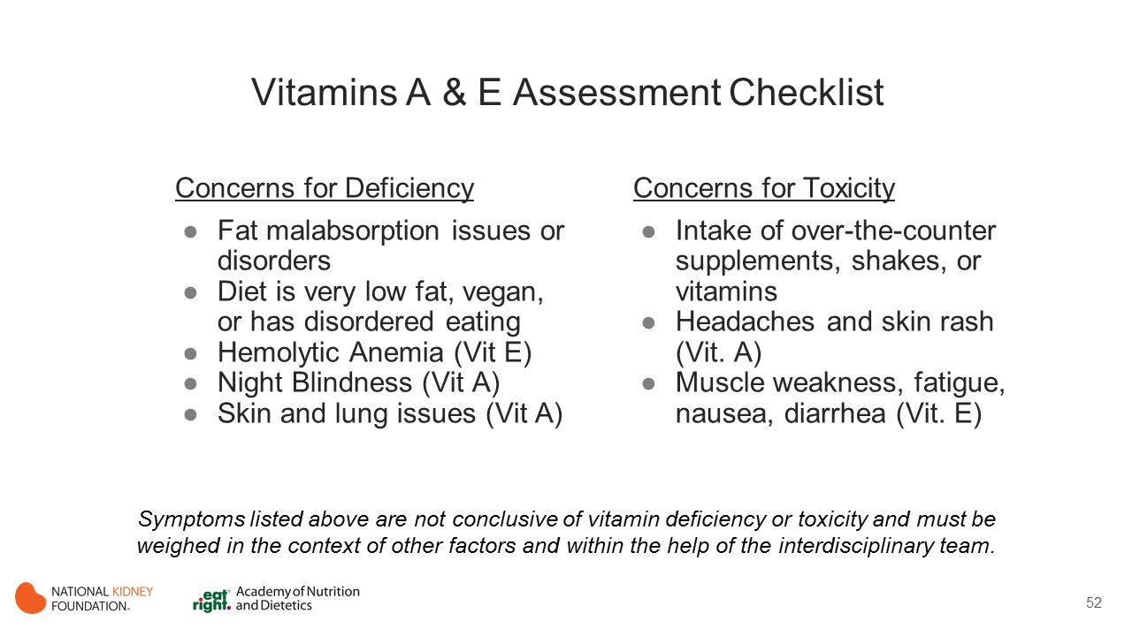
Notes:
In the case of Vitamin A and E, neither deficiency nor toxicity is well known in the CKD population but based on data available for the general US adult population, both expressions are rare and are usually related to a either a malabsorption issue and or limited diet (for deficiency) or intake of supplements containing higher concentrations of these vitamins (for toxicity). Also, keep in mind that a blood sample may not be definitive determination for deficiency due to: inflammation as one cause of suppression and/or other factors that do not reveal deficient levels until the individual is extremely deficient.
General Source of information: Merck Manual, consumer version

Slide 53

Notes:
General Source of information: Merck Manual, consumer version

Slide 54


Slide 55
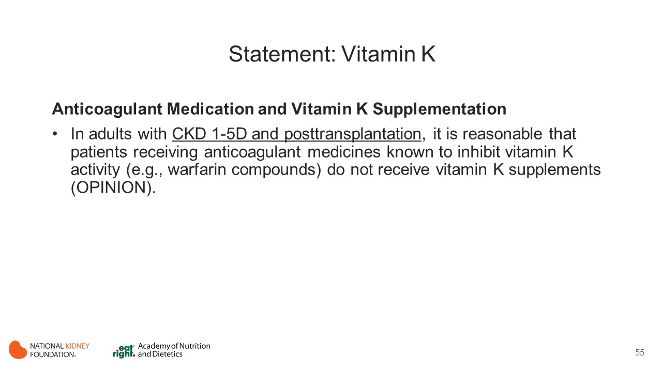
Notes:
Vitamin K is a fat-soluble vitamin
Cofactor for gamma-glutamyl carboxylase which enables carboxylation of vitamin K-dependent proteins
coagulations factors, MGP (inhibitor of vascular calcification) and osteocalcin (bone formation)
Two classes of vitamin K compounds are primarily responsible for vitamin K activity,
phylloquinone (vitamin K1) found in food (green and leafy vegetables)
menaquinones (vitamin K2) mostly produced by colonic bacteria
The US Institute of Medicine states that the adequate intake of vitamin K is 120 and 90 micrograms per day for adult men and women
In HD patients, Vitamin K intake and serum levels are often low or undetectable, and serum uncarboxylated proteins are often elevated.

Slide 56
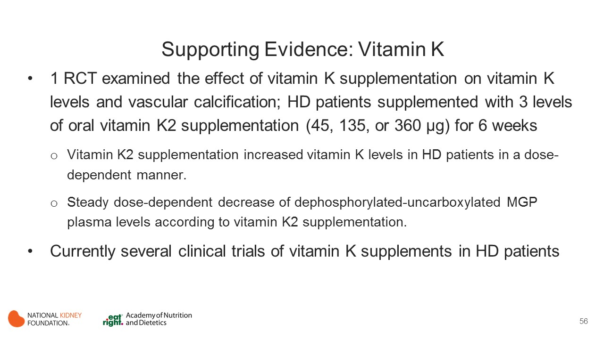
Notes:
1 RCT (Westenfeld, 2012) in HD patients
The data are strongly suggestive that there is a dietary need for vitamin K in maintenance hemodialysis patients and this need may exceed the current RDA for vitamin K.
There are currently several clinical trials of vitamin K supplements in MHD patients, and more information regarding vitamin K supplementation should be available within the near future. (Clinical Trials Identifier: NCT01528800; NCT01742273; NCT2610933; NCT02870829; UMIN000011490; UMIN000017119).

Slide 57

Notes:
There is a paucity of data on the long-term safety of different vitamin K intakes and especially of vitamin K supplements and of the value, if any, of taking different vitamin K compounds.
Individuals receiving vitamin supplements should not receive anticoagulant medicines that inhibit vitamin K activity (eg, warfarin compounds).

Slide 58

Notes:
Takeaways from 2019 KDOQI Guidelines

Slide 59

Notes:
General Source of information: Merck Manual, consumer version
High doses of vitamin E may antagonize vitamin K

Slide 60

Notes:
General Source of information: Merck Manual, consumer version

Slide 61


Slide 62

Notes:
Zn and Se are essential micronutrients
Zn forms a component of bio-membranes
Zn and Se have antioxidant and anti-inflammatory effects
Zn prevents free radicals-induced injury during inflammation
Current RDA for Zinc is 8 mg for women and 11 mg for men in general population
Current RDA for Selenium is 55 mcg for women and men in general population
Studies have reported higher prevalence of zinc and selenium deficiency in HD patients compared to healthy individuals

Slide 63

Notes:
In adults with CKD, 7 studies have examined the effect of selenium intake on biomarker levels and other surrogate health outcomes. Most of the studies used oral selenium supplementation and all studies were performed in MHD patients. (Salehi 2013; Temple 2000; Adamcowicz 2006; Zachara 2001; Koenig 1997; Stockler-Pinto 2012; Tonelli 2015)
Koenig et al examined the effect of IV selenium supplementation and Stockler-Pinto et al examined the effect of selenium supplementation in the form of a Brazil nut. Selenium dosages generally ranged from 175 to 1,400 µg per week. The selenium dosage in Stockler-Pinto et al was not described (1 Brazil nut per day), and in Koenig et al, the parenteral dose of selenium used was much higher (400 mg 3 times a week) compared with other studies. Study duration ranged from 14 days to 6 months.
In Temple et al, participants’ selenium status at baseline was normal. In a study by Tonelli et al, 28% of the treatment group versus 15% of the placebo group had low selenium levels after supplementation. Around 20% of participants were selenium deficient in Stockler-Pinto et al, and the remaining studies did not report selenium status at baseline.

Slide 64

Notes:
10 RCTs in HD (Tonelli 2015; Argani 2013; Chevalier 2002; Mazani 2013; Pakfetrat 2003; Rahimi-Ardabili 2012; Roozbeh 2009; Guo 2013; Jern 2000 and Rashidi 2009)
Nutritional Status
Three small short-term RCTs (Argani 2013; Guoa 2013; Jern 2000) examined the effects of zinc supplementation on nutrition status in MHD patients.
The study duration ranged from 8 weeks to 90 days. The dose of zinc supplementation ranged from a daily dose of 11 mg, 50 mg, to 100 mg of elemental zinc.
The data from these 3 small low-quality trials were regarded as inconclusive and not enough to make recommendation.
PNA/PCR = protein nitrogen appearance/protein catabolic rate
Lipid Profile
Four short-term RCTs examined the effect of oral zinc supplementation on lipid levels. (Argani 2013; Rahimi-Ardabili 2012; Roozbeh 2009; Chevalier 2002) The studies by Argani et al and Rahimi-Ardabili et al administered 100 mg of oral zinc daily to MHD patients for 2 months.
Argani et al showed no changes in cholesterol and TG levels with zinc supplementation.
Rahimi-Ardabili et al showed that cholesterol levels increased significantly in the placebo group but no change in the treatment group, and TC levels were not different between the 2 groups after 2 months’ study.
Roozbeh et al⁴¹² and Chevalier et al⁴¹⁰ both supplemented MHD patients with 50 mg of zinc daily for 6 weeks and 90 days, respectively. All patients in these 2 studies were zinc deficient at baseline (<80 μg/dL). Both studies showed that TC, LDL-C, HDL-C, and serum TG levels increased in the zinc-supplemented group but no change in the control group. The conclusions by the authors in these studies suggested that this increase in lipid parameters was desirable.
Pakfetrat et al examined the effect of 50 mg of oral zinc per day for 6 weeks in MHD patients and found that significantly decreased homocysteine levels decreased in the zinc-supplemented group compared with the placebo group.
Zinc Levels
Six RCTs examined zinc supplementation in relation to serum zinc levels in MHD patients. (Tonelli 2015; Argani 2013; Guo 2013; Chevalier 2002; Roozbeh 2009; Zachara 2001)
All except the Tonelli et al study described zinc deficiency at baseline.
The dosages of zinc supplementation ranged from 11 to 110 mg. Study durations ranged from 5 weeks up to 6 months.
In the study by Tonelli et al, zinc levels in the medium-dose (50 mg/d) but not the low-dose (25 mg/d) group were significantly higher than in the nonsupplemented group at 90 and 180 days after supplementation.
A pooled analysis of these 6 studies showed a mean increase of 30.97 μg/dL in serum zinc levels after supplementation compared with the control group. However, heterogeneity was high. It is not known whether zinc supplementation in deficient patients may affect any health-related outcomes or clinical hard outcomes in patients with CKD and dialysis patients. The long-term effects or any toxicity of zinc supplementation are also unclear at this stage.

Slide 65

Notes:
Implementation Considerations
Suggested intake should be based on recommendations for the general population (eg, RDA) unless there are specific considerations requiring modification.
Monitoring and Evaluation
There are no specific guidelines for monitoring selenium and zinc deficiency or supplementation. However, although unlikely, practitioners should be aware of signs and symptoms of severe selenium and zinc deficiency in patients with stages 3-5D CKD.

Slide 66


Slide 67


Slide 68


Slide 69


Slide 70

Notes:
These resources from the Academy of Nutrition and Dietetics and the National Kidney Foundation provide additional information to support implementation of the KDOQI Guideline for Nutrition in CKD.
For NKF resources go to kidney.org
For Academy resources go to eatright.org

Slide 71


