Slide 1
Academy of Nutrition and Dietetics Evidence Analysis Library®
www.andeal.org
Nutrition and Physical Activity for the General Population
Evidence-Based Nutrition Practice Guidelines Executive Summary of Recommendations
Guideline published March 2023

Slide 2
Definition
What is Evidence-based Dietetics Practice?
“Evidence-Based Dietetics Practice is the use of systematically reviewed scientific evidence in making food and nutrition practice decisions by integrating best available evidence with professional expertise and client values to improve outcomes.”
A.N.D. Scope of Dietetics Practice Framework: Approved by A.N.D. House of Delegates
© 2023 Evidence Analysis Library®

Slide 3
Overall Guideline Objective
The objective of this evidence-based nutrition practice guideline is to inform practice decisions for nutrition and exercise practitioners by providing nutrition and physical activity interventions for adults (≥18 years of age) who are healthy or have cardiometabolic risk factors to guide improvement of nutrition and physical activity behaviors and cardiometabolic disease risk reduction.
© 2023 Evidence Analysis Library®

Slide 4
Target Population
Adults (≥18 years of age)
Male and Female
Target Population Description
Adults (≥18 years of age) who are healthy or have cardiometabolic risk factors, such as overweight (body mass index ≥25 kg/m² or as defined for the specific population), pre-diabetes and pre-hypertension. It does not focus on adults with a diagnosed disease.
© 2023 Evidence Analysis Library®

Slide 5
Guideline Scope Characteristics
Guideline Category
These recommendations focus on the following major outcomes:
Intervention
Counseling
Treatment
Clinical Specialty
Cardiology, Family Practice, Geriatrics, Nutrition, Physical Medicine and Rehabilitation, Sports Medicine
© 2023 Evidence Analysis Library®

Slide 6
Statement of Intent
Evidence-based nutrition practice guidelines are developed to help Registered Dietitians, practitioners, patients, families, and consumers make shared decisions about health care choices in specific clinical circumstances. If properly developed, communicated, and implemented, guidelines can improve care.
While the evidence-based nutrition practice guideline represents a statement of promising practice based on the latest available evidence at the time of publication, the guideline is not intended to overrule professional judgment. Rather, it may be viewed as a relative constraint on individual clinician discretion in a particular clinical circumstance. The independent skill and judgment of the health care provider must always dictate treatment decisions. These nutrition practice guidelines are provided with the express understanding that they do not establish or specify particular standards of care, whether legal, medical or other.
© 2023 Evidence Analysis Library®

Slide 7
Disclaimer
While A.N.D. evidence-based nutrition practice guidelines represent a statement of best practice based on the latest available evidence at the time of publishing, they are not intended to overrule professional judgment. Rather, they may be viewed as a relative constraint on individual clinician discretion in a particular clinical circumstance. The independent skill and judgment of the health care provider must always dictate treatment decisions. These nutrition practice guidelines are provided with the express understanding that they do not establish or specify particular standards of care, whether legal, medical or other.
© 2023 Evidence Analysis Library®

Slide 8
Guideline Rating
Each Recommendation is Rated:
Strong,
Weak, or
Consensus
Recommendation statements include terms:
“Recommend/should” (Strong)
“Suggest/may” (Weak)
“It is reasonable” (Consensus)
Each Recommendation Statement is:
Conditional or
Imperative
© 2023 Evidence Analysis Library®

Slide 9
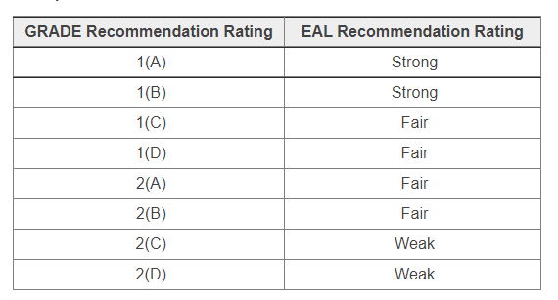
Recommendation Translation
© 2023 Evidence Analysis Library®

Slide 10
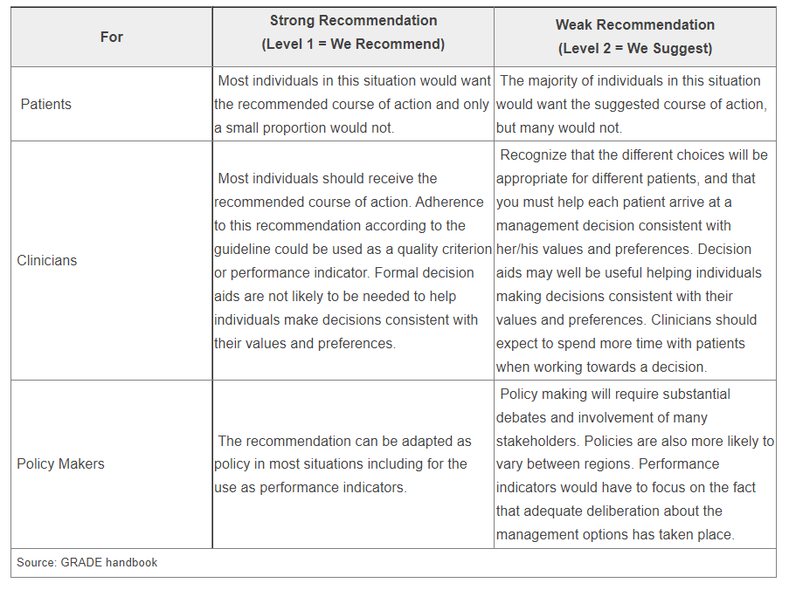
Implications of Strong/Weak Recommendations
© 2023 Evidence Analysis Library®

Slide 11
Conditional/Imperative
Imperative recommendations are broadly applicable to the target population and are stated as “require,” or “must,” or “should achieve certain goals.”
Conditional statements clearly define a specific situation and contain conditional text that would limit their applicability to specified circumstances, or to a sub-population group. More specifically, a conditional recommendation can be stated in if/then terminology.
© 2023 Evidence Analysis Library®

Slide 12
Saturated Fat Topics
Nutrition and Physical Activity Interventions
Healthy Adults
Adults with Cardiometabolic Risk Factors
© 2023 Evidence Analysis Library®

Slide 13
Nutrition and Physical Activity: General Population Evidence Based
Nutrition Practice Guideline
Executive Summary of Recommendations
Guideline published March 2023
© 2023 Evidence Analysis Library®

Slide 14
Nutrition Intervention
© 2023 Evidence Analysis Library®

Slide 15
DLMSF: Acronyms & Abbreviations
In alphabetical order
Term | Definition
ACE | American Council on Exercise
ACSM | American College of Sports Medicine
CLAS | Culturally and Linguistically Appropriate Services
CMD | Cardiometabolic disease
CVD | Cardiovascular disease
DGA | Dietary Guidelines for Americans
EAL | Evidence Analysis Library
EBNPG | Evidence-Based Nutrition Practice Guideline
EtD | Evidence-to-decision framework
FFQ | Food frequency questionnaire
GRADE | Grading of Recommendations, Assessment, Development and Evaluation
HbA1c | Hemoglobin A1c
HIPPA | Health Insurance Portability and Accountability Act
HRQoL | Health-related quality of life
IDEA | Inclusion, diversity, equity, and access
LGBTQ | Lesbian, gay, bisexual, transgender, and queer
NHANES | National Health and Nutrition Examination Survey
PRISMA | Preferred Reporting Items for Systematic Reviews and Meta-Analyses
RCT | Randomized controlled trials
ROB2 | Revised tool for randomized controlled trials
SDoH | Social determinants of health
SNAP | Supplemental Nutrition Assistance Program
T2DM | Type 2 diabetes mellitus
U.S. | United States of America
US DHHS | United States Department of Health and Human Services
WIC | Special Supplemental Nutrition Program for Women, Infants and Children
© 2023 Evidence Analysis Library®

Slide 16
NPA:GP: Healthy Adults
Nutrition and exercise practitioners should provide individualized nutrition and physical activity interventions to healthy adults (those without cardiometabolic risk factors or disease), within their professional scopes of practice, and refer to practitioners with necessary specializations when appropriate for or desired by each client to improve dietary intake and physical activity behaviors.
Level 1(B)
Imperative
© 2023 Evidence Analysis Library®

Slide 17
NPA-GP: Adults with Cardiometabolic Risk Factors
Nutrition and exercise practitioners should provide individualized nutrition and physical activity interventions to adults with cardiometabolic risk factors, within their professional scopes of practice, and refer to practitioners with necessary specializations when appropriate for or desired by each client to improve cardiometabolic risk factors.
Level 1(B)
Imperative
© 2023 Evidence Analysis Library®

Slide 18
No Implied Endorsement
No endorsement by the Academy of Nutrition and Dietetics of any brand-name product or service is intended or should be inferred from a Guideline or from any of its components (including Question, Evidence Summary, Conclusion Statement, Conclusion Statement Grade, Recommendation or Recommendation Rating).
Evidence-based Nutrition Practice Guidelines are intended to serve as a synthesis of the best evidence available to inform registered dietitians as they individualize nutrition care for their clients. Guidelines are provided with the express understanding that they do not establish or specify a particular standard of care, whether legal, medical or other.
Evidence-based Nutrition Practice Guidelines are intended to summarize best available research as a decision tool for A.N.D. members.
© 2023 Evidence Analysis Library®

Slide 19
Guideline Implementation
Information and Resources
© 2023 Evidence Analysis Library®

Slide 20
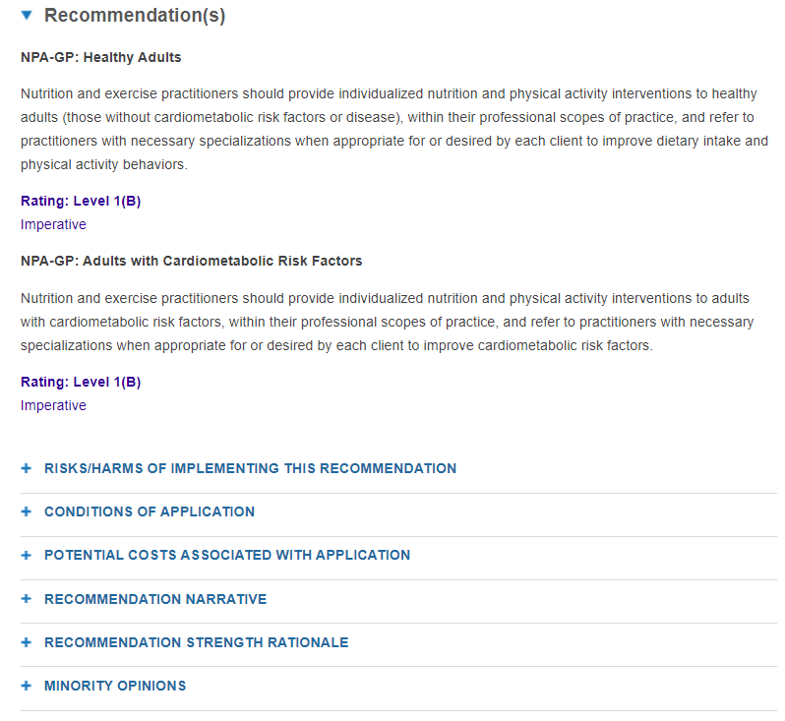
Implementation
Implementation involves integration of the evidence-based interventions into practice and includes examination of barriers and facilitators that can influence the effectiveness of the recommendations. See the sections titled “Considerations for Application” in the guideline for tools and expert advice regarding how to implement recommendations.
See the section titled “Considerations for Application” in the guideline for tools and expert advice regarding how to implement recommendations.
© 2023 Evidence Analysis Library®

Slide 21
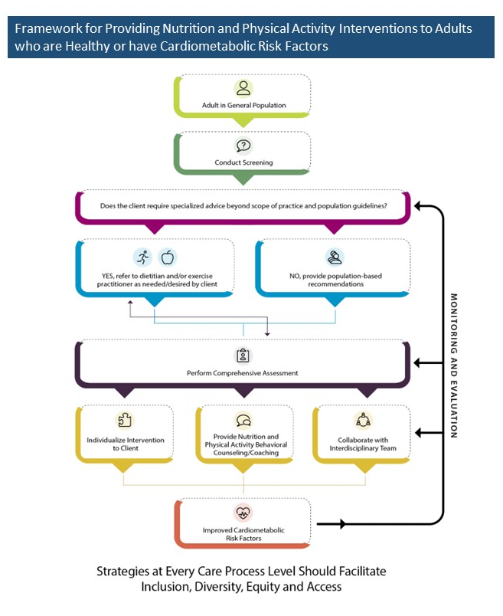
Framework
Utilizing a treatment framework can provide a flexible guide for nutrition and exercise practitioners to customize care, considering each individual’s unique requirements and goals.
Here is an overview of a framework for providing nutrition and physical activity care to the general population
© 2023 Evidence Analysis Library®

Slide 22
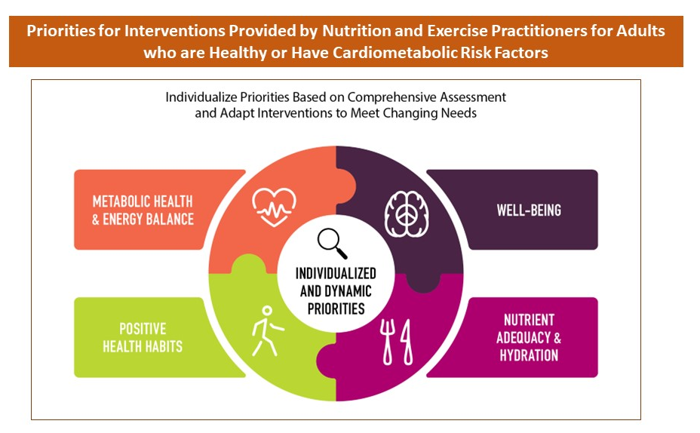
Individualizing Interventions
This figure demonstrates intervention priorities that can be individualized for each client, based on comprehensive assessment, and adapted to meet client needs as they change over time (through regular monitoring and re-evaluation).
© 2023 Evidence Analysis Library®

Slide 23
Guides
To assist nutrition and dietetics professionals with implementing evidence-based practice recommendations and clinical practice innovations into daily practice, the Academy developed Implementing Evidence: From Guidelines to Daily Practice. Download it from: www.andeal.org/guideline-implementation
For tips on implementing the guideline recommendations, download the Nutrition and Physical Activity Practitioner Guide from the EAL website. This two-page guide is designed with clear and unambiguous language that may help practitioners and their patients/clients to actively participate in shared decision making for their nutrition care. Visit www.andel.org/npa and select the Dissemination and Implementation tab.
© 2023 Evidence Analysis Library®

Slide 24
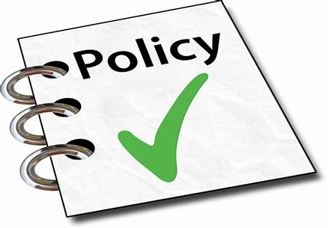
Guideline Development
© 2023 Evidence Analysis Library®

Slide 25
Methods
The methodology for this project was developed using the process of the Academy of Nutrition and Dietetics,^{1,2} in accordance with the Standards for Developing Clinical Practice Guidelines from the National Academy of Science using grading and guideline development tools from the GRADE (Grading of Recommendations Assessment, Development and Evaluation) group.^{3,4}
Visit the EAL for the complete NPA-GP guideline methods.
Handu D, Moloney L, Wolfram T, Ziegler P, Acosta A, Steiber A. Academy of Nutrition and Dietetics Methodology for Conducting Systematic Reviews for the Evidence Analysis Library. J Acad Nutr Diet. 2016;116(2):311-318.
Papoutsakis C, Moloney L, Sinley RC, Acosta A, Handu D, Steiber AL. Academy of Nutrition and Dietetics Methodology for Developing Evidence-Based Nutrition Practice Guidelines. J Acad Nutr Diet. 2017;117(5):794-804.
The GRADE Working Group. GRADE handbook for grading quality of evidence and strength of recommendations. Cochrane Collaboration. https://gdt.gradepro.org/app/handbook/handbook.html. Published 2013. Updated October 2013.
Collaboration TC. Cochrane Handbook for Systematic Reviews of Interventions Version 5.1.0 [updated March 2011]. . In: Higgins JPT GSe, ed.
© 2023 Evidence Analysis Library®

Slide 26
Nutrition and Physical Activity: General Population (2023) Team
Expert Panel Workgroup
Justin A. Robinson, MA, RDN, CSSD, Chair
Kimberly Gottesman, DCN, RDN, LDN, CNSC
Peggy L. Hamlett, PhD, MS
Lama Mattar, PhD, MS
Erin M. Nitschke, PhD, MS, NSCA-CPT, NFPT-CPT
Ashley P. Tovar, PhD, RDN
Project Leaders
Mary Rozga, PhD, RDN, Project Manager
Kathryn S. Keim, PhD, RD, Lead Analyst
Michelle Fiander, MA, MLIS, Medical Librarian
Visit the EAL for affiliations and any disclosures of potential conflicts of interests
© 2023 Evidence Analysis Library®

Slide 27
Major Recommendations
This presentation consisted of the Executive Summary of Recommendations for the Academy of Nutrition and Dietetics Nutrition and Physical Activity: General Population Evidence-Based Nutrition Practice Guideline.
The Major Recommendations and more detail (including the evidence analysis supporting these recommendations) is available for free to Academy members and EAL subscribers.
www.andeal.org
© 2023 Evidence Analysis Library®

Slide 28
Learn more:
Academy of Nutrition and Dietetics Evidence Analysis Library®
^{www.andeal.org}
eal@eatright.org
© 2023 Evidence Analysis Library®

